Slide 1


Notes:
We are here to help you realize life’s potential

Slide 2
Schedule - Thursday July 27th
8:00 a.m. – 8:15 a.m. Arrival/Opening Worship and Prayer
8:15 a.m. – 8:50 a.m. Omega Refresher (Sessions 13 - 16) Commit to Transformation
8:50 a.m. – 9:45 a.m. Reflection/Worksheets
9:45 a.m. – 10:15 a.m. Group Discussion/Interviews
10:15 a.m. – 10:30 Snack Break
10:30 a.m. – 10:45 a.m. Worship and Prayer
10:45 a.m. – 11:15 a.m. Omega Refresher (Sessions 17 - 20) Know Thyself
11:15 a.m. – 12:00 p.m. Reflection/Worksheets
12:00 a.m. – 12:30 p.m. Group Discussion/Interviews
12:30 p.m. – 1:30 p.m. Lunch*
*These meals are optional so if you need to skip we understand.

Slide 3
Schedule - Thursday July 27th
1:30 p.m. – 1:45 p.m. Worship and Prayer
1:45 p.m. – 2:15 p.m. Omega Refresher (Sessions 17-20) Know Thyself Part 2
2:15 p.m. – 3:00 p.m. Reflection/Worksheets
3:00 p.m. – 3:30 p.m. Group Discussion/Interviews
3:30 p.m. - 3:45 p.m. Snack Break
3:45 p.m. – 4:00 p.m. Worship and Prayer
4:00 p.m. – 4:40 p.m. Omega Refresher (Sessions 21 -24) Running The Course
4:40 p.m. – 5:30 p.m. Reflection/Worksheets
5:30 p.m. – 6:00 p.m. Group Discussion/Interviews
6:00 p.m. Dinner*
*These meals are optional so if you need to skip we understand.

Slide 4
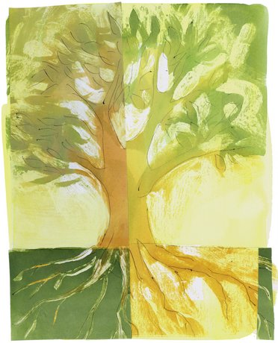
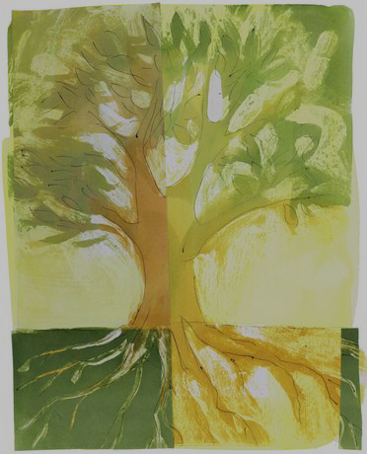
z
Commit to Transformation
Notes:
The Journey of Transformation

Slide 5
Narrow Way

Slide 6
z
Commit to Transformation
Notes:
The Journey of Transformation

Slide 7
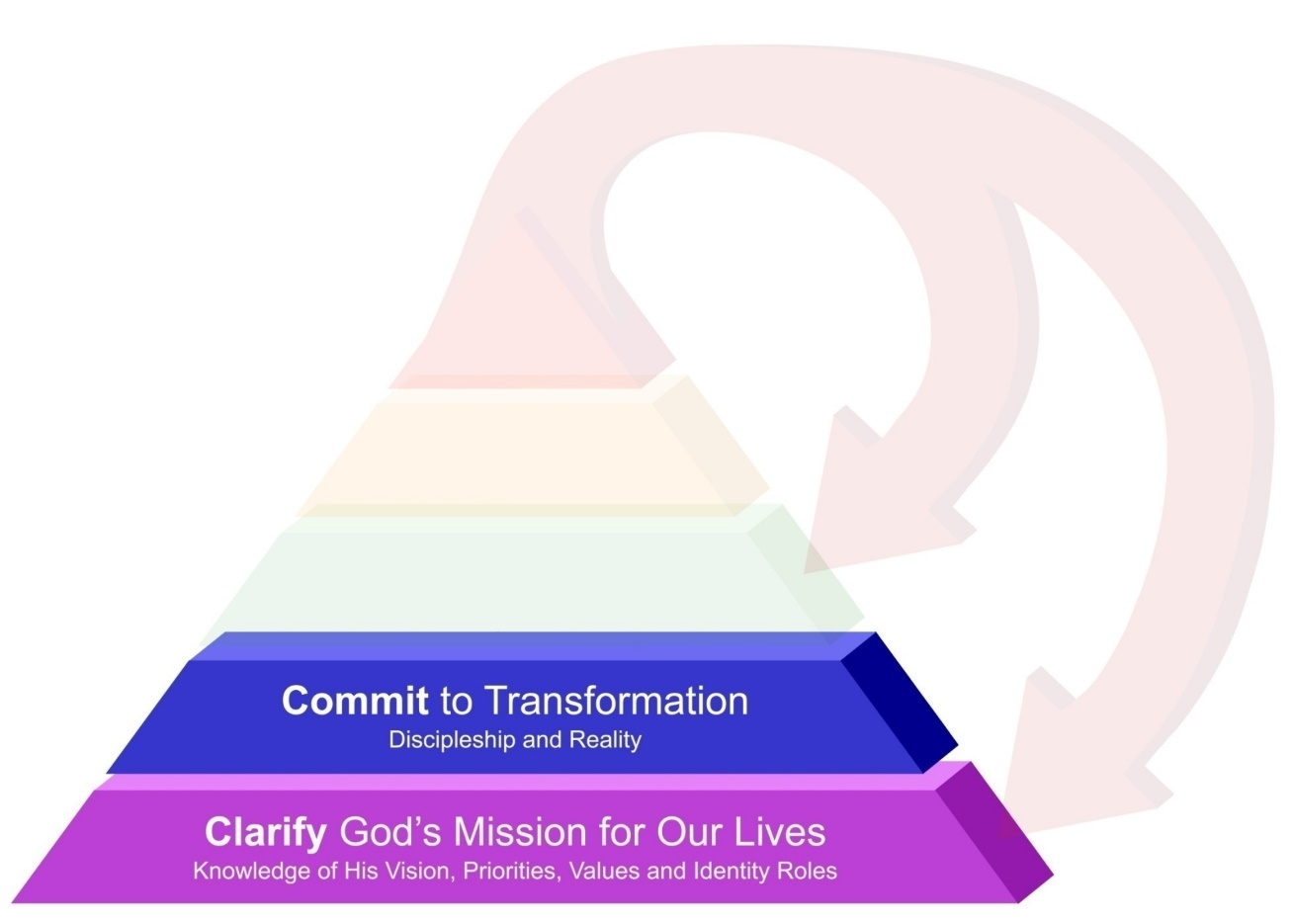
Life Focus Process
Notes:
This session we will move one step up the Life Focus Process Pyramid and Begin Committing to Transformation.
The journey of faith is not without its trials and tribulations.
Many times new believers will encounter trouble and find themselves asking, “What happened?”
It is important to take a look at the process of transformation and what to expect along the way so there are no surprises.

Slide 8
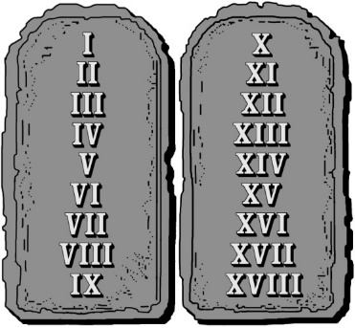
The 18 natural laws
Law 9 - The Law of Transformation
We must choose to submit ourselves to
God's mission and His transforming power,
if we are going to experience more
abundance in life.
Notes:
Law 9 - The Law of Transformation
We must choose to submit ourselves to
God's mission and His transforming power,
if we are going to experience more
abundance in life.
The abundant life that Jesus is calling us to doesn’t just happen right away. It involves a process of becoming more like Him by becoming more submitted to His guidance and empowering presence.

Slide 9
Romans 12:1-3
“ Therefore, I urge you, brothers, in view of God's mercy, to offer your bodies as living sacrifices, holy and pleasing to God—this is your spiritual act of worship.
Do not conform any longer to the pattern of this world, but be transformed by the renewing of your mind. Then you will be able to test and approve what God's will is—his good, pleasing and perfect will.
For by the grace given me I say to every one of you: Do not think of yourself more highly than you ought, but rather think of yourself with sober judgment, in accordance with the measure of faith God has given you.”
Notes:
Romans 12:1-3
“ Therefore, I urge you, brothers, in view of God's mercy,
to offer your bodies as living sacrifices, holy and pleasing to God—this is your spiritual act of worship.
Do not conform any longer to the pattern of this world,
but be transformed by the renewing of your mind. Then you will be able to test and approve what God's will is—
his good, pleasing and perfect will.
For by the grace given me I say to every one of you:
Do not think of yourself more highly than you ought,
but rather think of yourself with sober judgment, in accordance with the measure of faith God has
given you.”

Slide 10
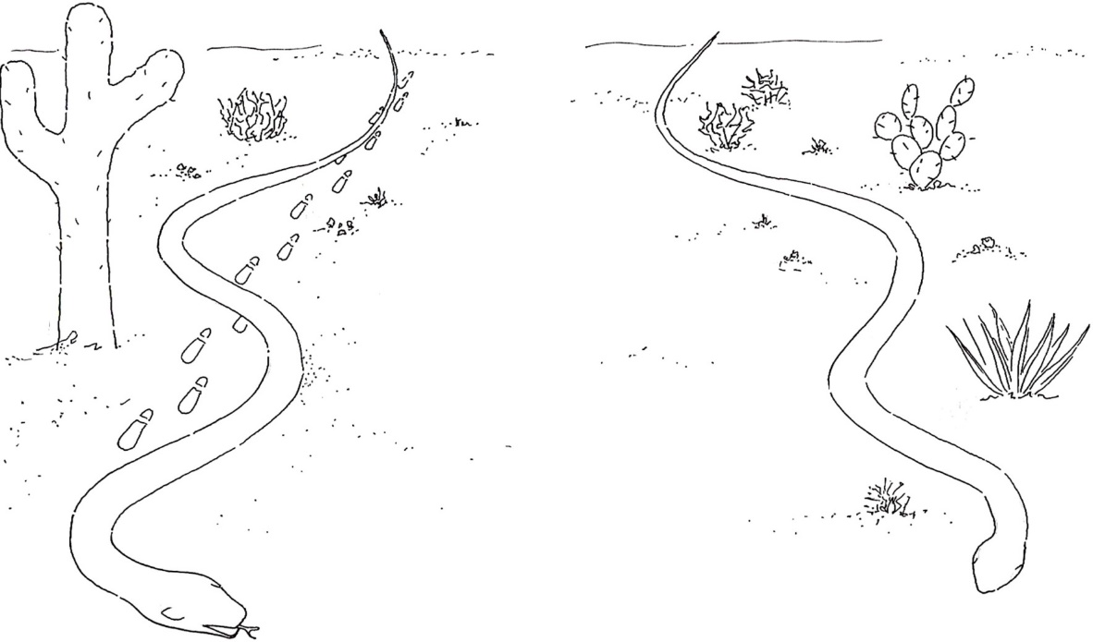
The Road of Life
Matthew 7:13
“¹³ Enter through the narrow gate. Wide is the gate and broad is the road that leads to destruction, and many enter through it.”
The Wide Road to Destruction
Notes:
The wide road reflects the world’s system that ultimately leads to
destruction. We are all on a journey and we all have decisions to make along that journey. The road of life is difficult because we have an enemy who tries to distract us from finding the abundant, balanced, Spirit-led life for which we were created.

Slide 11
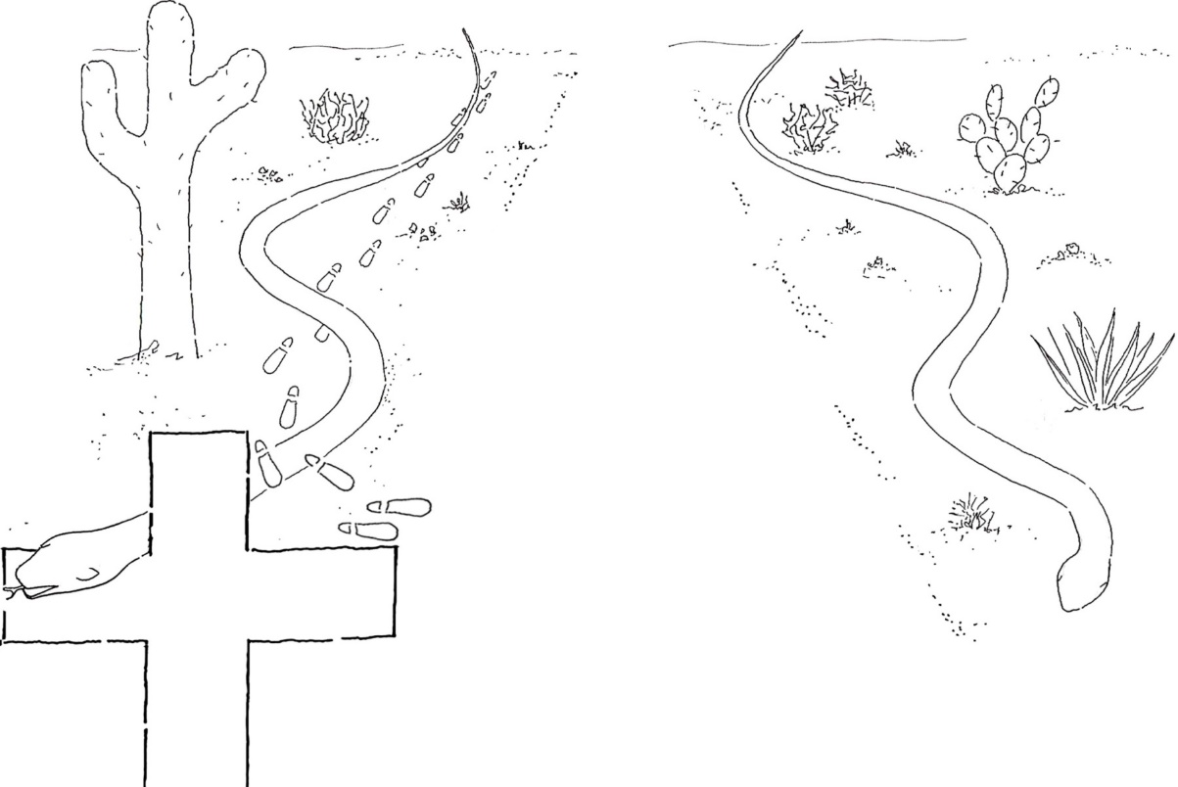
The Road of Life – The Turning Point
Matthew 7:14
“ But small is the gate and narrow the road that leads to life, and only a few find it.”
God's Narrow Road
To Eternal Life
The Wide Road to Destruction
Notes:
The Turning Point
Before we accept Christ, we are all moving along the path toward
destruction. Some are farther along the road than others. Christians are people who have come to the reality that we are the problem and that we are in need of God’s grace to help us find our purpose for living. When we ask Jesus Christ to come into our lives and be our Lord, we die to our old lives, repent (or turn) and begin to follow God. This is when we embark on the narrow road that leads to eternal life.

Slide 12
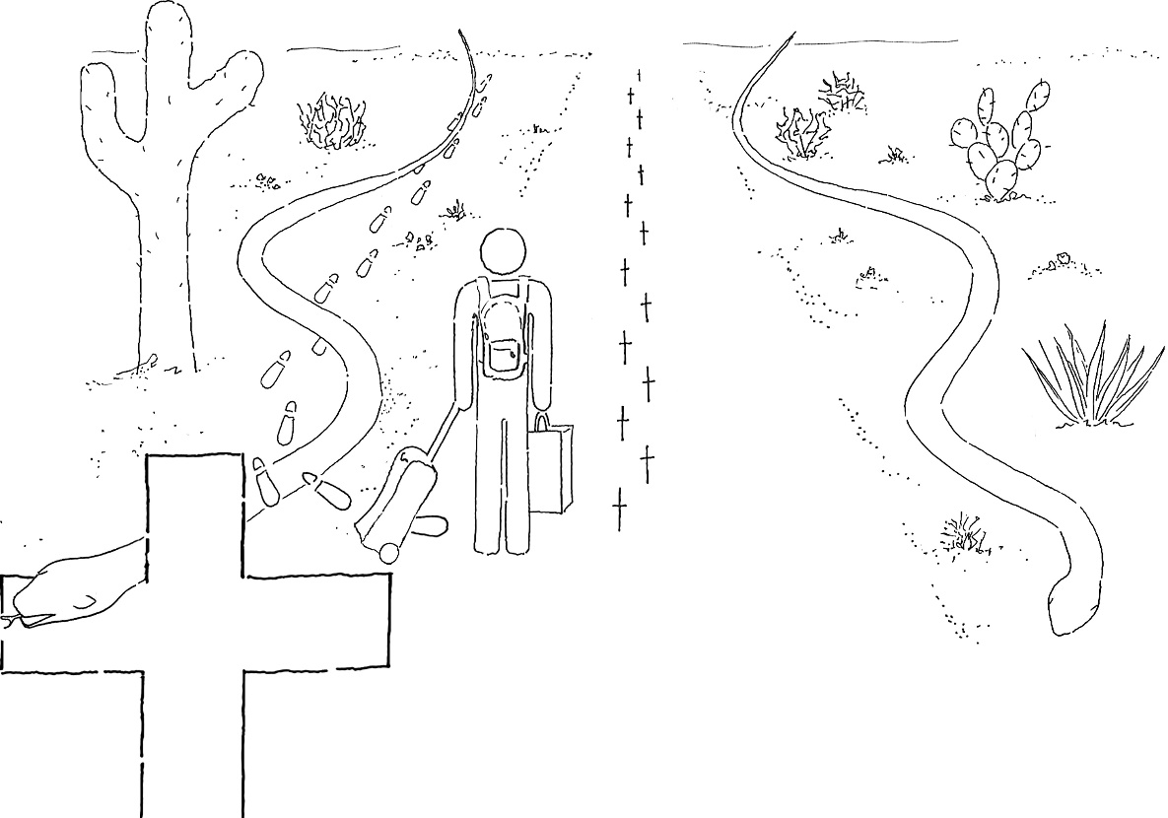
The Road of Life – The New “Way”
To Eternal Life
The Wide Road to Destruction
Notes:
The New “Way”
Once we have received God’s free gift of grace, God shuts the door on our old destiny, and begins His transformation process. We all bring in our fair share of baggage that needs to be discarded over time. The good news is that we have an example in Jesus of how to live our lives. The key is to study His life of love and follow in His footsteps. We can study the way He lived and loved and went through life and replicate that “way,” and experience more abundant life as we do so.

Slide 13
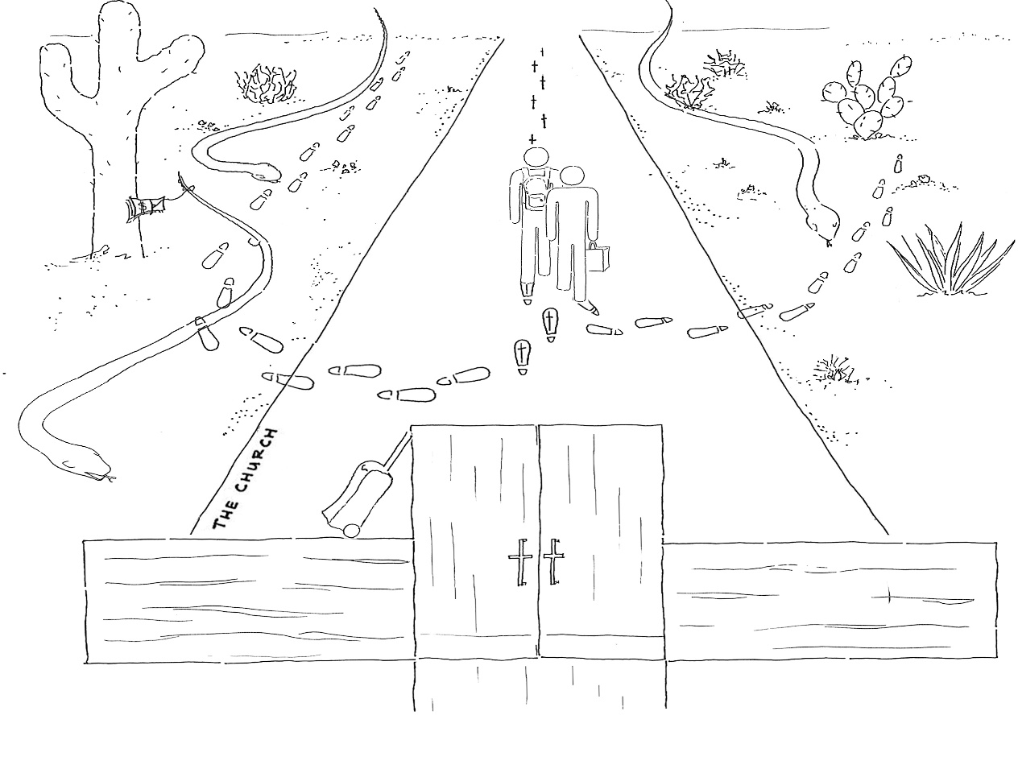
The Road of Life – The Role of The Church
To Eternal Life
The Wide Road to Destruction
Notes:
The Role of the Church
On the journey, off-ramps (our own baggage and the influence of the evil one) exist that we may be tempted to take. The love and nurture of the church can help bring us back to God and strengthen our resolve.
The evil one loves to get us to try to do it all on our own because when we’re isolated it’s easier to get us to choose an off-ramp. The good news is that God tells us that whenever two or three are gathered in His name, we have the power to resist the temptations of the evil one. The community of faith is the essence of this kind of corporate support.
As God uses His Church to mature us, our lives will begin to look more and more like the life of Jesus. In order to experience transformation we need to submit ourselves to the Church and to this process.

Slide 14
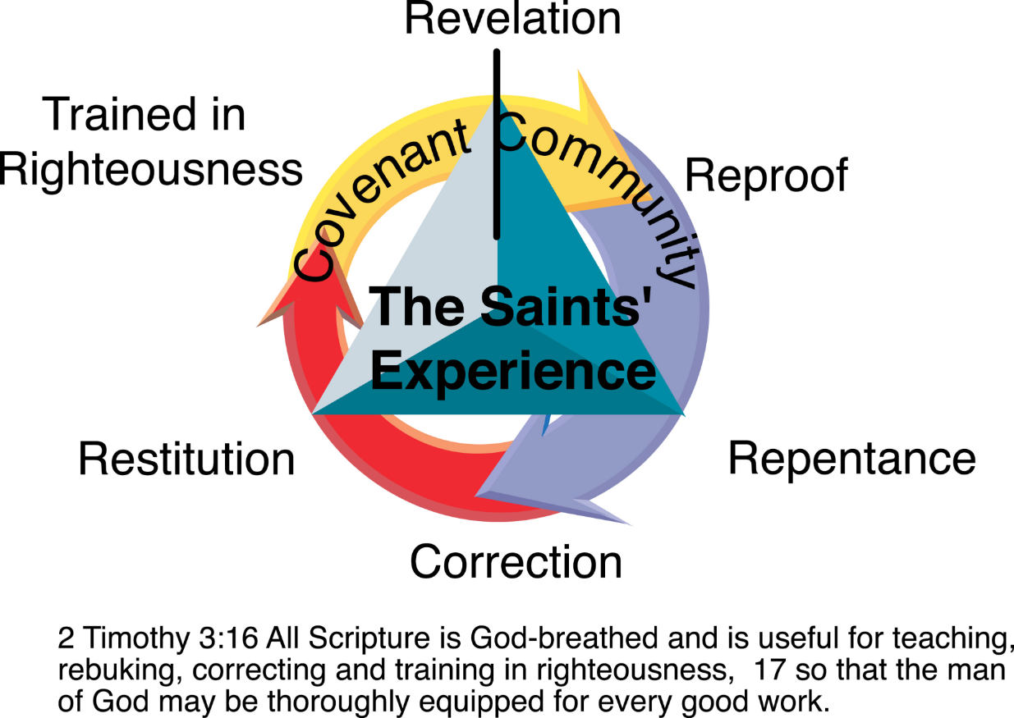
Cycle of Renewal
Notes:
Cycle of Renewal - This cycle is best done in the context of Covenant Community!
Revelation- Revelation from God leads the process.
Reproof or Rebuke- Reproof challenges our status quo.
Repentance - We can either agree with God and turn (repent) or disagree and, in
essence, say “No. I don’t think you know better. I think I know better.” Sometimes God sends more revelation.
Correction - This decision to change is followed by figuring out the appropriate
corrections needed. The Biblical term here is actually a forensic term for resetting a bone.
Restitution - We make restitution for our sins by asking for forgiveness from those
we have sinned against and behaving in accordance with the new
directional correction. The process is short-circuited if you don’t submit yourself to community.
Trained in Righteousness - Healing comes as part of your being Trained in Righteousness, which is a main goal of the faith.
Without training we will drift a totally different way: toward selfishness and decline. Once you get a taste of God’s training, you’ll desire it more and more.

Slide 15
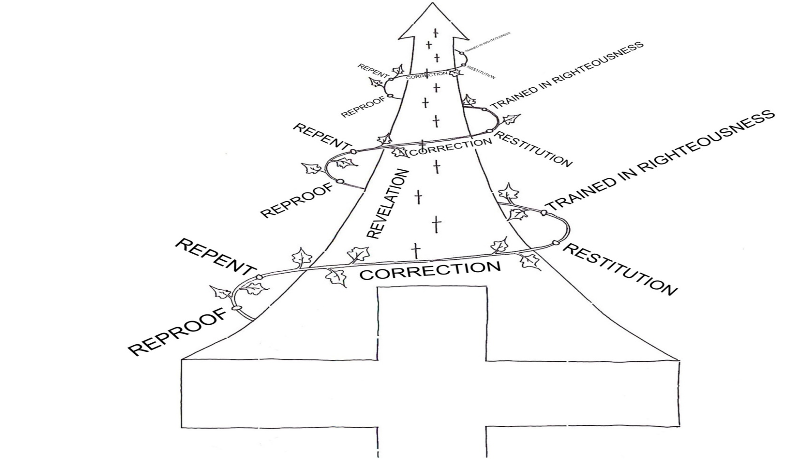
The Road of Life and The Cycle of Renewal
Notes:
We go through several cycles of renewal as God grows us up in Him.
We grow in our ability to experience and express love - this is the marker of our maturity in faith. All along the way, our growth process will be opposed by the evil one and his influence in the world, so we should be prepared for
a battle!
But it is a battle for which God both prepares and equips us.
I like to describe it as a helical process of growth and renewal.

Slide 16
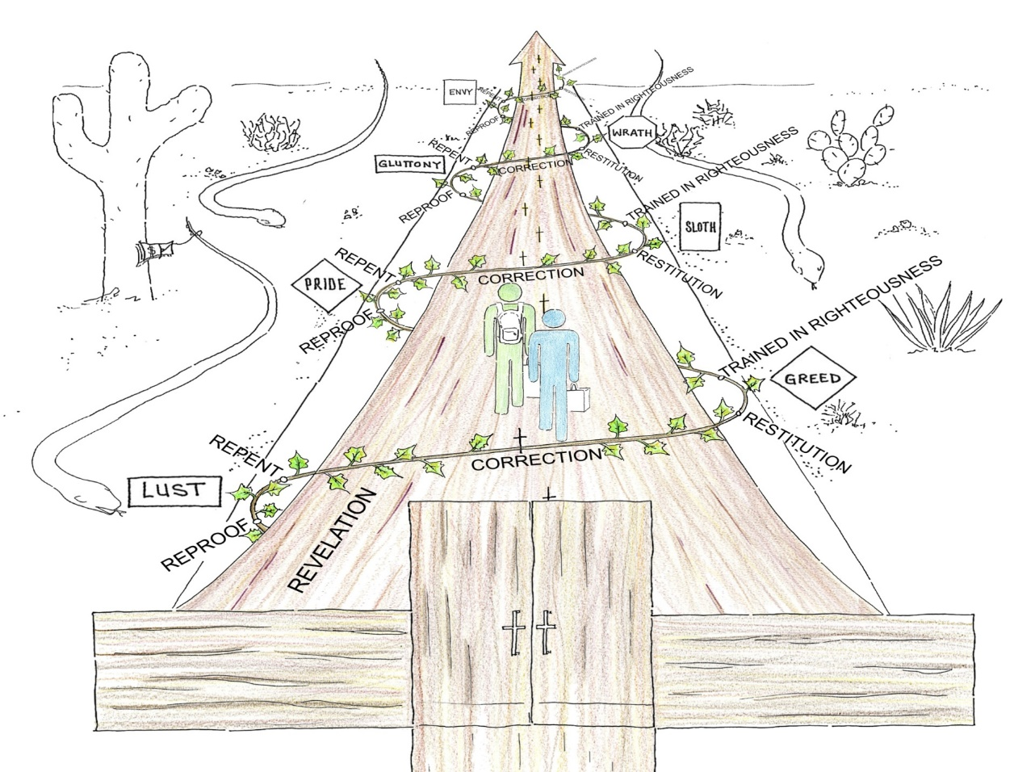
The Road of Life
To Eternal Life
The Wide Road to Destruction
Notes:
Put together with the church framing up and helping us walk the road of life together!
This is when our lives move from Black and White to Color!

Slide 17
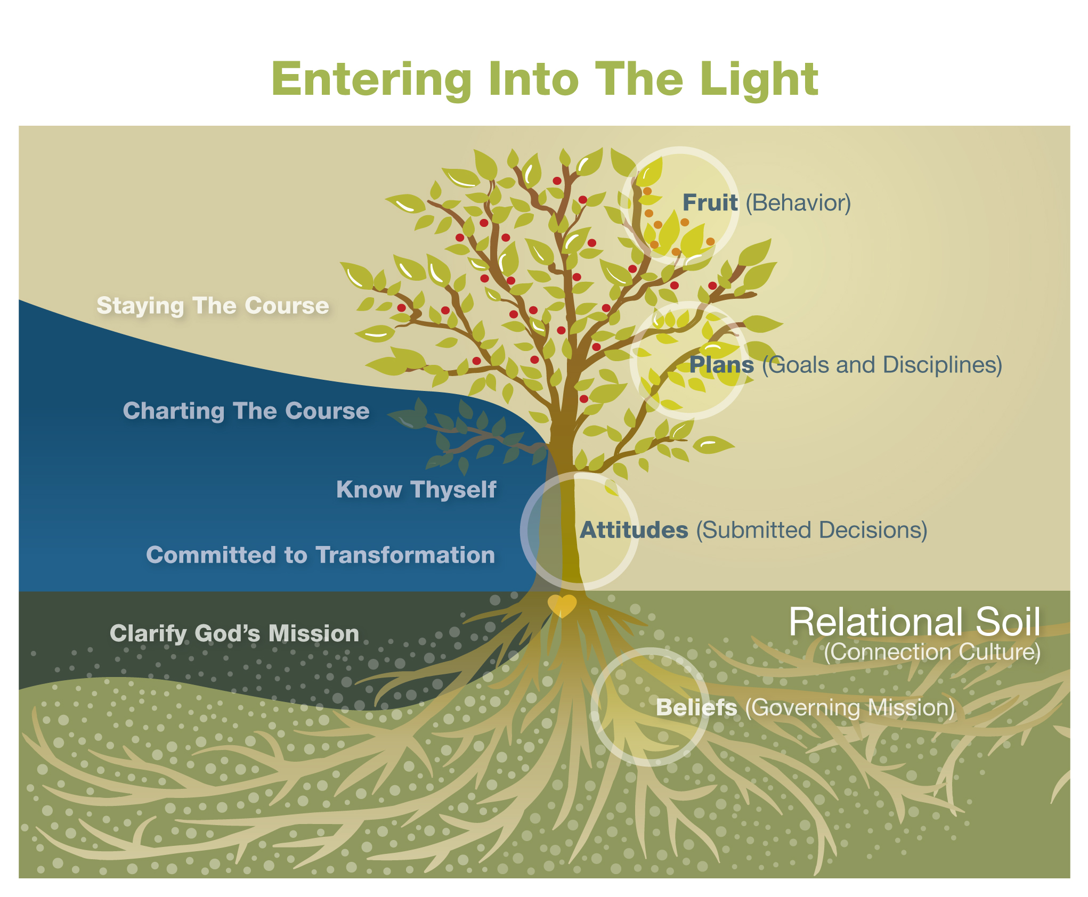


Slide 18
The 18 natural laws
Law 10 - The Law of Attitude
Choosing Godly Attitudes brings focus to the journey of transformation and prepares us to experience and express love abundantly in any situation.
Attitudes are advanced decisions about how we are going to desire, feel, think and act.
Notes:
Law 10 - The Law of Attitude
Choosing Godly Attitudes brings focus
to the journey of transformation and
prepares us to experience and express
love abundantly in any situation.
Attitudes are advanced decisions
about how we are going to desire,
feel, think and act.

Slide 19
The Attitude of Jesus Philippians 2:1-6
“If you have any encouragement from being united with Christ, if any comfort from his love, if any fellowship with the Spirit, if any tenderness and compassion, then make my joy complete by being like-minded, having the same love, being one in spirit and purpose. (Grace)
Do nothing out of selfish ambition or vain conceit, but in humility consider others better than yourselves. (Group)
Each of you should look not only to your own interests, but also
to the interests of others. (Good Stewardship)
Your attitude should be the same as that of Christ Jesus:
Who, being in very nature God, did not consider equality with God something to be grasped,” (Growth)
Notes:
Philippians 2:1-6
“ If you have any encouragement from being united with Christ, if any comfort from his love, if any fellowship with the Spirit, if any tenderness and compassion, then make my joy complete by being like-minded, having the same love, being one in spirit and purpose. (Grace)
Do nothing out of selfish ambition or vain conceit, but in humility consider others better than yourselves. (Group)
Each of you should look not only to your own interests, but also
to the interests of others. (Good Stewardship)
Your attitude should be the same as that of Christ Jesus:
Who, being in very nature God, did not consider equality
with God something to be grasped,” (Growth)

Slide 20
The Attitude of Jesus Philippians 2:7-11
“…but made himself nothing, taking the very nature of a servant, being made in human likeness. (Gifts)
And being found in appearance as a man, he humbled himself and became obedient to death — even death on a cross! (Guidance)
Therefore God exalted him to the highest place and gave him the name that is above every name, that at the name of Jesus every knee should bow, in heaven and on earth and under the earth, and every tongue confess that Jesus Christ is Lord, to the glory of God the Father.” (Glorification)
Notes:
Philippians 2:7-11
“ …but made himself nothing, taking the very nature of a servant,
being made in human likeness. (Gifts)
And being found in appearance as a man, he humbled himself and became obedient to death — even death on a cross! (Guidance)
Therefore God exalted him to the highest place and gave him the name that is above every name, that at the name of Jesus every knee should bow, in heaven and on earth and under the earth,
and every tongue confess that Jesus Christ is Lord, to the glory
of God the Father.” (Glorification)

Slide 21

Godly Attitudes are based on the Promises of God
Godly attitudes are based on the promises of God.
If our attitudes are advanced decisions about how we are going to desire, feel, think and act in any situation, then we need to base these attitudes on a sure foundation.
We can decide in advance to trust in what God has promised.
Notes:
Godly attitudes are based on the promises of God.
If our attitudes are advanced decisions about how we are going to desire, feel, think and act in any situation, then we need to base these attitudes on a sure foundation.
We can decide in advance to trust in what God has promised.
If Christians would at once believe, and apply the promises, meet God on the ground that he has promised to meet them, they would find in their own experience how much value there is in prayer, and how powerfully they can prevail with God.
They would find that there was a cheerfulness and willingness on God's part to meet them at every point. Many individuals plead the promises without fulfilling their conditions, and then they lose their faith in the promises, because they are not fulfilled in their experiences.
The reason of this is because they have not fulfilled the required conditions.

Slide 22

7 Values of Abundant Living and the Promises of God
Guidance - God Promises His Guidance to those who submit themselves to His Lordship and follow Him.
Growth – God promises to train and transform earnest disciples of God’s righteous life.
Grace – God promises His forgiveness to those who repent and live as His ambassadors in the world.
Good Stewardship – God promises His provision to those who depend on Him and Steward life wisely.
Glorification – God promises to glorify himself through reverent worshippers who serve His purposes!
Gifts – God promises His empowerment and protection to those who surrender to Him and serve through His Strength.
Group – God promises His love, peace and presence to members of His Family.
Notes:
Guidance - God Promises His Guidance to those who submit themselves to His Lordship and follow Him.
Growth – God promises to train and transform earnest disciples of God’s righteous life.
Grace – God promises His forgiveness to those who repent and live as His ambassadors in the world.
Good Stewardship – God promises His provision to those who depend on Him and Steward life wisely.
Glorification – God promises to glorify himself through reverent worshippers who serve His purposes!
Gifts – God promises His empowerment and protection to those who surrender to Him and serve through His Strength.
Group – God promises His love, peace and presence to members of His Family.

Slide 23

7 Values of Abundant Living and Godly Attitudes
Guidance – I have decided that I need God’s guidance in every aspect of my life and will live as His follower!
Growth – I have decided that I will live as a disciple, striving to become more like Jesus in every area of my life!
Grace – I have decided that I will receive God’s grace for my life and live as His ambassador of reconciliation in the world!
Good Stewardship – I have decided that life is a gift of time, talents and treasure that I will gratefully steward as God leads.
Glorification – I have decided to live as a worshipper and glorify God in every aspect of my life.
Gifts – I have decided to live every day as an empowered servant allowing God to express His love through me.
Group – I have decided to live in covenant community as a member of God’s family, serving them with my life and welcoming in all who desire to join!
Notes:
Guidance – I have decided that I need God’s guidance in every aspect
of my life and will live as His follower!
Growth – I have decided that I will live as a disciple, striving to become
more like Jesus in every area of my life!
Grace – I have decided that I will receive God’s grace for my life and live
as His ambassador of reconciliation in the world!
Good Stewardship – I have decided that life is a gift of time, talents
and treasure that I will gratefully steward as God leads.
Glorification – I have decided to live as a worshipper and glorify God
in every aspect of my life.
Gifts – I have decided to live every day as an empowered servant
allowing God to express His love through me.
Group – I have decided to live in covenant community as a member of
God’s family, serving them with my life
and welcome in all who desire to join!

Slide 24

Cycle of Renewal and Holistic Transformation

Slide 25

Cycle of Renewal and Holistic Transformation
Believing in the Lord Jesus with all our Heart, Soul, Mind and Strength means that we:
  Embrace the revelation or feedback that God brings into our lives which convicts us of our sin and need for Him.
  Change incorrect or negative attitudes or beliefs through holistic Repentance:
    agreeing with God’s will (Heart),
    healing of wounds (Soul),
    learning His truth (Mind) and
    calling upon His strength (Strength).
  Embrace God’s new correct Beliefs (Desires, Feelings, Thoughts and Capabilities) for our lives by making amends or restitution to those we have wounded and engaging our new training in righteousness!
Notes:
Believing in the Lord Jesus with all our Heart, Soul, Mind and Strength means that we:
Embrace the revelation or feedback that God brings into our lives which convicts us of our sin and need for Him.
Change incorrect or negative beliefs through holistic Repentance: agreeing with God’s will (Heart), healing of wounds (Soul), learning His truth (Mind) and calling upon His strength (Strength).
Embrace God’s new correct Beliefs (Desires, Feelings, Thoughts and Capabilities) for our lives by making amends or restitution to those we have wounded and Engaging our new training in righteousness!

Slide 26

Cycle of Renewal and Believing
Discussion Time:
What is something that you are struggling with right now in your life that needs holistic transformation?
How have you either not begun or short circuited this process in your life?
Notes:
Table Time:
What is something that you are struggling with right now in your life that needs holistic repentance?
How have you either not begun or short circuited this process in your life?

Slide 27
The 18 natural laws
Law 11 - The Law of Reality
Our sinful nature combined with the
influence of evil in the world co-conspire
to lead us away from God, but God has
provided all we need to stand against
these forces and realize His abundant life.
The Book of Ephesians, Romans 7 & 8
Notes:
Law 11 - The Law of Reality
Our sinful nature combined with the
influence of evil in the world co-conspire
to lead us away from God, but God has
provided all we need to stand against
these forces and realize His abundant life.
The Book of Ephesians, Romans 7 & 8
Our sinful nature provides us with the tendency to want to do our will over the will of the Father. When we try to do otherwise, we often try to do it (or at least some portion of it) on our own. However, as Jesus observes, apart from Him we “can do nothing.” (John 15:5b)
We’re Spiritual People

Slide 28
The Reality Picture of Spiritual Warfare
By Ed Silvoso, from his book “That None Should Perish.”
There are 5 references to the heavenly places in the book of Ephesians. Each one represents a move by God that eventually leads to cosmic checkmate like in chess.
The first time has to do with the father.
Ephesians 1:3-6
The second with Jesus.
Ephesians 1:18-23
The third time with the church (Jesus BODY)
Ephesians 2:1-7
The fourth time with principalities and powers.
Ephesians 3:7-12
And the last time with the struggle between the
Church and those principalities and powers
Ephesians 6:10-12
Notes:
There are 5 references to the heavenly places
in the book of Ephesians. Each one represents
a move by God that eventually leads to
cosmic checkmate like in chess.
The first time has to do with the father.
Ephesians 1:3-6
The second with Jesus.
Ephesians 1:18-23
The third time with the church (Jesus BODY)
Ephesians 2:1-7
The fourth time with principalities and powers.
Ephesians 3:7-12
And the last time with the struggle between the
Church and those principalities and powers
Ephesians 6:10-12

Slide 29
The Heavenly Places
The Prince of the Power of the Air
Principalities and Powers
The Gates
of Hell
SINS
Transgressions
The Cosmic Grave
Notes:
Picture of the heavenly places before Jesus

Slide 30
The Heavenly Places
GOD
Constants
The Gates
of Hell
The Prince of the Power of the Air
Principalities and Powers
The Cosmic Grave
Notes:
Reality picture of the heavenly Places After Jesus.

Slide 31
The Heavenly Places
The Prince of the Power of the Air
Principalities and Powers
After
The Gates
of Hell
SINS
Transgressions
The Heavenly Places
The Cosmic Grave
GOD
Before
Variable
Constants
The Gates
of Hell
The Prince of the Power of the Air
Principalities and Powers
The Cosmic Grave
Notes:
Before and After

Slide 32
The Heavenly Places
GOD
Variable
Constants
The Gates
of Hell
The Prince of the Power of the Air
Principalities and Powers
The Cosmic Grave
Notes:
The Role of the Body of Christ in bringing forth the Manifold wisdom of God!

Slide 33
Satan’s Weapons
By Ed Silvoso, from his book “That None Should Perish.”
Lies and Deception
Anger triggered by Unwholesome words.
Ephesians 4:25-32
Notes:
Lies and Deception
Anger triggered by Unwholesome words.
Ephesians 4:25-32

Slide 34
The Full Armor of God and the
7 Values of Abundant Living
Guidance – The Belt of Truth
Growth – The Breastplate of Righteousness
Grace – Feet Fitted with the readiness that comes from the Gospel of Peace
Good Stewardship – The Shield of Faith
Glorification – The Helmet of Salvation
Gifts – And the Sword of the Spirit, which is the Word of God.
Group – And pray in the Spirit on all occasions with all kinds of prayers and requests. With this in mind, be alert and always keep on praying for all the saints.
Notes:
Guidance – The Belt of Truth
Growth – The Breastplate of Righteousness
Grace – Feet Fitted with the readiness that comes from the Gospel of Peace
Good Stewardship – The Shield of Faith
Glorification – The Helmet of Salvation
Gifts – And the Sword of the Spirit, which is the Word of God.
Group – And pray in the Spirit on all occasions with all kinds of prayers and requests. With this in mind, be alert and always keep on praying for all the saints.

Slide 35
The 18 natural laws
Law 12 - The Law of Consequences
Actions taken and words spoken have
profound consequences on our journey
of transformation, either blessing or
cursing our lives and the lives of those
we touch.
Deuteronomy 30:15-20, Galatians 6:7-10
Notes:
Law 12 - The Law of Consequences
Actions taken and words spoken have
profound consequences on our journey
of transformation, either blessing or
cursing our lives and the lives of those
we touch.
Deuteronomy 30:15-20, Galatians 6:7-10

Slide 36
Blessings and Curses
Definition: Both blessings and curses
are impartations of spiritual power,
one for the positive and one for the
negative. They can both come about
as a result of words spoken or actions
taken by oneself or others.
From Derek Prince’s
Blessings or Curses: You can choose
Notes:
Definition: Both blessings and curses
are impartations of spiritual power,
one for the positive and one for the
negative.
They can both come about
as a result of words spoken or actions
taken by oneself or others.
From Derek Prince’s
Blessings or Curses: You can choose

Slide 37
Dealing with sin in the Church
In order to deal with sin against one
another in the church Jesus has provided
us a model of how to confront one another
and move towards healing, reconciliation
and peace in Matthew 18:15-20.
By moving through this process with one another we can reverse the effects of the curse that has been brought to bear on our lives through one another’s sins and maintain the unity of the church through forgiveness, healing and restoration of trust as we move towards reconciliation.
Notes:
In order to deal with sin against one
another in the church Jesus has provided
us a model of how to confront one another
and move towards healing, reconciliation
and peace in Matthew 18:15-20.
By moving through this process with one another we can reverse the affects of the curse that has been brought to bear on our lives through one another’s sins and maintain the unity of the church through forgiveness, healing and restoration of trust as we move towards reconciliation.

Slide 38
Curses of Disobedience and the
7 values of Abundant Living
Curses of Disobedience – Deuteronomy 27:15-26 and Others
Guidance – Idolatry v.15
Group – Disrespect of Parents v.16
Sexual Immorality v. 20-23
Good Stewardship – Dishonesty/Greed
Unrighteous Stewardship – Haggai 1:5-6, Malachi 3:8-9
Grace – Harming the helpless and weak – vs. 18-19
Hatred/Murder v. 24-25
Growth – Hypocrisy and Disobedience to the Word v.26
Glorification – Pride - Jeremiah 17:5-6
Gifts – Religion – Galatians 3:10
Notes:
Curses of Disobedience – Deuteronomy 27:15-26
Guidance – Idolatry v.15
Group – Disrespect of Parents v.16
Sexual Immorality v. 20-23
Good Stewardship – Dishonesty/Greed
Unrighteous Stewardship – Haggai 1:5-6, Malachi 3:8-9
Grace – Harming the helpless and week – vs. 18-19
Hatred/Murder v. 24-25
Growth – Hypocrisy and Disobedience to the Word v.26
Glorification – Pride - Jeremiah 17:5-6
Gifts – Religion – Galatians 3:10

Slide 39

Cycle of Renewal and Believing
Believing in the Lord Jesus with all our Heart, Soul, Mind and Strength means that we:
  Embrace the revelation or feedback that God brings into our lives which convicts us of our sin and need for Him.
  Change incorrect or negative beliefs through holistic Repentance: agreeing with God’s will (Heart), healing of wounds (Soul), learning His truth (Mind) and calling upon His strength (Strength).
  Embrace God’s new correct Beliefs (Desires, Feelings, Thoughts and Capabilities) for our lives by making amends or restitution to those we have wounded and engaging our new training in righteousness!
Notes:
Believing in the Lord Jesus with all our Heart, Soul, Mind and Strength means that we:
Embrace the revelation or feedback that God brings into our lives which convicts us of our sin and need for Him.
Change incorrect or negative beliefs through holistic Repentance: agreeing with God’s will (Heart), healing of wounds (Soul), learning His truth (Mind) and calling upon His strength (Strength).
Embrace God’s new correct Beliefs (Desires, Feelings, Thoughts and Capabilities) for our lives by making amends or restitution to those we have wounded and Engaging our new training in righteousness!

Slide 40
Homework Commit to Transformation
Road of Life Worksheet
Cycle of Renewal Worksheet
Godly attitudes and the Seven Values of Abundant Living Worksheet
Cycle of Renewal – Holistic Transformation Worksheet Attitude
Spiritual Warfare Worksheet
Blessings and Curses Worksheet
Cycle of Renewal – Holistic Transformation Worksheet Blessings and Curses

Slide 41
Group Questions
What scriptures or concepts stood out to you the most?
What do you hear God trying to teach you?
What do you need to do about it?

Slide 42
Schedule - Thursday July 27th
8:00 a.m. – 8:15 a.m. Arrival/Opening Worship and Prayer
8:15 a.m. – 8:50 a.m. Omega Refresher (Sessions 13 - 16) Commit to Transformation
8:50 a.m. – 9:45 a.m. Reflection/Worksheets
9:45 a.m. – 10:15 a.m. Group Discussion/Interviews
10:15 a.m. – 10:30 Snack Break
10:30 a.m. – 10:45 a.m. Worship and Prayer
10:45 a.m. – 11:15 a.m. Omega Refresher (Sessions 17 - 20) Know Thyself
11:15 a.m. – 12:00 p.m. Reflection/Worksheets
12:00 a.m. – 12:30 p.m. Group Discussion/Interviews
12:30 p.m. – 1:30 p.m. Lunch*
*These meals are optional so if you need to skip we understand.

