Slide 1


Notes:
We are here to help you realize life’s potential

Slide 2
Schedule - Thursday July 27th
1:30 p.m. – 1:45 p.m. Worship and Prayer
1:45 p.m. – 2:15 p.m. Omega Refresher (Sessions 17-20) Know Thyself Part 2
2:15 p.m. – 3:00 p.m. Reflection/Worksheets
3:00 p.m. – 3:30 p.m. Group Discussion/Interviews
3:30 p.m. - 3:45 p.m. Snack Break
3:45 p.m. – 4:00 p.m. Worship and Prayer
4:00 p.m. – 4:40 p.m. Omega Refresher (Sessions 21 -24) Running The Course
4:40 p.m. – 5:30 p.m. Reflection/Worksheets
5:30 p.m. – 6:00 p.m. Group Discussion/Interviews
6:00 p.m. Dinner*
*These meals are optional so if you need to skip we understand.

Slide 3

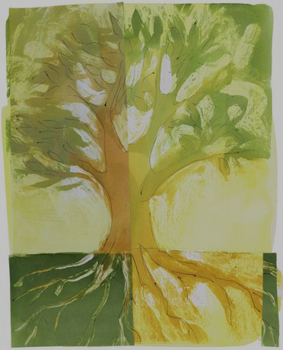
z
Charting and Running The Course
Notes:
The Joy of Discipline

Slide 4
There’s a Reason

Slide 5
Dirt

Slide 6
Refiner

Slide 7
z
Charting and Running The Course
Notes:
The Joy of Discipline

Slide 8
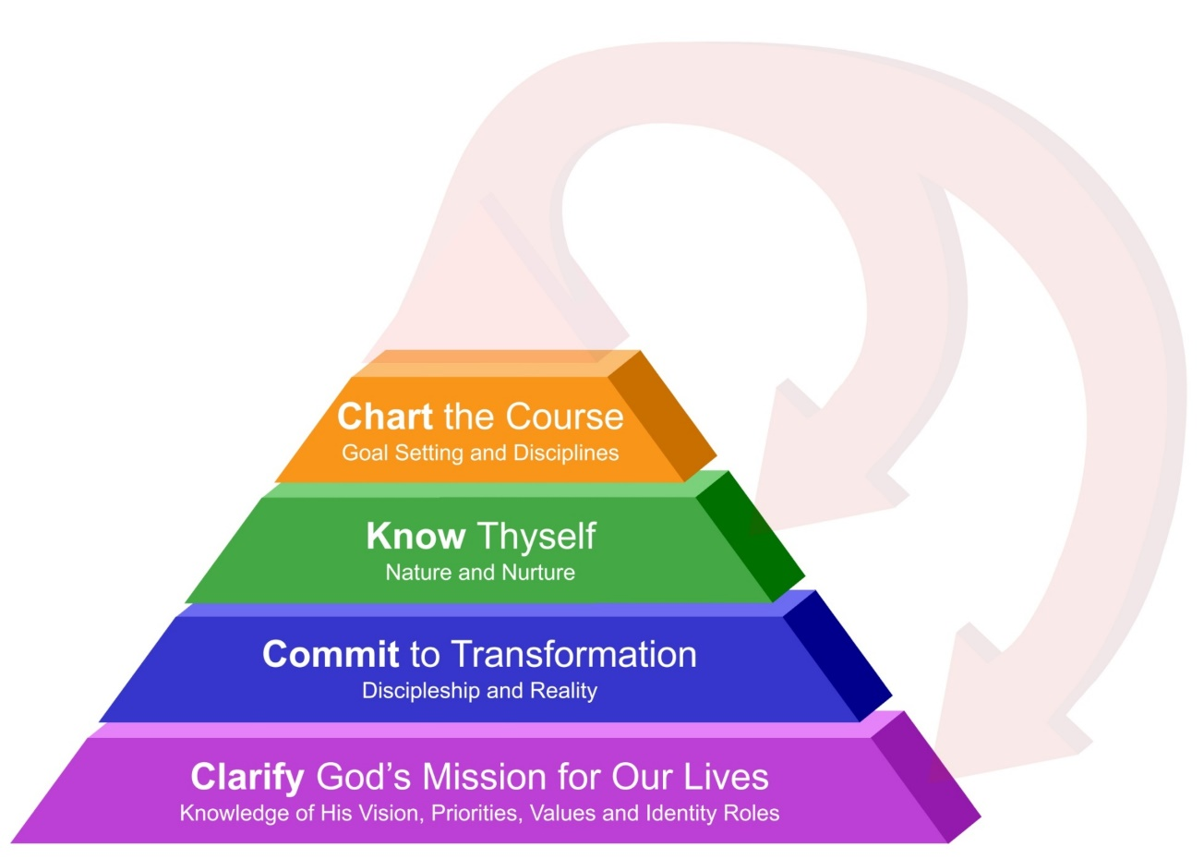
Life Focus Process
Notes:
This session we begin Charting the Course.

Slide 9
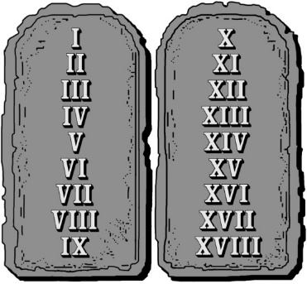

The 18 natural laws
Law 15 - The Law of Discipline
Negative habits are overcome by
changing incorrect (negative) beliefs
(desires, feelings, thoughts and
capabilities) and engaging in spiritually
discerned disciplines.
Hebrews 12
Notes:
Law 15 - The Law of Discipline
Negative habits are overcome by
changing incorrect (negative) beliefs
(desires, feelings, thoughts and
capabilities) and engaging in spiritually
discerned disciplines.

Slide 10
Disciplines are the key to unlocking our potential
Focusing our efforts through daily, weekly
and monthly disciplines is the key to good habit formation and personal growth in our lives.
Notes:
Disciplines: The Key to Unlocking Our Potential
Again, bad habits and areas where we struggle with self-control need to be examined in light of our real beliefs (See the Belief Model in Session 10), and then we need to engage in appropriate spiritually discerned disciplines to help us form healthy habits.
Focusing our efforts through daily, weekly and monthly disciplines is the key to good habit formation and personal growth in our lives. Remember this is a process.
Don’t engage in a discipline that is going to burn you out because it is unrealistic.
Be patient and build on realistic disciplines for yourself.

Slide 11

Disciplines and Spiritual Pathways
The key to wise yoke-bearing and training in righteousness through spiritual disciplines is understanding your preferred spiritual pathways and walking in them.
The combination of Spiritually Discerned Disciplines in each area of our lives and our Spiritual Pathways create a synergy and enthusiasm for seeking God and for maintaining motivation.
Notes:
The key to wise yoke-bearing and training in righteousness through spiritual disciplines is understanding your preferred spiritual pathways and walking in them.
The combination of Spiritually Discerned Disciplines in each area of our lives and our Spiritual Pathways create a synergy and enthusiasm for seeking God and for maintaining motivation.

Slide 12

What Is a Spiritual Pathway?
A spiritual pathway is the way we most naturally connect with God and grow spiritually.
We tend to favor one or two main pathways.
There’s usually at least one pathway that is
very unnatural for us.
The goal is to feel great FREEDOM and joy using them.
Notes:
A spiritual pathway is the way we most naturally connect with God and grow spiritually.
We tend to favor one or two main pathways.
There’s usually at least one pathway that is very unnatural for us.
The goal is to feel great FREEDOM and joy using them.

Slide 13

Seven Spiritual Pathways
Intellectual
Relational
Serving
Worship
Activist
Contemplative
Creation
Adapted from John Ortberg’s course
An Ordinary Day with Jesus.
Notes:
Intellectual
Relational
Serving
Worship
Activist
Contemplative
Creation
Adapted from John Ortberg’s course
An Ordinary Day with Jesus.

Slide 14

Seven Spiritual Pathways and the 7 G’s
Intellectual – Guidance
Relational – Group
Serving – Gifts
Worship – Glorification
Activist – Growth
Contemplative – Grace
Creation – Good Stewardship
Notes:
Intellectual – Guidance
Relational – Group
Serving – Gifts
Worship – Glorification
Activist – Growth
Contemplative – Grace
Creation – Good Stewardship

Slide 15
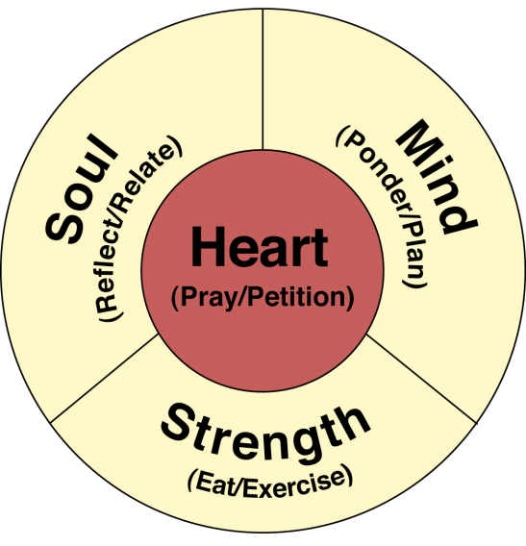
Disciplines for Being Human
Heart
  Pray (Prayer, Solitude and Silence) &
  Petition (Intercession and Watching)
Soul
  Reflect (Journaling, Singing and Meditation) &
  Relate (Confession, Counseling, Retreats)
Mind
  Ponder (Study of Scripture, Journaling) &
  Plan (Planning your life, Life Coaching)
Strength
  Eat (Surrender, Temperance, Fasting) &
  Exercise (Exercise, Sabbath)
Notes:
Heart
Pray (Prayer, Solitude and Silence) &
Petition (Intercession and Watching)
Soul
Reflect (Journaling, Singing and Meditation) &
Relate (Confession, Counseling, Retreats)
Mind
Ponder (Study of Scripture, Journaling) &
Plan (Planning your life, Life Coaching)
Strength
Eat (Surrender, Temperance, Fasting) &
Exercise (Exercise, Sabbath)

Slide 16
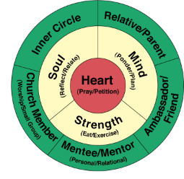
Disciplines for Contagious community
Inner Circle – Fellowship, Chastity, Celebration, Hospitality and Confession while consistently praying for and relationship building with our spouses and/or great friends.
Relative Parent – Fellowship, Sacrifice, Celebration, Hospitality and Submission while consistently praying for and connecting with our parents, relatives and children if appropriate.
Church Member – Worship, Fellowship, Confession, Assembling, Celebration, Singing, Hospitality and Communion while consistently praying for and relating to our church family and engaging in small group and local fellowship gatherings.
Mentee/Mentor – We grow through Guidance, Study, Pilgrimage, Sabbatical, Submission and meeting regularly with mentors, counselors, and covenant community members who help us to implement what we are learning into our lives. We learn from studying books, tapes, videos and taking classes. We also meet regularly with others who seek us out for mentoring.
Ambassador/Friend – Friendship Evangelism and Hospitality through regular prayer for and connection with friends God brings our way and sharing the gospel with them in word and deed.
Notes:
Inner Circle – Fellowship, Chastity, Celebration, Hospitality and Confession while consistently praying for and relationship building with our spouses and/or great friends.
Relative Parent – Fellowship, Sacrifice, Celebration, Hospitality and Submission while consistently praying for and connecting with our parents, relatives and children if appropriate.
Church Member – Worship, Fellowship, Confession, Assembling, Celebration, Singing, Hospitality and Communion while consistently praying for and relating to our church family and engaging in small group and local fellowship gatherings.
Mentee/Mentor – We grow through Guidance, Study, Pilgrimage, Sabbatical, Submission and meeting regularly with mentors, counselors, and covenant community members who help us to implement what we are learning into our lives. We learn from studying books, tapes, videos and taking classes. We also meet regularly with others who seek us out for mentoring.
Ambassador/Friend – Friendship Evangelism and Hospitality
through regular prayer for and connection with friends God brings
our way and sharing the gospel with them in word and deed.

Slide 17
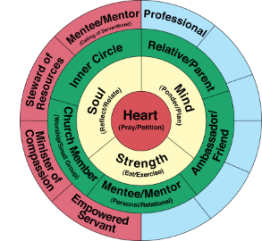
Disciplines for Calling of Servanthood
Minister of Compassion – Secrecy, Service and Sacrifice while serving the “poor in our world” and compassionately loving them as led by God. This includes but is not limited to visiting the sick and prisoners, and clothing and feeding those in need.
Steward of Resources – Simplicity, Frugality, Saving, Sacrifice and Giving (Tithing) while stewarding God’s resources.
Empowered Servant – Teaching, Service, Sacrifice and Fellowship through the regular exercising of your spiritual gifts while serving on ministry teams.
Calling Mentee/Mentor – We grow through Guidance, Study, Pilgrimage, Sabbatical, Submission and meeting regularly with mentors, counselors, and covenant community members who help us to implement what we are learning into our lives. We learn from studying books, tapes, videos and taking classes. We also meet regularly with others who seek us out for mentoring.
Professional – Diligent Earner through faithful accomplishment of tasks and Friendship Evangelism through relationship excellence while Serving as unto the Lord.
Notes:
Minister of Compassion – Secrecy, Service and Sacrifice while serving the “poor in our world” and compassionately loving them as led by God. This includes but is not limited to visiting the sick and prisoners, and clothing and feeding those in need.
Steward of Resources – Simplicity, Frugality, Saving, Sacrifice and Giving (Tithing) while stewarding God’s resources.
Empowered Servant – Teaching, Service, Sacrifice and Fellowship through the regular exercising of your spiritual gifts while serving on ministry teams.
Calling Mentee/Mentor – We grow through Guidance, Study, Pilgrimage, Sabbatical, Submission and meeting regularly with mentors, counselors, and covenant community members who help us to implement what we are learning into our lives. We learn from studying books, tapes, videos and taking classes. We also meet regularly with others who seek us out for mentoring.
Professional – Diligent Earner through faithful accomplishment of tasks and Friendship Evangelism through relationship excellence while Serving as unto the Lord.

Slide 18
Disciplines of Abstinence
The Disciplines of Abstinence are:
1. Solitude
2. Silence
3. Fasting
4. Simplicity
5. Chastity
6. Secrecy
7. Sacrifice
8. Watching (Vigil)
Notes:
PHI is Phillips New Testament in Modern English 1958

Slide 19
Disciplines of Engagement
We have grouped the Disciplines of Engagement into disciplines of:
God engagement,
God and Community engagement, and
Life and Wisdom engagement.
Disciplines of God Engagement
9. Worship
10. Prayer
11. Meditation
12. Singing
13. Surrender
14. Study
15. Pilgrimage
16. Sabbath
Notes:
Very few disciplines can be regarded as absolutely indispensable for a healthy life and work, though some are obviously more important than others. Practicing a range of activities that have proven track records across the centuries will help to keep us from erring.
We have grouped the disciplines of engagement into disciplines of:
God Engagement
God and Community Engagement
Life and Wisdom engagement
Disciplines of God Engagement
9. Worship
10. Prayer
11. Meditation
12. Singing
13. Surrender
14. Study
15. Pilgrimage
16. Sabbath

Slide 20
Disciplines of Engagement
We have grouped the Disciplines of Engagement into:
God engagement,
God and Community engagement, and
Life and Wisdom engagement.
Disciplines of God and Community Engagement
17. Teaching
18. Celebration
19. Service
20. Fellowship
21. Confession
22. Submission
23. Friendship Evangelism
24. Assembling
25. Hospitality
26. Intercessory Prayer
Notes:
Disciplines of God and Community Engagement
17. Teaching
18. Celebration
19. Service
20. Fellowship
21. Confession
22. Submission
23. Friendship Evangelism
24. Assembling
25. Hospitality
26. Intercessory Prayer

Slide 21
Disciplines of Engagement
We have grouped the Disciplines of Engagement into:
God engagement,
God and Community engagement, and
Life and Wisdom engagement.
Disciplines of Life and Wisdom Engagement
27. Journaling
28. Earning
29. Saving
30. Giving (Including Tithing)
31. Frugality
32. Guidance
33. Retreat
34. Temperance
35. Planning
36. Exercise
Notes:
Disciplines of Life and Wisdom Engagement
27. Journaling
28. Earning
29. Saving
30. Giving (Including Tithing)
31. Frugality
32. Guidance
33. Retreat
34. Temperance
35. Planning
36. Exercise

Slide 22
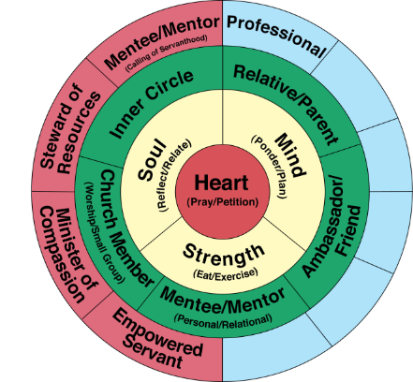
The 18 natural laws
Law 16 - The Law of Growth
Growth towards Christlikeness requires
Accountability, Process, & Perseverance.
Notes:
Law 16 - The Law of Growth
Growth towards Christlikeness requires
Accountability, Process, & Perseverance.

Slide 23
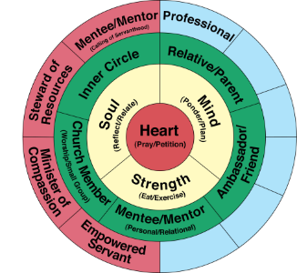
Using planning pages
Use the planning pages to record your goals and remind you of your focus.
Share your planning pages with a mentor, and use them as the basis for your discussion about how you are doing and the kinds of adjustments you might want to make.
Notes:
Use the planning pages to record your goals and remind you of your focus.
Share your planning pages with a mentor, and use them as the basis for your discussion about how you are doing and the kinds of adjustments you might want to make.

Slide 24
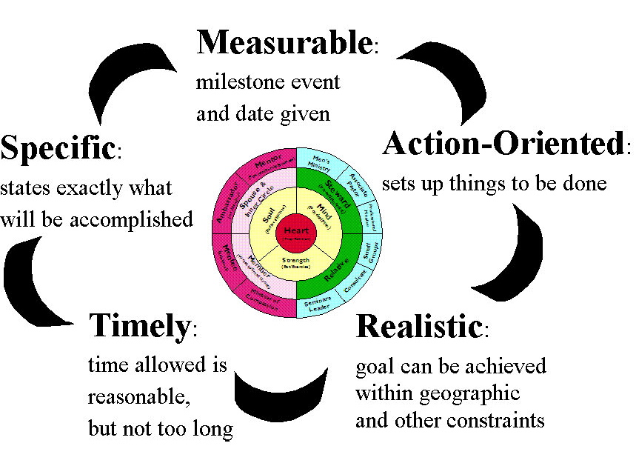
S.M.A.R.T. Goals
Notes:
S.M.A.R.T. Goals

Slide 25
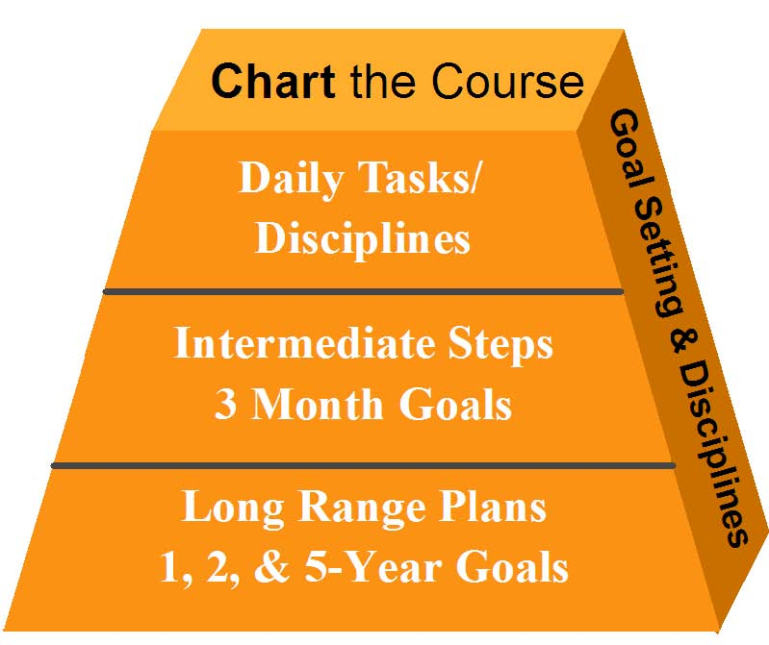
Charting the Course - Goal Setting
Notes:
Chart the Course
Goal Setting and Disciplines
If you’ve ever done any time management work, you know that the best thing to do is to build it on a base of a long range vision. Then those goals are broken down further into shorter and shorter increments.
Many times people overwhelm themselves, then guilt themselves, and then just stop rather than being strategic, being focused, and building the proper encouragement and accountability systems.

Slide 26
Using planning pages
Role/Identity | Milestones | Ideas | Roadblocks | Resources | 1 Year Goals | 2 Year Goals | 5 Year Goals
1. Christ Follower: Need: To live Heart - Devotion Spiritual Lover/Prayer Warrior
Soul – Priorities Emotional Sinner/Saint Balance, Reflection & Life Management
Mind – Plans Intellectual Learner/Planner
Strength – Actions - Physical Temple/ Recreator
Notes:
Using Planning Pages
Use the planning pages to record your goals and remind you of your focus.
Share your planning pages with a mentor, and use them as the basis for your discussion about how you are doing and the kinds of adjustments you might want to make.

Slide 27
Using planning pages
Role/Identity | Milestones | Ideas | Roadblocks | Resources | 1 Year Goals | 2 Year Goals | 5 Year Goals
2. Community: Need: to love & experience variety Inner Circle - Spouse and Soul Mates
Relative & Parent - Extended Family Children,
Member of God’s Family- Small Group & Church Member
Mentee/ Mentor - Learner
Ambassador Friend/ Connector Civic and Community
Notes:
Using Planning Pages
Use the planning pages to record your goals and remind you of your focus.
Share your planning pages with a mentor, and use them as the basis for your discussion about how you are doing and the kinds of adjustments you might want to make.

Slide 28
Using planning pages
Role/Identity | Milestones | Ideas | Roadblocks | Resources | 1 Year Goals | 2 Year Goals | 5 Year Goals
3. Calling: Minister of Compassion
Empowered Servant General & Specific.
Steward of Resources
Professional Mentee/Mentor
Profession
Notes:
Using Planning Pages
Use the planning pages to record your goals and remind you of your focus.
Share your planning pages with a mentor, and use them as the basis for your discussion about how you are doing and the kinds of adjustments you might want to make.

Slide 29
Using planning pages
Role/ Identity | Weekly/Daily Disciplines | 3 Month Goals | 1 Year Mega Goals
Christ Follower: Heart –
Soul -
Mind -
Strength -
Community: Spouse Inner Circle of 3
Relative/Parent
Member of God’s Family -
Mentee/Mentor Relational learner
Ambassador - Friend/ Connector
Calling of Servanthood: Steward of Resources -
Servant In the Church
Calling of Compassion
Professional:
Professional Mentee/Mentor
Notes:
Using Planning Pages
Use the planning pages to record your goals and remind you of your focus.
Share your planning pages with a mentor, and use them as the basis for your discussion about how you are doing and the kinds of adjustments you might want to make.
This weeks home work will be to fill out the Goal planning sheets.
Beginning with your Mega Goals for one year in each role.

Slide 30
Honoring seasons in your life
You will have different emphases during different seasons in your life.
In Ecclesiastes 3:1-14 Solomon wrote, "To everything there is a season, and a time for every purpose under heaven.“
Notes:
Honoring the Seasons of Your Life
There will be emphases on different roles depending on your stage and place in life. It is important to attend to each stage as it comes.
If you decide not to do what you need to be doing during that particular season, it will only prolong the process.
You will have different emphases during different times in your life.
In Ecclesiastes 3:1-14 Solomon wrote, "To everything there is a season, and a time for every purpose under heaven.“

Slide 31
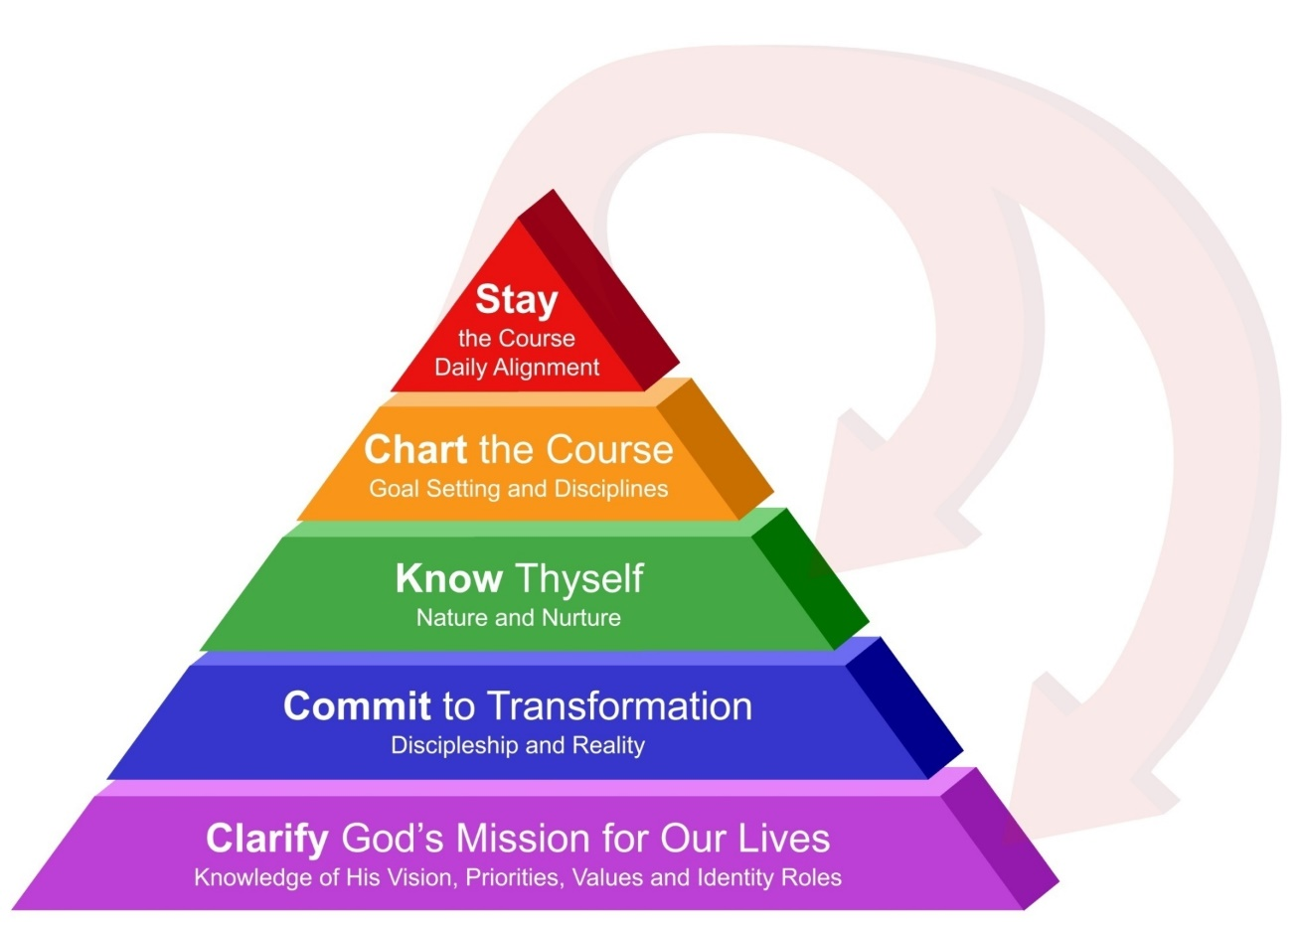
Stay the course – Daily Alignment
Notes:
During this session we will look at Staying the Course.

Slide 32
The 18 natural laws
Law 17 - The Law of Alignment
Regular evaluation, planning and realignment with God's mission, leverages time through increased focus.
Jeremiah 29:13
“You will seek me and find me when you
seek me with all your heart.”
Notes:
Law 17 - The Law of Alignment
Regular evaluation, planning and
realignment with God's mission,
leverages time through increased focus.
Jeremiah 29:13
“You will seek me and find me when you
seek me with all your heart.”

Slide 33

Planning and tracking
Our tendency is to drift away from God’s will for our lives. Therefore, we must create a plan for engaging our Spiritually-discerned disciplines and have regular times of planning and recalibration with Him.
No one naturally drifts toward righteousness.
We need the daily discipline of planning when we align and submit ourselves to the Guidance and Power of God.
Notes:
Our tendency is to drift away from God’s will for our lives.
Therefore, we must create a plan for engaging our Spiritually-discerned disciplines and have regular times of planning and recalibration with Him.
No one naturally drifts toward righteousness.
We need the daily discipline of planning when we align and submit ourselves to the Guidance and Power of God.

Slide 34
“Big Picture” planning and tracking
We recommend a rhythm to your planning.
  Annual and Quarterly “Big Picture” Planning.
  Weekly and Daily “Detail” Planning.
Annual Retreat: Annual retreats to seek God’s wisdom for any major readjustments in your life, holistically thinking through your long-range plans, establish your annual mega-goals and plan annual events for the year with the key relationships in your life.
Quarterly Renewal - Establishing your three-month seasonal goals and discerning the 3 roles you are going to focus on growing in over the following 3 months. This should be done with the help of your mentors by reviewing your “Big Picture” roles and goals, evaluating your progress and synthesizing any new revelations, projects, tasks and appointments into your personal growth plan.
Notes:
We recommend a rhythm to your planning.
Annual and Quarterly “Big Picture” Planning.
Weekly and Daily “Detail” Planning.
Annual Retreat: Annual retreats to seek God’s wisdom for any major readjustments in your life, holistically thinking through your long-range plans, establish your annual mega-goals and plan annual events for the year with the key relationships in your life.
Quarterly Renewal - Establishing your three-month seasonal goals and discerning the 3 roles you are going to focus on growing in over the following 3 months. This should be done with the help of your mentors by reviewing your “Big Picture” roles and goals, evaluating your progress and synthesizing any new revelations, projects, tasks and appointments into your personal growth plan.

Slide 35

Using planning pages
Role Planning Worksheets:
Annual Planning Worksheets:
Long Range Planning Worksheets:
Project Planning Worksheets:
Notes:
Role Planning Worksheets:
Annual Planning Worksheets:
Long Range Planning Worksheets:
Project Planning Worksheets:

Slide 36
“Detail” planning and tracking
We recommend a rhythm to your planning.
  Annual and Quarterly “Big Picture” Planning.
  Weekly and Daily “Detail” Planning.
  Weekly: Review the previous week, evaluate your progress and synthesize any new revelations, projects, tasks, disciplines and appointments into your calendar and personal growth plan.
  Daily: Daily overview, prioritization and alignment.
Notes:
We recommend a rhythm to your planning.
Annual and Quarterly “Big Picture” Planning.
Weekly and Daily “Detail” Planning.
Weekly: Review the previous week, evaluate your progress and synthesize any new revelations, projects, tasks, disciplines and appointments into your calendar and personal growth plan.
Daily: Daily overview, prioritization and alignment.

Slide 37

Jason Pankau Roles Diagram
President Life Spring Network
Content Creator
Speaker
Mentor/Life Coach
Seminar Trainer
Leadership Consultant
Notes:
37
Our Roles Diagram

Slide 38
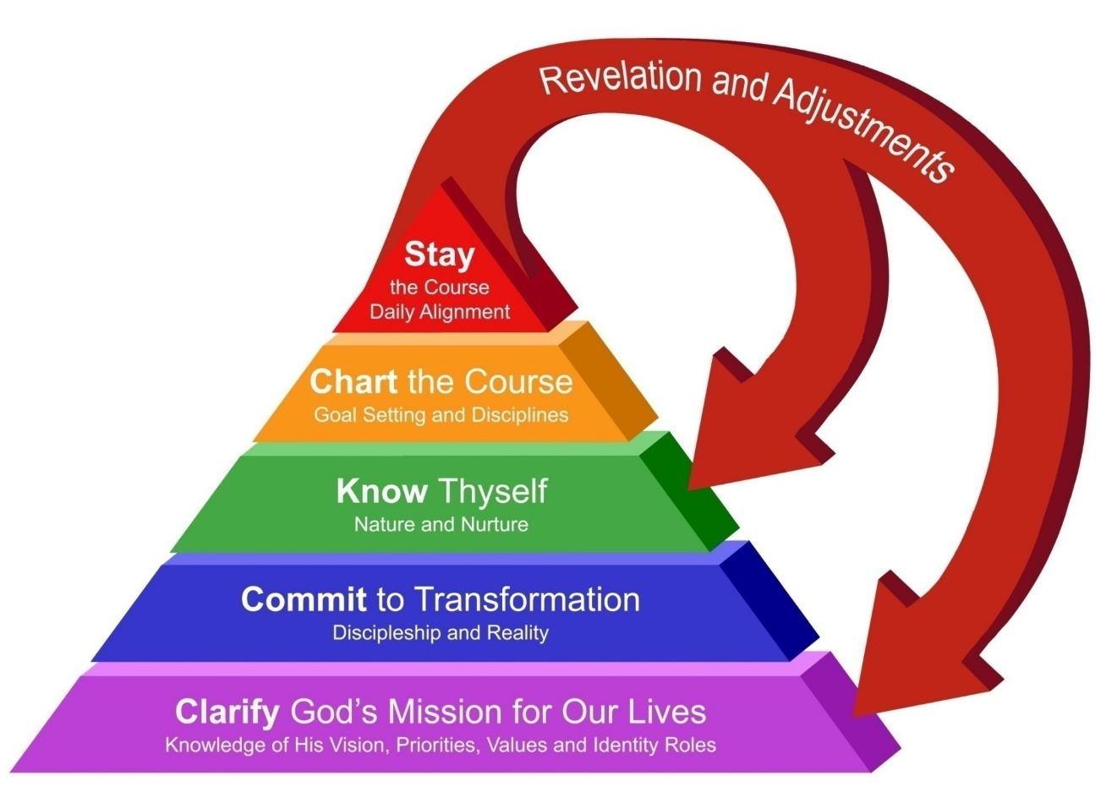
Revelation and Adjustments

Slide 39

The 18 natural laws
Law 18 - The Law of Training
The life you live trains you for the
life you are going to lead!
1 Corinthians 9:24-27
Notes:
Law 18 - The Law of Training
The life you live trains you for the
life you are going to lead!

Slide 40

Developing Christlikeness
To help someone develop in Christlikeness you need to understand the component parts that make up their lives.
This course has been designed as a journey to help you reflect upon the various areas of your life and what God’s perspective is concerning those areas, so that you can intentionally move towards becoming a person who lives out God’s Mission for our lives.
Notes:
To help someone develop in Christlikeness you need to
understand the component parts
that make up their lives.
This course has been designed as a journey to help you reflect upon the various areas of your life and what God’s perspective is concerning those areas, so that you can intentionally move towards becoming a person who lives out God’s Mission for our lives.

Slide 41
Training for Abundant Living
Developing Christlikeness
In the Christian context developing Christlikeness comes about through a process of seeking God’s guidance and training, then applying one’s life to God’s training in the power of the Holy Spirit.
God’s discipline and training mold, shape and empower you to Desire, Feel, Think and Act in accordance with His will.
This is only possible when done in community with others empowered by the Holy Spirit.
When the Fruit of the Spirit are manifest in ones life we know that Christlikeness is being formed and able to let the Spirit bear fruit.
Notes:
In the Christian context developing
Christlikeness comes about through a
process of seeking God’s guidance
and training, then applying one’s life to
God’s training in the power of the Holy Spirit.
God’s discipline and training mold, shape and empower you to Desire, Feel,
Think and Act in accordance with His will.
This is only possible when done in community with others empowered by the Holy Spirit.
When the Fruit of the Spirit are manifest in ones
life we know that Christlikeness is being formed
and able to let the Spirit bear fruit.

Slide 42
Fruit of the Spirit that flow through Christlikeness
Galatians 5: 22-23
Love – The Fullness of Life
Joy – On Mission With God
Peace – Grace filled Shalom of God
Patience – Grace for others
Kindness – Hospitable to others
Goodness – God’s Power flowing through us
Faithfulness – Good Stewardship
Gentleness - Correcting others delicately
Self-control – Divine power at work which brings Glory to God
Notes:
Galatians 5: 19-21
Love – The Fullness of Life
Joy – On Mission With God
Peace – Grace filled Shalom of God
Patience – Grace for others
Kindness – Hospitable to others
Goodness – God’s Power flowing through us
Faithfulness – Good Stewardship
Gentleness - Correcting others delicately
Self-control – Divine power at work which brings Glory to God.

Slide 43
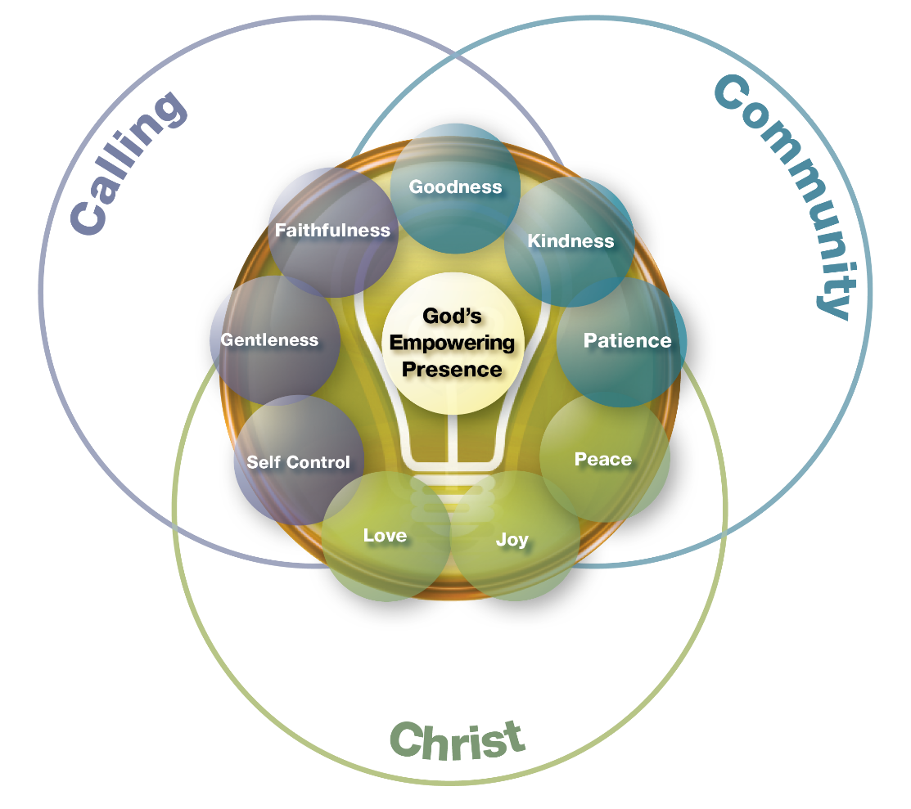
Fruit of the Spirit

Slide 44
Homework Know Thyself Part 1
Spiritual Pathways Worksheet
Spiritual Disciplines Assessment
Life Plan – Daily Weekly, Monthly and Quarterly Disciplines Worksheets
Life Plan Model Week Worksheet
Role Planning Worksheets
Short Range Goal Planning Worksheets
Planning Your New Schedule
Fruit of the Spirit Worksheet

Slide 45
Schedule - Thursday July 27th
1:30 p.m. – 1:45 p.m. Worship and Prayer
1:45 p.m. – 2:15 p.m. Omega Refresher (Sessions 17-20) Know Thyself Part 2
2:15 p.m. – 3:00 p.m. Reflection/Worksheets
3:00 p.m. – 3:30 p.m. Group Discussion/Interviews
3:30 p.m. - 3:45 p.m. Snack Break
3:45 p.m. – 4:00 p.m. Worship and Prayer
4:00 p.m. – 4:40 p.m. Omega Refresher (Sessions 21 -24) Running The Course
4:40 p.m. – 5:30 p.m. Reflection/Worksheets
5:30 p.m. – 6:00 p.m. Group Discussion/Interviews
6:00 p.m. Dinner*
*These meals are optional so if you need to skip we understand.

Slide 46
Group Questions
What scriptures or concepts stood out to you the most?
What do you hear God trying to teach you?
What do you need to do about it?

