Slide 1


Notes:
We are here to help you realize life’s potential

Slide 2
Forms for you to Download
Go to www.lifespringnetwork.org and under the DiscipleU tab select Digital Downloads.
Put in your email and you will be given access to all of our digital downloads. Then go to Rebalibrate retreat and download the following:
Recalibrate Retreat Workbook Fillable PDF
Fillable Consent Form
Fillable Interview Questionnaire
Fillable Post Retreat Experience Questionnaire

Slide 3
Goodness of God

Slide 4
Open The Eyes of My Heart

Slide 5
Schedule - Wednesday July 26th
12:00 p.m. – 12:15 p.m. Arrival/Opening Worship and Prayer
12:15 p.m. – 12:45 p.m. Omega Refresher (Sessions 1 – 4) Abundant Living
12:45 p.m. – 1:45 p.m. Reflection/Worksheets
1:45 p.m. – 2:15 p.m. Group Discussion/Interviews
2:15 a.m. – 2:30 Snack Break
2:30 p.m. – 2:45 p.m. Worship and Prayer
2:45 p.m. – 3:00 p.m. Omega Refresher (Sessions 5 – 8) Biblical Humanity
3:00 p.m. – 4:00 p.m. Reflection/Worksheets
4:00 p.m. – 4:30 p.m. Group Discussion/Interviews
4:30 a.m. – 4:45 Snack Break

Slide 6
Schedule - Wednesday July 26th
4:45 p.m. – 5:00 p.m. Worship and Prayer
5:00 p.m. – 5:30 p.m. Omega Refresher (Sessions 9 - 12) Calling of Servanthood
5:30 p.m. – 6:15 p.m. Reflection/Worksheets
6:15 p.m. – 7:00 p.m. Group Discussion/Interviews
7:00 p.m. – 8:00 p.m. Dinner*
*These meals are optional so if you need to skip we understand.

Slide 7
Schedule - Thursday July 27th
8:00 a.m. – 8:30 a.m. Arrival/Opening Worship and Prayer
8:30 a.m. – 9:00 a.m. Omega Refresher (Sessions 13 - 16) Commit to Transformation
9:00 a.m. – 10:00 a.m. Reflection/Worksheets
10:00 a.m. – 10:30 a.m. Group Discussion/Interviews
10:30 a.m. – 10:45 Snack Break
10:45 a.m. – 11:00 a.m. Worship and Prayer
10:45 a.m. – 11:15 a.m. Omega Refresher (Sessions 17 - 20) Know Thyself
11:15 a.m. – 12:15 p.m. Reflection/Worksheets
12:15 a.m. – 1:00 p.m. Group Discussion/Interviews
1:00 p.m. – 2:00 p.m. Lunch*
*These meals are optional so if you need to skip we understand.

Slide 8
Schedule - Thursday July 27th
2:00 a.m. – 2:15 a.m. Worship and Prayer
2:15 p.m. – 2:45 p.m. Omega Refresher (Sessions 17-20) Know Thyself Part 2
2:45 p.m. – 3:45 p.m. Reflection/Worksheets
3:45 p.m. – 4:15 p.m. Group Discussion/Interviews
4:15 p.m. - 4:30 p.m. Snack Break
4:30 p.m. – 4:45 p.m. Worship and Prayer
4:45 p.m. – 5:15 p.m. Omega Refresher (Sessions 21 -24) Running The Course
5:15 p.m. – 6:15 p.m. Reflection/Worksheets
6:15 p.m. – 7:00 p.m. Group Discussion/Interviews
7:00 p.m. Dinner*
*These meals are optional so if you need to skip we understand.

Slide 9
Schedule - Friday July 26th
8:00 a.m. – 8:30 a.m. Arrival/Opening Worship and Prayer
8:30 a.m. – 9:30 a.m. Spiritual Functionality (Fruit of the Spirit and 9 Faith Functions)
9:30 a.m. – 10:00 a.m. Reflection/Worksheets
10:00 a.m. – 10:30 a.m. Group Discussion/Interviews
10:30 a.m. – 10:45 Snack Break
10:45 a.m. – 11:00 a.m. Worship and Prayer
10:45 a.m. – 11:15 a.m. Spiritual Relationships (Creating a Connection Culture)
11:15 a.m. – 11:45 p.m. Reflection/Worksheets
11:45 a.m. – 12:30 p.m. Group Discussion/Interviews
12:30 Lunch* and trips to the Airport
*These meals are optional so if you need to skip we understand.

Slide 10
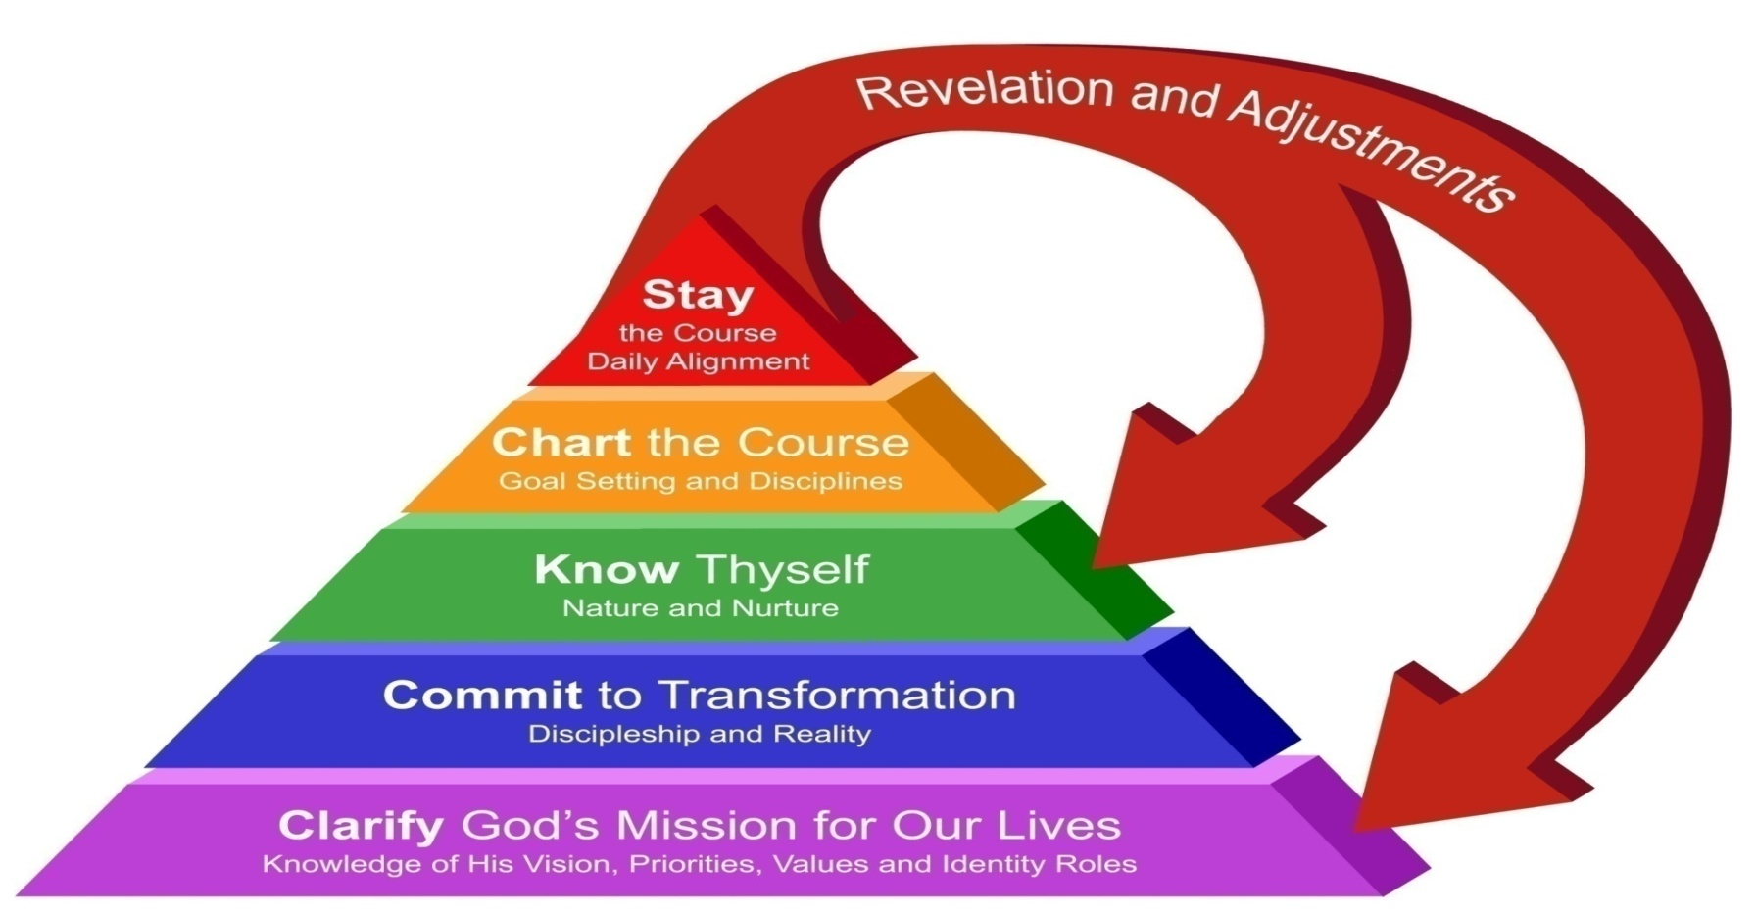

Life Focus Process
Notes:
Clarify God’s Mission: 12 Sessions
Commit to Transformation: 4 Sessions
Know Thyself: 4 Sessions
Chart the Course: 2 Sessions
Stay the Course: 2 Sessions

Slide 11
18 Foundational Truths
(Natural Laws) of Life Stewardship
Foundational Truths are fundamental patterns of nature and life that divine revelation, human experience and testing have shown to be valid.
They describe things as they really are, as opposed to how we think they are or how we wish they were.

Slide 12
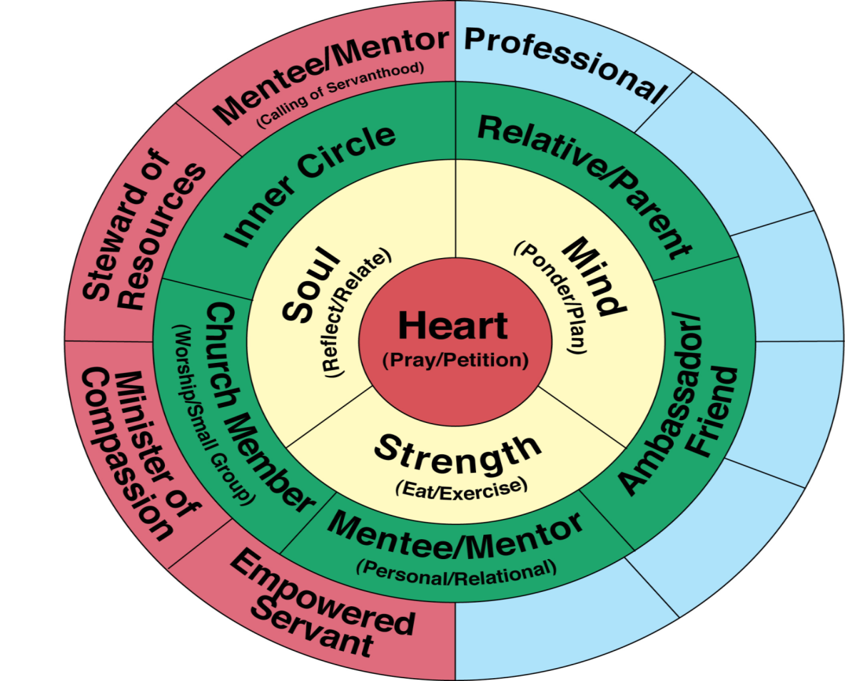
Our Roles Diagram
Notes:
The first twelve sessions of Omega will explore Life Spring Network’s Identity Roles Diagram.
Through examining roles in three different categories of our identity in Christ, we gain a holistic perspective of what new life in Christ was designed to be.

Slide 13
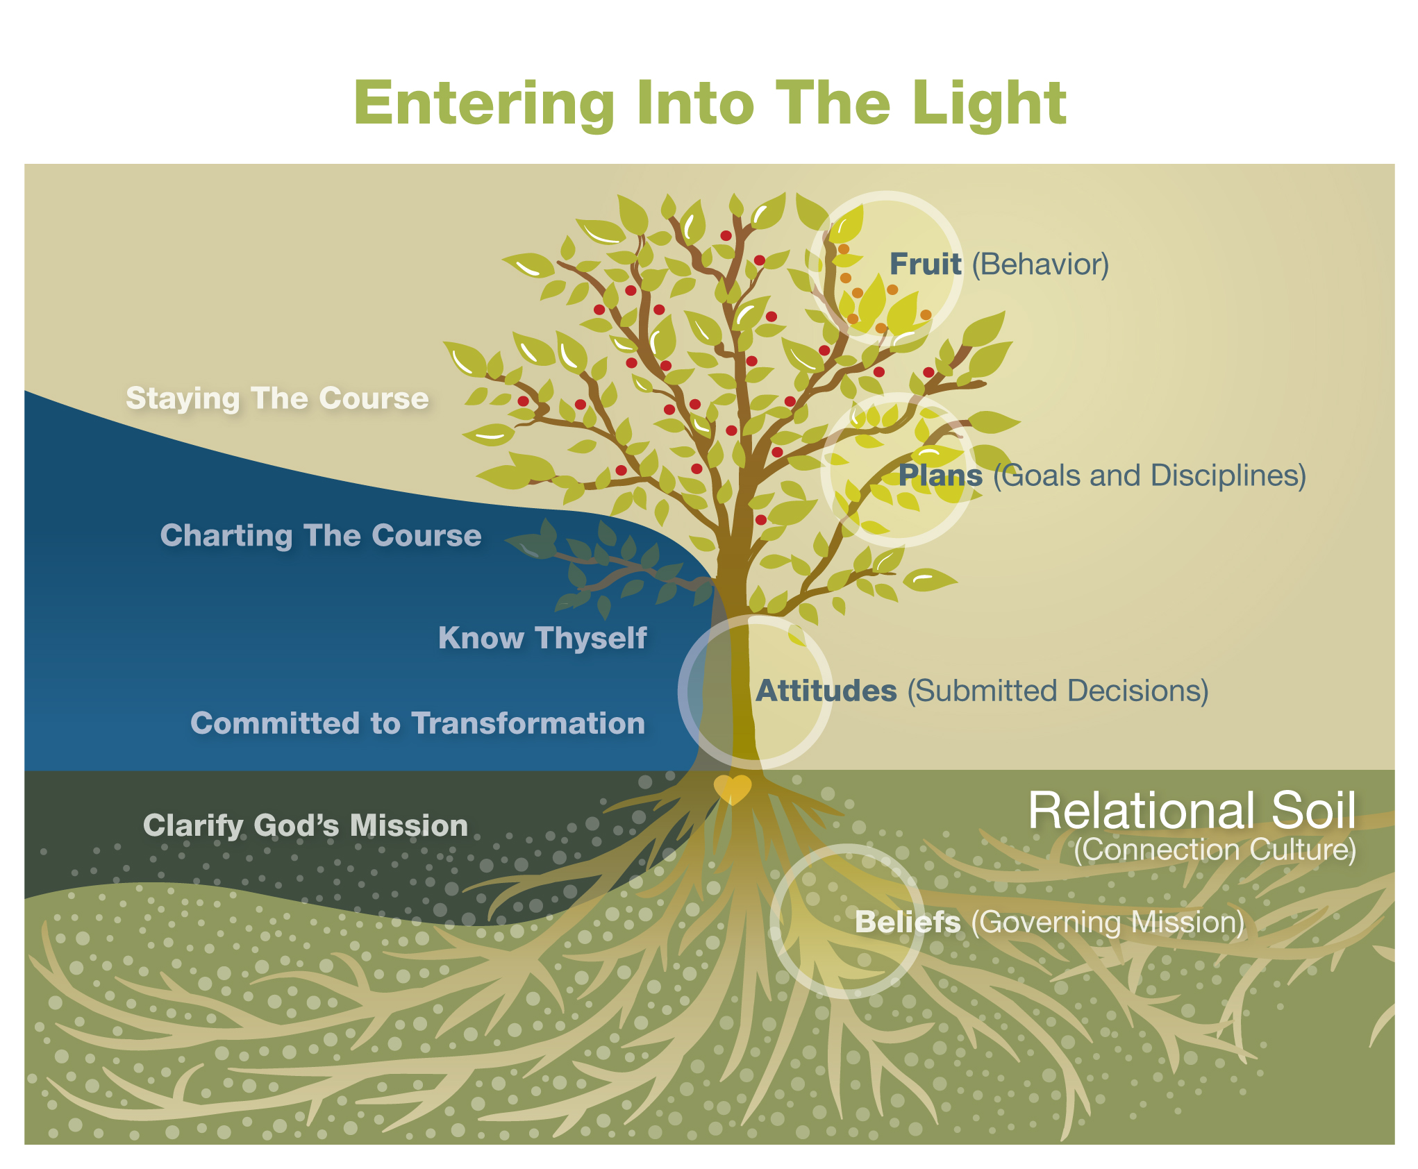

Slide 14
The Belief Model
Our beliefs are formed in our being by processing the interaction
of our true desires, feelings, thoughts and capabilities.
For each belief we subconsciously create rules that govern our behavior.
Needs
Belief
Window
Rules:
"If...
Then..."
Behavior
Patterns
Results
Something physically happens.
Feedback
If the results of your behavior meet your needs over the
long haul, this feedback tells you that you have a correct
belief or harmless opinion on your belief window.
Notes:
Our beliefs are a combination of what is truly in our Heart, Soul, Mind and Strength (Our Desires, Feelings, Thoughts, and Capabilities).
For each belief we subconsciously create rules that govern our behavior act on our belief and something happens. If the results of your behavior meet your needs over the long haul, this feedback tells you that you have a correct belief or harmless opinion on your belief window.
Regardless of whether or not our desires and beliefs are correct (in
line with God’s reality), incorrect (not reflective of reality), or matters of opinion or preference, we assume that all of them are correct and we behave accordingly.
Bad habits and areas where we struggle with self-control need to
be examined in light of our real beliefs, and then we need to engage in appropriate spiritually discerned disciplines to help us form
healthy habits.

Slide 15
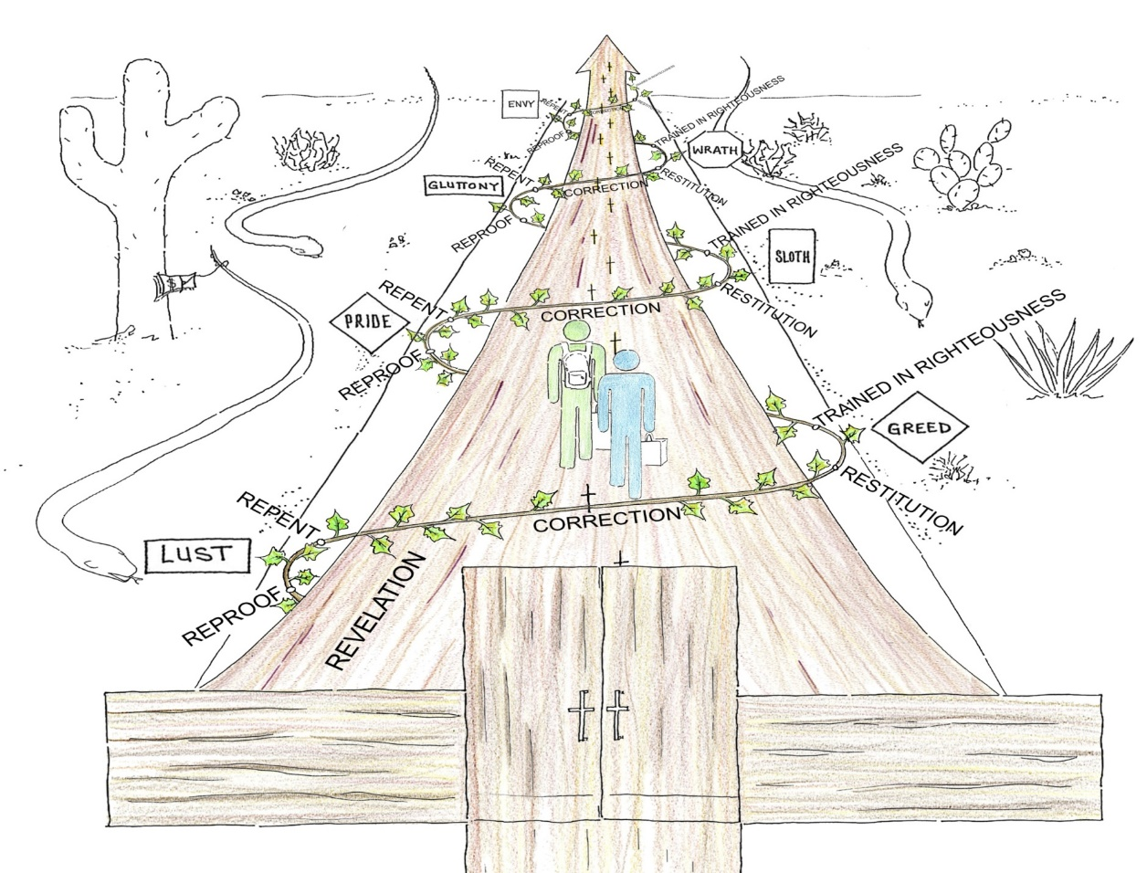
The Road of Life
To Eternal Life
The Wide Road to Destruction
Notes:
Put together with the church framing up and helping us walk the road of life together!
This is when our lives move from Black and White to Color!

Slide 16
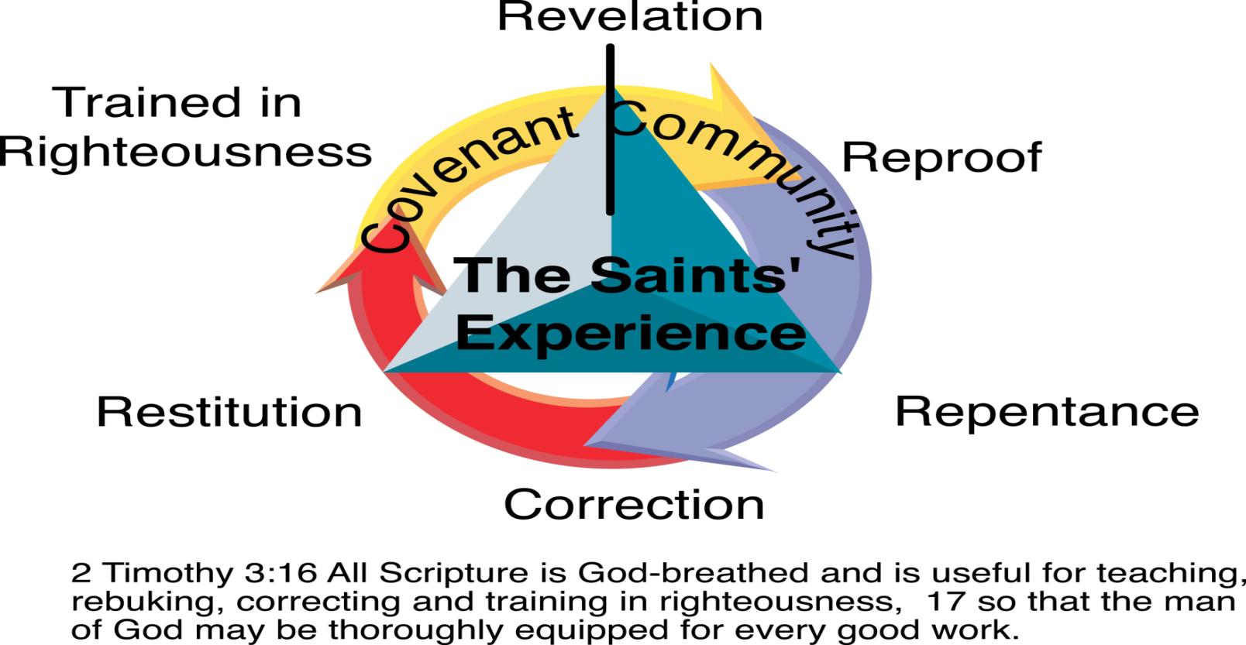
Cycle of Renewal and Holistic Transformation

Slide 17
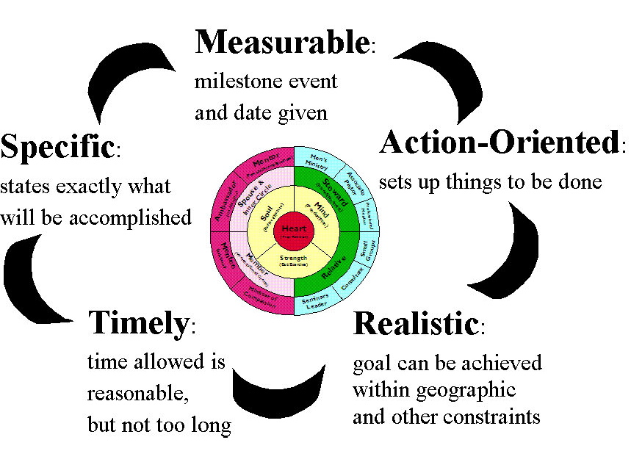
S.M.A.R.T. Goals
Notes:
S.M.A.R.T. Goals

Slide 18
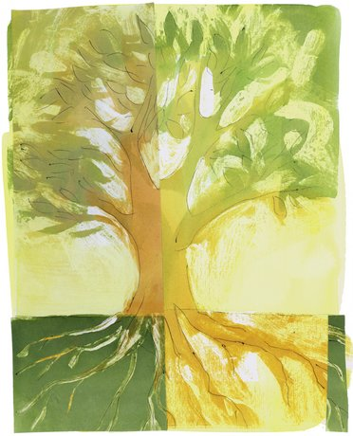
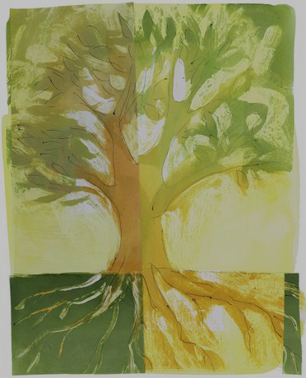
z
Personal Growth Plan
Abundant Living
Notes:
Our Core Identity

Slide 19

Life Focus Process

Slide 20

Life Focus Process

Slide 21
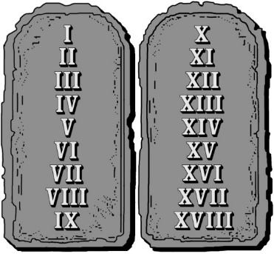
The 18 natural laws
Law 1 - The Law of Stewardship
Life is a gift of time that we are
responsible to steward with the
decisions that we make until we die.

Slide 22
1 Peter 4:1-5
“Therefore, since Christ suffered in his body, arm yourselves also with the same attitude, because he who has suffered in his body is done with sin.
As a result, he does not live the rest of his earthly life for
evil human desires, but rather for the will of God.
For you have spent enough time in the past doing what
pagans choose to do—living in debauchery, lust, drunkenness, orgies, carousing and detestable idolatry.
They think it strange that you do not plunge with them into
the same flood of dissipation, and they heap abuse on you.
But they will have to give account to him who is ready
to judge the living and the dead.”

Slide 23
In becoming a Fully Devoted Follower, we must die to our desires
Do you feel the tension between your desires
and God’s desires for you?
Notes:
When we seek God with all of our hearts, and devote our lives to Him, He is able to work in and through us.
But we must die to self-leadership and seek after God’s plans for us if we are going to experience the abundant life.

Slide 24
God begins transforming us!
We become new creatures with new devotion, priorities, and identities.
2 Corinthians 5:17
"Therefore, if anyone is in Christ, he is a new creation; the old has gone, the new has come."
Notes:
God wants to renew our heart, soul, mind and strength.
When He does this, how we relate and what we do will be transformed as well.
We become new creatures with new devotion, priorities, and identities.

Slide 25
Matthew 6:19-21(NIV)
19 "Do not store up for yourselves treasures on earth, where moth and rust destroy, and where thieves break in and steal.
20 But store up for yourselves treasures in heaven, where moth and rust do not destroy, and where thieves do not break in and steal.
21 For where your treasure is, there your heart will be also.”

Slide 26
Experiencing the Kairos of God!
Are you living in Chronos and/or Kairos?
Chronos = Measured time - Man Time
Kairos = the Fullness of Time – God Time
Notes:
The Greeks used several words to correspond with the English word for “time.”
The first word is “Chronos.” This means measured time. It denotes the minute by minute and moment by moment experience of time.
As Jeff Caliguire says in his book Shifting into High Gear, “Some of us feel constrained by it. It makes us feel anxious.. We try to manage it or control it. There never seems to be enough of it and when it is gone, it is gone.”
The second word is “Kairos.” Kairos can be defined as the fullness of time. Caliguire continues, “It’s the present, time without limit, the kind of time God inhabits: not dragged to the next thing or too busy to notice. Fully there, alive in the now!”1
Chronos = Measured time - Man Time
Kairos = the Fullness of Time – God Time

Slide 27

The Issue of Control
No Control
Total Control
Notes:
We have to decide who is going to be in control of our lives. God or us. Will we live as Stewards or Owners of our lives.

Slide 28
Matthew 6:33-34
33 But seek first his kingdom and his righteousness, and all these things will be given to you as well.
34 Therefore do not worry about tomorrow, for tomorrow will worry about itself. Each day has enough trouble of its own.

Slide 29
The 18 natural laws
Law 2 - The Law of Mission
Every life (Being and Doing) is guided
by a governing mission, which is a combination of our vision, priorities, values & identity roles we have learned from our life experience and chosen as a path to an abundant life!
Notes:
Law 2 - The Law of Mission
Every life (Being and Doing) is guided by a governing mission, which is a combination of our vision, priorities, values & identity roles we have learned from our life experience and chosen as a path to an abundant life!
Each and every one of us has a mission that we plan to carry out each day. It may be conscious, it may be unconscious. However, it’s the mission that we believe will bring us what we perceive to be the abundant life.
When our feet hit the floor in the morning, we’ve got an internal compass that is bent toward accomplishing that Mission. If we take time to dissect it, we will see that it is comprised of our vision, priorities, values, and identity roles.
Our understanding of these has been influenced by our upbringing, our environment, and our life experiences. Some of this influence may be good; however, some of it may not be so good.
Omega is designed to give you the space and time you need with God to examine some of these issues and get your internal compass moving in the right direction...God’s!

Slide 30
Understanding Your Mission

Slide 31
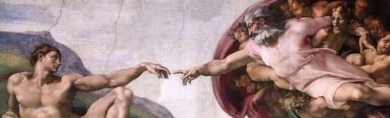
God’s Mission for our lives
Connecting in real loving Relationship
with God through Jesus Christ in the
Power of the Holy Spirit,
with others in Contagious Christian Community,
and with our Calling of Servanthood
in the World.
Notes:
Connecting in real loving Relationship
with God through Jesus Christ in the
Power of the Holy Spirit,
with others in Contagious Christian Community,
and with our Calling of Servanthood
in the World.

Slide 32
Deuteronomy 30:19-20
“This day I call heaven and earth as witnesses against you that I have set before you life and death, blessings and curses.
Now choose life, so that you and your children may live and that you may love the LORD your God, listen to his voice, and hold fast to him.
For the LORD is your life, and he will give you many years in the land he swore to give to your fathers, Abraham, Isaac and Jacob.”
Notes:
Deuteronomy 30:19-20
This day I call heaven and earth as witnesses against you that I have set before you life and death, blessings and curses.
Now choose life, so that you and your children may live and that you may love the LORD your God, listen to his voice, and hold fast to him.
For the LORD is your life, and he will give you many years in the land he swore to give to your fathers, Abraham, Isaac and Jacob.”

Slide 33
God's Vision for us is to
Experience and Express Love

Slide 34
1 John 4:16
"And so we know and rely on the love God has for us. God is love. Whoever lives in love lives in God, and God in him.”
Ephesians 5:14-17
“For it is light that makes everything visible.
This is why it is said: "Wake up, O sleeper, rise from the dead,and Christ will shine on you."
Be very careful, then, how you live—not as unwise but as wise, making the most of every opportunity, because the days are evil. Therefore do not be foolish, but understand what the Lord's will is.”
Notes:
1 John 4:16
And so we know and rely on the love God has for us. God is love. Whoever lives in love lives in God, and God in him.”
Ephesians 5:14-17
“For it is light that makes everything visible.
This is why it is said:
"Wake up, O sleeper, rise from the dead,
and Christ will shine on you."
Be very careful, then, how you live—not as unwise but as wise, making the most of every opportunity, because the days are evil. Therefore do not be foolish, but understand what the Lord's will is.”

Slide 35
What is God's priority scale?
Our Relationship with God - Being Fully Human
Our Family
Our Community
Our Calling and Profession

Slide 36
God’s priorities are focused on meeting our needs
Our Needs
To live
To love and be loved
To experience variety
To feel important
God’s Priorities
Connecting with God
Our Family
Our Community
Our Calling and Profession

Slide 37
The 18 natural laws
Law 3 - The Law of Abundant Life
When your life (being and doing) reflects
God's governing mission for your life
(vision, priorities, values & identity roles)
you experience the abundant life.
Notes:
Law 3 - The Law of Abundant Life
When your life (being and doing) reflects
God's governing mission for your life
(vision, priorities, values & identity roles)
you experience the abundant life.
When we choose God’s governing mission and abide in His power for living it we experience the abundant life

Slide 38
God has a plan for our lives
Jeremiah 29:11-13
“ ‘ For I know the plans I have for you, declares the Lord, plans to prosper you and not to harm you, plans to give you hope and a future. Then you will call upon me and come and pray to me, and I will listen to you. You will seek me and find me when you seek me with all of your heart.’ ”
Do you find it easy to find
direction from God?
Notes:
Jeremiah 29:11-13
“ ‘ For I know the plans I have for you, declares the Lord, plans to prosper you and not to harm you, plans to give you hope and a future.
Then you will call upon me and come and pray to me, and I will listen to you.
You will seek me and find me when you seek me with all of your heart.’
Do you find it easy to find direction from God?

Slide 39
The 18 natural laws
Law 4 - The Law of Perspective
Seeing life from God’s perspective is
essential if we are going to experience
God’s abundant life! (Having a Biblical
World View)
If you can’t see it you can’t do it!
Luke 3:21-22 21, Mark 1:35, Galatians 4:6-7, John 15:1-5
Notes:
Law 4 - The Law of Perspective
Seeing life from God’s perspective is
essential if we are going to experience
God’s abundant life!
Having a Biblical World View)
If you can’t see it you can’t do it!
Luke 3:21-22 21, Mark 1:35,
Galatians 4:6-7, John 15:1-5

Slide 40
Cycle of Grief
4. Acceptance
1. Achievement
and Activity
The Cycle
of Grief
3. Driven
2. Identity
Notes:
The combination of various perspectives and beliefs that we form because of those perspectives and come together to create destructive life styles that lead us away from God’s Abundant life for us.

Slide 41
Cycle of Grace
4. Fruitfulness
1. Acceptance
John 15:1-5
Luke 3:21-22
The Cycle
of Grace
3. Identity
2. Sustenance
Galatians 4:6-7
Mark 1:35
Notes:
Cycle of Grace
1. Who I am in Christ - Luke 3:21-22 21 When all the people were being baptized, Jesus was baptized too. And as he was praying, heaven was opened 22 and the Holy Spirit descended on him in bodily form like a dove. And a voice came from heaven: You are my Son, whom I love; with you I am well pleased.
2. Sustenance - Jesus is loved by God and draws away to be with the Father. Mark 1:35 Very early in the morning, while it was still dark, Jesus got up, left the house and went off to a solitary place, where he prayed.
3. Our Identity is secureas sons and daughters. Galatians 4:6-7 6 Because you are sons, God sent the Spirit of his Son into our hearts, the Spirit who calls out, Abba, Father. 7 So you are no longer a slave, but a son; and since you are a son, God has made you also an heir.
4. Fruitfulness pours forth as God lives through us. John 15:1-5 I am the true vine, and my Father is the gardener. 2 He cuts off every branch in me that bears no fruit, while every branch that does bear fruit he prunes so that it will be even more fruitful. 3 You are already clean because of the word I have spoken to you. 4 Remain in me, and I will remain in you. No branch can bear fruit by itself; it must remain in the vine. Neither can you bear fruit unless you remain in me. 5 I am the vine; you are the branches. If a man remains in me and I in him, he will bear much fruit; apart from me you can do nothing.

Slide 42
Acceptance: Luke 3:21-22
When all the people were being baptized, Jesus was baptized too. And as he was praying, heaven was opened ²² and the Holy Spirit descended on him in bodily form like a dove. And a voice came from heaven: "You are my Son, whom I love; with you I am well pleased."
Notes:
When all the people were being baptized, Jesus was baptized too. And as he was praying, heaven was opened ²² and the
Holy Spirit descended on him in bodily form like a dove. And a voice came from heaven: "You are my Son, whom I love; with you
I am well pleased."

Slide 43
Sustenance: Mark 1:35
Very early in the morning, while it was still dark, Jesus got up, left the house and went off to a solitary place, where he prayed.
Notes:
Very early in the morning, while it was still dark, Jesus got up, left the house and went off to a solitary place, where he prayed.

Slide 44
Identity: Galatians 4: 6-7
Because you are sons, God sent the Spirit of his Son into our hearts, the Spirit who calls out, "Abba, Father." ⁷ So you are no longer a slave, but a son; and since you are a son, God has made you also an heir.
Notes:
Because you are sons, God sent the Spirit of his Son into our hearts, the Spirit who calls out, "Abba, Father." ⁷ So you are no longer a slave, but a son; and since you are a son, God has made you also an heir.

Slide 45
Fruitfulness: John 15: 1-5 (NIV)
”1 I am the true vine, and my Father is the gardener. 2 He cuts off every branch in me that bears no fruit, while every branch that does bear fruit he prunes so that it will be even more fruitful. 3 You are already clean because of the word I have spoken to you. 4 Remain in me, and I will remain in you. No branch can bear fruit by itself; it must remain in the vine. Neither can you bear fruit unless you remain in me. 5 "I am the vine; you are the branches. If a man remains in me and I in him, he will bear much fruit; apart from me you can do nothing.
Notes:
”1 I am the true vine, and my Father is the gardener. 2 He cuts off every branch in me that bears no fruit, while every branch that does bear fruit he prunes so that it will be even more fruitful. 3 You are already clean because of the word I have spoken to you. 4 Remain in me, and I will remain in you. No branch can bear fruit by itself; it must remain in the vine. Neither can you bear fruit unless you remain in me. 5 "I am the vine; you are the branches. If a man remains in me and I in him, he will bear much fruit; apart from me you can do nothing.

Slide 46
The 7 Values of Abundant Living and their Belief Statements
Guidance is necessary in order to carry out God's will.
Grace is God's bridge to us and our bridge to others.
Growth is a process towards full maturity in Christ.
Glorification of God is the goal of our lives and our church.
Groups provide the optimal environment for life change.
Gifts of divine empowerment are given to all believers to grow God's church.
Good Stewardship is the reasonable and loving response to our gracious God.
Notes:
Guidance is necessary in order to carry out God's will.
Grace is God's bridge to us and our bridge to others.
Growth is a process towards full maturity in Christ.
Glorification of God is the goal of our lives and our church.
Groups provide the optimal environment for life change.
Gifts of divine empowerment are given to all believers to grow God's church.
Good Stewardship is the reasonable response to
our gracious God.

Slide 47
Praying the Lord’s Prayer and the 7 values of abundant living into our lives!
Glorification – "'Our Father in heaven, hallowed be your name,
Group – your kingdom come,
Growth – your will, be done
Gifts – on earth as it is in heaven.
Good Stewardship – Give us today our daily bread.
Grace – Forgive us our debts, as we also have forgiven our debtors.
Guidance – And lead us not into temptation but deliver us from the evil one."
Notes:
Glorification – "'Our Father in heaven, hallowed be your name,
Group – your kingdom come,
Growth – your will, be done
Gifts – on earth as it is in heaven.
Good Stewardship – Give us today our daily bread.
Grace – Forgive us our debts, as we also have forgiven our debtors.
Guidance – And lead us not into temptation, but deliver us from the evil one."

Slide 48
Homework Session 1
Life Transformation – Reflection and Praise Report
Owner vs. Steward Worksheet
God’s Mission Worksheet
Cycles of Grief and Grace
The Lord’s Prayer and the 7 Values of Abundant Living Worksheet

Slide 49
Schedule - Wednesday July 26th
12:00 p.m. – 12:15 p.m. Arrival/Opening Worship and Prayer
12:15 p.m. – 12:45 p.m. Omega Refresher (Sessions 1 – 4) Abundant Living
12:45 p.m. – 1:45 p.m. Reflection/Worksheets
1:45 p.m. – 2:15 p.m. Group Discussion/Interviews
2:15 p.m. – 2:30 p.m. Snack Break
2:30 p.m. – 2:45 p.m. Worship and Prayer
2:45 p.m. – 3:15 p.m. Omega Refresher (Sessions 5 – 8) Biblical Humanity
3:15 p.m. – 4:00 p.m. Reflection/Worksheets
4:00 p.m. – 4:30 p.m. Group Discussion/Interviews
4:30 a.m. – 4:45 p.m. Snack Break

Slide 50
Group Questions
What scriptures or concepts stood out to you the most?
What do you hear God trying to teach you?
What do you need to do about it?

Slide 51
z
Biblical Humanity
Notes:
Our Core Identity

Slide 52
Christ The Lord Is With Me

Slide 53
Who You Say I Am

Slide 54
z
Biblical Humanity
Notes:
Our Core Identity

Slide 55


The 18 natural laws
Law 5 - The Law of Identity
Abundant living comes from being who
God created you to be and engaging
your identity in Christ.
Notes:
Law 5 - The Law of Identity
Abundant living comes from being who
God created you to be and engaging
your identity in Christ.

Slide 56
Psalm 139:13-16
“ For you created my inmost being; you knit me together in my mother’s womb. I praise you because I am fearfully and wonderfully made; your works are wonderful, I know full well. My frame was not hidden from you when I was made in the secret place. When I was woven together in the depths of the earth, your eyes saw my unformed body. All the days ordained for me were written in your book before one of them came to be.”
Notes:
“ For you created my inmost being; you knit me together in my mother’s womb. I praise you because I am fearfully and wonderfully made; your works are wonderful, I know full well. My frame was not hidden from you when I was made in the secret place. When I was woven together in the depths of the earth, your eyes saw my unformed body. All the days ordained for me were written in your book before one of them came to be.”

Slide 57
Role & Vision Statements
By defining each role (identity in Christ) in our lives we gain a holistic perspective of our new lives in Christ.
A Vision Statement is a description of your understanding of who you would like to become in each role. It is your expression of what you believe to be ideal and worthy of striving towards.
Each role is accompanied by suggested disciplines that will help to develop that identity role in your life.
Notes:
By defining each role (identity in Christ) in our
lives we gain a holistic perspective of our new
lives in Christ.
A Vision Statement is a description
of your understanding of who you
would like to become in each role.
It is your expression of what you believe
to be ideal and worthy of striving towards.
Each role is accompanied by suggested disciplines that will help to develop that identity role in your life.

Slide 58
Luke 10:27
And he answered and said,
"You shall love the Lord your God
with all your heart,
and with all your soul,
and with all your strength,
and with all your mind;
and your neighbor as yourself."
Notes:
And he answered and said,
"You shall love the Lord your God
with all your heart,
and with all your soul,
and with all your strength,
and with all your mind;
and your neighbor as yourself."

Slide 59
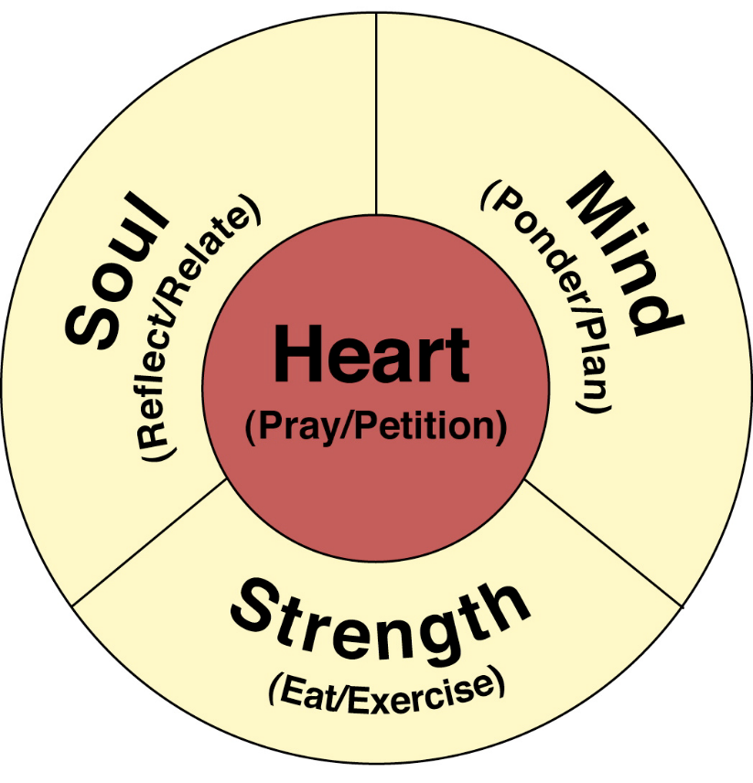
The Wellspring of Life
Notes:
The Heart is the Wellspring of Life! It is the center of our Being.
It is our decision making center. It takes in all of the input from The Soul, Mind and Strength and decides what it wants.
When our heart is not submitted to God and His will for our lives we lead our selves toward destruction, but when we are submitted, God Breathes life into our entire being!
Wellspring 1. the head or source of a spring, stream, river, etc.; fountainhead.
2. a source or supply of anything, esp. when considered inexhaustible: a wellspring of affection.

Slide 60
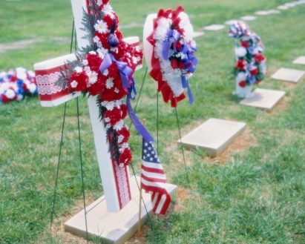

Heart
Heart has to do with our will, desires,
dreams and our spiritual center.
It is the freest aspect of our being.
We choose what we will love or want
with our heart!
Notes:
Heart has to do with our will, desires,
dreams and our spiritual center.
It is the freest aspect of our being.
We choose what we will love or want
with our heart!

Slide 61
Genesis 6:5-6
“ The Lord saw how great man's wickedness on the earth had become, and that every inclination of the thoughts of his heart was only evil all the time. The Lord was grieved that he had made man on the earth, and his heart was filled with pain.”
Genesis 8:21
“ The Lord smelled the pleasing aroma and said in his heart:‘Never again will I curse the ground because of man, even though every inclination of his heart is evil from childhood. And never again will I destroy all living creatures, as I have done
Notes:
Genesis 6:5-6
“ The Lord saw how great man's wickedness on the earth had become, and that every inclination of the thoughts of his heart was only evil all the time.
The Lord was grieved that he had made man on the earth, and his heart was filled with pain.”
Genesis 8:21
“The Lord smelled the pleasing aroma and said in his heart:‘Never again will I curse the ground because of man, even though every inclination of his heart is evil from childhood. And never again will I destroy all living creatures, as I have done

Slide 62

Soul (Feelings, Personality, Conscience and Intuition)
Soul has to do with the aspect of our being that is most uniquely the real us...our feelings, personality, conscience and intuition.
This is God’s thumbprint on our lives. It is the aspect of our being that is hard-wired to be like God and sense connection to His life in and through us.
Notes:
Soul has to do with the aspect of your being that is most uniquely
the real you...your feelings, personality, conscience and intuition.
We process our soul through feelings and impressions about ourselves,
people and circumstances in our lives, allowing God and His
understanding of who we are to be expressed.

Slide 63
Hebrews 4:12
“ For the word of God is living and active. Sharper than any double-edged sword, it penetrates even to dividing soul and spirit, joints and marrow; it judges the thoughts and attitudes of the heart.”
Matthew 16:24-26
“Then Jesus said to his disciples, ‘If anyone would come after me, he must deny himself and take up his cross and follow me. For whoever wants to save his life will lose it, but whoever loses his life for me will find it. What good will it be for a man if he gains the whole world, yet forfeits his soul? Or what can a man give in exchange for his soul?”
Notes:
Hebrews 4:12
“For the word of God is living and active. Sharper than any double-edged sword, it penetrates even to dividing soul and spirit, joints and marrow; it judges the thoughts and attitudes of the heart.”
Matthew 16:24-26
“ Then Jesus said to his disciples,‘If anyone
would come after me, he must deny himself
and take up his cross and follow me.
For whoever wants to save his life will lose it,
but whoever loses his life for me will find it.
What good will it be for a man if he gains the
whole world, yet forfeits his soul?
Or what can a man give in exchange for his soul?”

Slide 64
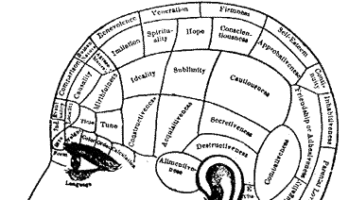

Intellectual - Mind
With our minds we process ideas, images and information with our ability to think. With this ability we discern what is true and organize our world view to accomplish a mission in life. All truth is God's truth!
Plans are the strategies we formulate in our MINDS. We also use our minds to set goals for our lives that move us towards our mission and evaluate its efficacy.
Notes:
With our minds we process ideas, images and information with our ability to think. With this ability we discern what is true and organize our world view to accomplish a mission in life. All truth is God's truth!
Plans are the strategies we formulate in our MINDS. We also use our minds to set goals
for our lives that move us towards our mission and evaluate its efficacy.

Slide 65
Romans 12:2
“ Do not conform any longer to the pattern of this world, but be transformed by the renewing of your mind.Then you will be able to test and approve what God's will is—his good, pleasing and perfect will.”
Philippians 3:18-19
“ For, as I have often told you before and now say again even with tears, many live as enemies of the cross of Christ. Their destiny is destruction, their god is their stomach, and their glory is in their shame. Their mind is on earthly things.”
Notes:
Romans 12:2
“ Do not conform any longer to the pattern of
this world, but be transformed by the renewing
of your mind.
Then you will be able to test and approve what God's will is—his good, pleasing and perfect will.”
Philippians 3:18-19
“ For, as I have often told you before and now
say again even with tears, many live as enemies
of the cross of Christ.
Their destiny is destruction, their god is their stomach,
and their glory is in their shame. Their mind is on earthly things.”

Slide 66

Physical - Strength
This is our energy and abilities.
We need to find the right balance or rhythm to the pace of our lives, which helps us to grow physically while remaining surrendered to living in and through God's strength.
Notes:
This is our energy and abilities.
We need to find the right balance or rhythm to the pace of our lives, which helps us to grow physically while remaining surrendered to living in and through God's strength

Slide 67
Philippians 4:12-13
“ I know what it is to be in need, and I know what it is to have plenty. I have learned the secret of being content in any and every situation, whether well fed or hungry, whether living in plenty or in want. I can do everything through him who gives
me strength.”
1 Corinthians 6:19
“ Do you not know that your body is a temple
of the Holy Spirit, who is in you, whom you have received from God? You are not your own”
Notes:
Philippians 4:12-13
“ I know what it is to be in need, and I know
what it is to have plenty. I have learned the secret of being content in any and every situation, whether well fed or hungry, whether living in plenty or in want.
I can do everything through him who gives
me strength.”
1 Corinthians 6:19
“Do you not know that your body is a temple
of the Holy Spirit, who is in you, whom you have received from God? You are not your own”

Slide 68
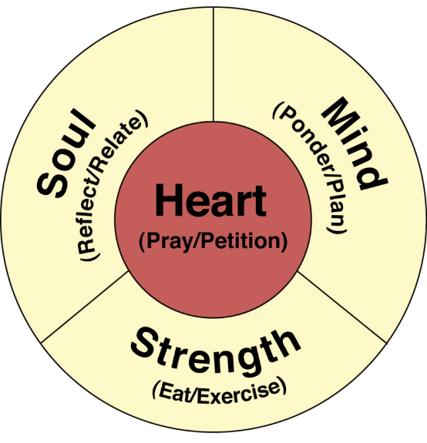
Disciplines - P.R.E.P.²
Pray & Petition
Reflect & Relate
Eat & Exercise
Ponder & Plan
Set up time - the time it takes
to put things in order, to arrange
things so that you can start on a
specific task or start each day properly.
Take the time to set up your being for each day!
Notes:
Pray & Petition
Reflect & Relate
Eat & Exercise
Ponder & Plan
Set up time - the time it takes to put things in order, to arrange
things so that you can start on a specific task or start each day properly.
Take the time to set up your being for each day!

Slide 69
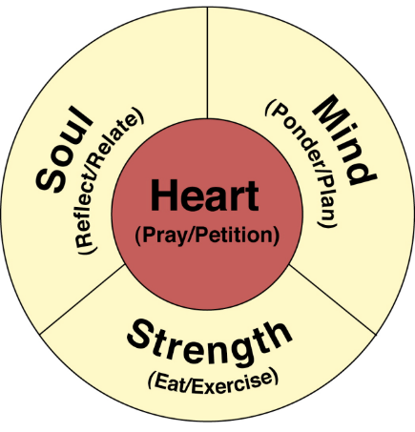
Disciplines for Being Human
Heart –
Pray (Prayer, Solitude and Silence) &
Petition (Intercession and Watching)
Soul –
Reflect (Journaling and Meditation) &
Relate (Confession, Counseling, Retreats)
Mind –
Ponder (Study of Scripture, Journaling and Life Studies) &
Plan (Planning your life, Life Coaching)
Strength –
Eat (Diet, Fasting) &
Exercise (Exercise, Sabbath, Surrender)
Notes:
Heart –
Pray (Prayer, Solitude and Silence) &
Petition (Intercession and Watching)
Soul –
Reflect (Journaling and Meditation) &
Relate (Confession, Counseling, Retreats)
Mind –
Ponder (Study of Scripture, Journaling and Life Studies) &
Plan (Planning your life, Life Coaching)
Strength –
Eat (Diet, Fasting) &
Exercise (Exercise, Sabbath, Surrender)

Slide 70

The 18 natural laws
Law 6 - The Law of Community
We need the love, fellowship, wisdom and accountability of Christ-centered covenant relationships to keep us on track and growing.
Galatians 6:1-10
Notes:
Law 6 - The Law of Community
We need the love, fellowship, wisdom
and accountability of Christ-centered
covenant relationships to keep us on
track and growing.

Slide 71
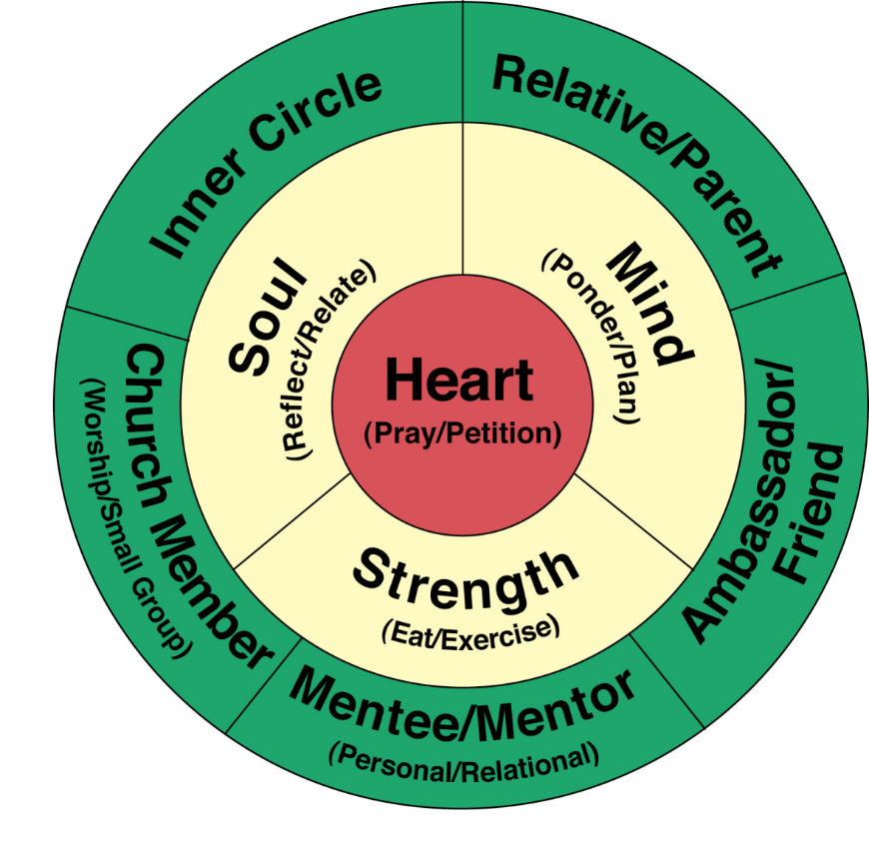
Our Roles Diagram
Notes:
71
Our Roles Diagram – Human Being and Relational Roles

Slide 72
Galatians 6:1-5 (NIV)
¹ Brothers, if someone is caught in a sin, you who
are spiritual should restore him gently. But watch yourself, or you also may be tempted. ² Carry each other's burdens, and in this way you will fulfill the law of Christ. ³ If anyone thinks he is something when he is nothing, he deceives himself. ⁴ Each one should test his own actions. Then he can take pride in himself, without comparing himself to somebody else, ⁵ for each one should carry his own load.
Notes:
Galatians 6:1-10 (NIV)
¹Brothers, if someone is caught in a sin, you who
are spiritual should restore him gently. But watch yourself, or you also may be tempted. ² Carry each other's burdens, and in this way you will fulfill the law of Christ. ³ If anyone thinks he is something when he is nothing, he deceives himself. ⁴ Each one should test his own actions. Then he can take pride in himself, without comparing himself to somebody else, ⁵ for each one should carry his own load.

Slide 73
Galatians 6:6-10 (NIV)
⁶ Anyone who receives instruction in the word must share all good things with his instructor. ⁷ Do not be deceived: God cannot be mocked. A man reaps what he sows. ⁸ The one who sows to please his sinful nature, from that nature will reap destruction; the one who sows to please the Spirit, from the Spirit will reap eternal life. ⁹ Let us not become weary in doing good, for at the proper time we will reap a harvest if we do not give up. ¹⁰ Therefore, as we have opportunity, let us do good to all people, especially to those who belong to the family of believers.
Notes:
Galatians 6:6-10 (NIV)
⁶ Anyone who receives instruction in the word must share all good things with his instructor. ⁷ Do not be deceived: God cannot be mocked. A man reaps what he sows. ⁸ The one who sows to please his sinful nature, from that nature will reap destruction; the one who sows to please the Spirit, from the Spirit will reap eternal life. ⁹ Let us not become weary in doing good, for at the proper time we will reap a harvest if we do not give up. ¹⁰ Therefore, as we have opportunity, let us do good to all people, especially to those who belong to the family of believers.

Slide 74


Inner Circle
For those of us who are married,
our first role is that of being a
spouse or having relational oneness.
For those of us who are single,
it is being single and relating to
our great friends.
Notes:
For those of us who are married, our first role is that of being a spouse or having relational oneness. For those of us who are single, it is being single and relating to our great friends.
These are our most trusted and intimate relationships outside of our relationship with God. Some would call them soul mates, for they desire to see God’s best for us and from us.
Because our inner circle of friends are the most trusted and feel the most secure, they unfortunately are the first relationships that we are willing to neglect when life gets too busy.
Second only to our time with God, this needs to be the next biggest rock in our life. Like the “Big Rocks” illustration we used when talking about priorities, these relationships are “big rocks” in our lives.

Slide 75

Relative and Parent
These are the relationships
in our lives in which we are
responsible to and for.
We are responsible to
honor our parents and for
our Children.
Notes:
These are the relationships in our lives in which we are
responsible to and for.
We are responsible to honor our parents and for
our Children.

Slide 76
Church Member
Following Christ together
with other brothers and
sisters in Christ in covenant
community is essential for
us to realize the love and
variety that God desires for
us all to experience.
For some, their church
family provides the nurturing that their nuclear family may not.
Notes:
Following Christ together with other brothers and
sisters in Christ in covenant community is essential for
us to realize the love and variety that God desires for
us all to experience.
For some, their church family provides nurture
that their nuclear family may not.

Slide 77
Contagious Christian Community and the 7 G’s - Acts 2:42-47
Growth - They devoted themselves to the apostles’ teaching
Group - and to the fellowship
Grace - to the breaking of bread
Guidance - and to prayer.
Gifts - Everyone was filled with awe, and many wonders and miraculous signs were done by the apostles.
Good Stewardship - All the believers were together and had everything in common. Selling their possessions and goods, they gave to anyone as he had need.
Glorification - Every day they continued to meet together in the temple courts. They broke bread in their homes and ate together with glad and sincere hearts, praising God
Grace - and enjoying the favor of all the people. And the
Lord added to their number daily those who were being saved.
Notes:
Growth - They devoted themselves to the apostles’ teaching
Group - and to the fellowship
Grace - to the breaking of bread
Guidance - and to prayer.
Gifts - Everyone was filled with awe, and many wonders and miraculous signs were done by the apostles.
Good Stewardship - All the believers were together and had everything in common. Selling their possessions and goods, they gave to anyone as he had need.
Glorification - Every day they continued to meet together in the temple courts. They broke bread in their homes and ate together with glad and sincere hearts, praising God
Grace - and enjoying the favor of all the people. And the
Lord added to their number daily those who were being saved.

Slide 78
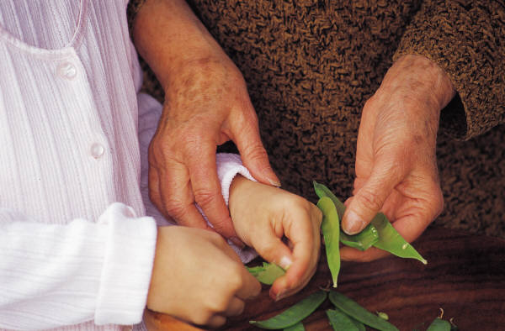

Mentee/Mentor
It should be our goal to
willingly learn from those who
are wiser than we are.
Then to be God’s conduit of
wisdom for others as He leads.
Proverbs 15:22
“ Plans fail for lack of
counsel, but with many advisers they succeed.”
Notes:
It should be our goal to
willingly learn from those who
are wiser than we are.
Then to be God’s conduit of
wisdom for others as He leads.

Slide 79

Ambassador/Friend
As God's ambassadors
we are commissioned to
reach out and share
God's love with the people
we come into contact with.
Notes:
As God's ambassadors we are commissioned to
reach out and share God's love with the people
we come into contact with.

Slide 80

Disciplines for Contagious community
Inner Circle – Fellowship, Chastity, Celebration, Hospitality and Confession while consistently praying for and relationship building with our spouses and/or great friends.
Relative Parent – Fellowship, Sacrifice, Celebration, Hospitality and Submission while consistently praying for and connecting with our parents, relatives and children if appropriate.
Church Member – Worship, Fellowship, Confession, Assembling, Celebration, Singing, Hospitality and Communion while consistently praying for and relating to our church family and engaging in small group and local fellowship gatherings.
Mentee/Mentor – We grow through Guidance, Study, Pilgrimage, Sabbatical, Submission and meeting regularly with mentors, counselors, and covenant community members who help us to implement what we are learning into our lives. We learn from studying books, tapes, videos and taking classes. We also meet regularly with others who seek us out for mentoring.
Ambassador/Friend – Friendship Evangelism and Hospitality through regular prayer for and connection with friends God brings our way and sharing the gospel with them in word and deed.
Notes:
Inner Circle – Fellowship, Chastity, Celebration, Hospitality and Confession while consistently praying for and relationship building with our spouses and/or great friends.
Relative Parent – Fellowship, Sacrifice, Celebration, Hospitality and Submission while consistently praying for and connecting with our parents, relatives and children if appropriate.
Church Member – Worship, Fellowship, Confession, Assembling, Celebration, Singing, Hospitality and Communion while consistently praying for and relating to our church family and engaging in small group and local fellowship gatherings.
Mentee/Mentor – We grow through Guidance, Study, Pilgrimage, Sabbatical, Submission and meeting regularly with mentors, counselors, and covenant community members who help us to implement what we are learning into our lives. We learn from studying books, tapes, videos and taking classes. We also meet regularly with others who seek us out for mentoring.
Ambassador/Friend – Friendship Evangelism and Hospitality
through regular prayer for and connection with friends God brings
our way and sharing the gospel with them in word and deed.

Slide 81
Homework Biblical Humanity
Vision Statements Worksheets (Heart, Soul, Mind and Strength)
Vision Statements Worksheets (Inner Circle, Relative/Parent, Church Member, Mentee/Mentor, Ambasador/Friend)

Slide 82
Schedule - Wednesday July 26th
12:00 p.m. – 12:15 p.m. Arrival/Opening Worship and Prayer
12:15 p.m. – 12:45 p.m. Omega Refresher (Sessions 1 – 4) Abundant Living
12:45 p.m. – 1:45 p.m. Reflection/Worksheets
1:45 p.m. – 2:15 p.m. Group Discussion/Interviews
2:15 p.m. – 2:30 p.m. Snack Break
2:30 p.m. – 2:45 p.m. Worship and Prayer
2:45 p.m. – 3:15 p.m. Omega Refresher (Sessions 5 – 8) Biblical Humanity
3:15 p.m. – 4:00 p.m. Reflection/Worksheets
4:00 p.m. – 4:30 p.m. Group Discussion/Interviews
4:30 a.m. – 4:45 p.m. Snack Break

Slide 83
Schedule - Wednesday July 26th
4:45 p.m. – 5:00 p.m. Worship and Prayer
5:00 p.m. – 5:30 p.m. Omega Refresher (Sessions 9 - 12) Calling of Servanthood
5:30 p.m. – 6:15 p.m. Reflection/Worksheets
6:15 p.m. – 7:00 p.m. Group Discussion/Interviews
7:00 p.m. – 8:00 p.m. Dinner*
*These meals are optional so if you need to skip we understand.

Slide 84
Group Questions
What scriptures or concepts stood out to you the most?
What do you hear God trying to teach you?
What do you need to do about it?

Slide 85
z
Calling of Servanthood
Notes:
Our Core Identity

Slide 86
I Will Follow

Slide 87
Narrow Way

Slide 88
z
Calling of Servanthood
Notes:
Our Core Identity

Slide 89

The 18 natural laws
Law 7 - The Law of Calling
God has called and equipped each
person to function interdependently
with others in a concerted effort to
express His love to the world!
Ephesians 2:8-10,
Ephesians 4:1-16,
2 Thessalonians 1:11-12
Notes:
Law 7 - The Law of Calling
God has called and equipped each
person to function interdependently
with others in a concerted effort to
express His love to the world!

Slide 90
Ephesians 2:8-10 (NAS)
“ For it is by grace you have been saved, through faith – and this not from yourselves, it is the gift of God – not by works, so that no one can boast.
For we are God's workmanship, created in Christ Jesus to do good works, which God prepared in advance for us to do.”
Notes:
Ephesians 2:8-10 (NAS)
“ For it is by grace you have been saved, through faith – and this not from yourselves,
It is the gift of God – not by works, so that no one can boast.
For we are God's workmanship, created in Christ Jesus to do good works,
which God prepared in advance for us to do.”

Slide 91
2 Thessalonians 1: 11-12 (NIV)
“ With this in mind, we constantly pray for you, that our God may count you worthy of his calling, and that by his power he may fulfill every good purpose of yours and every act prompted by your faith. We pray this so that the name of our Lord Jesus may be glorified in you, and you in him, according to the grace of our God and the Lord Jesus Christ.
Notes:
2 Thessalonians 1: 11-12 (NIV)
“With this in mind, we constantly pray for you,
that our God may count you worthy of his calling, and that by his power he may fulfill every good purpose of yours and every act prompted by your faith. We pray this so that the name of our Lord Jesus may be glorified in you, and you in him, according to the grace of our God and the Lord Jesus Christ.

Slide 92

Our Roles Diagram
Notes:
92
Our Full Roles Diagram
The Rest of your profession must be categorized individually!

Slide 93
Minister of Compassion
We are called to serve the poor among us. Our compassion for the “poor” and appreciation of God's blessings in our lives, increases when we intentionally serve those less fortunate than ourselves with our lives.
Notes:
We are called to serve the poor among us. Our compassion for the “poor” and appreciation of God's blessings on our lives, increases when we intentionally serve those less fortunate than ourselves with our lives.

Slide 94
Steward of Resources
Our next role is that of a
financial steward. We are
stewards of the resources
God entrusts us with.
Proverbs 13:22, Titus 3:14, 1 Timothy 5:7
Notes:
Our next role is that of a
financial steward. We are
stewards of the resources
God entrusts us with.

Slide 95
The 5 Financial Areas
Earning
Giving
Saving
Debt
Spending
Notes:
Earning
Giving
Saving
Debt
Spending

Slide 96

Empowered Servant
We are called to use our gifts
to build the church.
To be servants:
  Generally
  Specifically, Uniquely
It is important for us to take time
to explore and understand
our unique giftings in Christ.
Notes:
Being an Empowered Servant means you receive a “divine empowerment” ...God showing up through you on the face of the earth by the power of the Holy Spirit.
We are called to use our gifts
to build the church.
To be servants:
Generally
Specifically, Uniquely
It is important for us to take time
to explore and understand
our unique giftings in Christ.

Slide 97
Ephesians 4:1-5
“ As a prisoner for the Lord, then, I urge you to live
a life worthy of the calling you have received. ² Be completely humble and gentle; be patient, bearing with one another in love. ⁴ Make every effort to keep the unity of the Spirit through the bond of peace. ⁴ There is one body and one Spirit – just as you were called to one hope when you were called – ⁵ one Lord, one faith, one baptism;
Notes:
Ephesians 4:1-5
As a prisoner for the Lord, then, I urge you to live
a life worthy of the calling you have received. ² Be completely humble and gentle; be patient, bearing with one another in love. ⁴ Make every effort to keep the unity of the Spirit through the bond of peace.
⁴ There is one body and one Spirit – just as you were called to one hope when you were called –
⁵ one Lord, one faith, one baptism;

Slide 98
Ephesians 4:6-11
⁶ one God and Father of all, who is over all and through all and in all. ⁷ But to each one of us grace has been given as Christ apportioned it. ⁸ This is why it says: "When he ascended on high, he led captives in his train and gave gifts to men." ⁹ (What does "he ascended" mean except that he also descended to the lower, earthly regions? ¹⁰ He who descended is the very one who ascended higher than all the heavens, in order to fill the whole universe.) ¹¹ It was he who gave some to be apostles, some to be prophets, some to be evangelists, and some to be pastors and teachers,
Notes:
Ephesians 4:6-11
⁶ one God and Father of all, who is over all and through all and in all. ⁷ But to each one of us grace has been given as Christ apportioned it. ⁸ This is why it says: "When he ascended on high, he led captives in his train and gave gifts to men." ⁹ (What does "he ascended" mean except that he also descended to the lower, earthly regions? ¹⁰ He who descended is the very one who ascended higher than all the heavens, in order to fill the whole universe.) ¹¹ It was he who gave some to be apostles, some to be prophets, some to be evangelists, and some to be pastors and teachers,

Slide 99
Ephesians 4:12-16
¹² to prepare God's people for works of service, so that the body of Christ may be built up ¹³ until we all reach unity in the faith and in the knowledge of the Son of God and become mature, attaining to the whole measure of the fullness of Christ. ¹⁴ Then we will no longer be infants, tossed back and forth by the waves, and blown here and there by every wind of teaching and by the cunning and craftiness of men in their deceitful scheming. ¹⁵ Instead, speaking the truth in love, we will in all things grow up into him who is the Head, that is, Christ. ¹⁶ From him the whole body, joined and held together by every supporting ligament, grows and builds itself up in love, as each part does its work.
Notes:
Ephesians 4:12-16
¹² to prepare God's people for works of service, so that the body of Christ may be built up ¹³ until we all reach unity in the faith and in the knowledge of the Son of God and become mature, attaining to the whole measure of the fullness of Christ. ¹⁴ Then we will no longer be infants, tossed back and forth by the waves, and blown here and there by every wind of teaching and by the cunning and craftiness of men in their deceitful scheming. ¹⁵ Instead, speaking the truth in love, we will in all things grow up into him who is the Head, that is, Christ. ¹⁶ From him the whole body, joined and held together by every supporting ligament, grows and builds itself up in love, as each part does its work.

Slide 100
How many Spiritual Gifts are there?
The primary scripture passages list 20 and there is
Biblical support for at least 12 others.
Prophecy Knowledge Hospitality
Encouragement Faith Missionary
Teaching Healing Intercession
Miracles Craftsmanship Exhortation/Disciple Maker
Giving Discernment Music/Worship Leader
Leadership Helps/Service Creative Communication
Apostleship Pastor/Shepherd Mercy/Compassion
Wisdom Tongues Interpretation of Tongues
Evangelist Deliverance Administration
Martyrdom Celibacy Volunteer Poverty
Stewardship Community Builder
Notes:
The primary scripture passages list 20 and there is
Biblical support for at least 12 others.
Prophecy Knowledge Hospitality
Encouragement Faith Missionary
Teaching Healing Intercession
Miracles Craftsmanship Exhortation/Disciple Maker
Giving Discernment Music/Worship Leader
Leadership Helps/Service Creative Communication
Apostleship Pastor/Shepherd Mercy/Compassion
Wisdom Tongues Interpretation of Tongues
Evangelist Deliverance Administration
Martyrdom Celibacy Volunteer Poverty
Stewardship Community Builder

Slide 101
The 18 natural laws
Law 8 - The Law of Servanthood
In serving one another with our lives, we become free and express significant transforming love!
John 13:1-17
Notes:
Law 8 - The Law of Servanthood
In serving one another with our lives,
we become free and express significant transforming love!
Generosity and selflessness (as opposed to selfishness) cause us to grow and increase our experience of the abundant life.
Engaging our calling of servanthood gives our lives greater satisfaction, expression, and meaning.
The only treasures that will live beyond the grave are the memories we have because of the investments we have made into others' lives.
A line from an old Episcopal prayer book, "In whose service is perfect freedom."

Slide 102

My Roles Diagram
Notes:
102
Our Roles Diagram

Slide 103
Calling Mentee/Mentor
It should be our goal to
willingly learn from those who
are wiser than we are.
Then to be God’s conduit of
wisdom for others as He leads.
Proverbs 15:22
“ Plans fail for lack of
counsel, but with many advisers they succeed.”
Notes:
It should be our goal to
willingly learn from those who
are wiser than we are.
Then to be God’s conduit of
wisdom for others as He leads.

Slide 104
Our Profession
Here is where we are called to
work in a profession which can
support our family financially.
This needs to be categorized
individually so that we are focused.
  Your roles diagram allows you to fill in these specific areas.
  Note: Professional Mom
  2006 salary: $134,121.00
2 Thessalonians 3:6-15
Notes:
Here is where we are called to
work in a profession which can
support our family financially.
This needs to be categorized
individually so that we are focused.
Your roles diagram allows you to
fill in these specific areas.
Note: Professional Mom
2006 salary: $134,121.00
2 Thessalonians 3:6-15

Slide 105
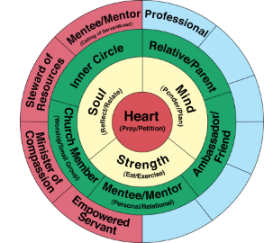
Disciplines for Calling of Servanthood
Minister of Compassion – Secrecy, Service and Sacrifice while serving the “poor in our world” and compassionately loving them as led by God. This includes but is not limited to visiting the sick and prisoners, and clothing and feeding those in need.
Steward of Resources – Simplicity, Frugality, Saving, Sacrifice and Giving (Tithing) while stewarding God’s resources.
Empowered Servant – Teaching, Service, Sacrifice and Fellowship through the regular exercising of your spiritual gifts while serving on ministry teams.
Calling Mentee/Mentor – We grow through Guidance, Study, Pilgrimage, Sabbatical, Submission and meeting regularly with mentors, counselors, and covenant community members who help us to implement what we are learning into our lives. We learn from studying books, tapes, videos and taking classes. We also meet regularly with others who seek us out for mentoring.
Professional – Diligent Earner through faithful accomplishment of tasks and Friendship Evangelism through relationship excellence while Serving as unto the Lord.
Notes:
Minister of Compassion – Secrecy, Service and Sacrifice while serving the “poor in our world” and compassionately loving them as led by God. This includes but is not limited to visiting the sick and prisoners, and clothing and feeding those in need.
Steward of Resources – Simplicity, Frugality, Saving, Sacrifice and Giving (Tithing) while stewarding God’s resources.
Empowered Servant – Teaching, Service, Sacrifice and Fellowship through the regular exercising of your spiritual gifts while serving on ministry teams.
Calling Mentee/Mentor – We grow through Guidance, Study, Pilgrimage, Sabbatical, Submission and meeting regularly with mentors, counselors, and covenant community members who help us to implement what we are learning into our lives. We learn from studying books, tapes, videos and taking classes. We also meet regularly with others who seek us out for mentoring.
Professional – Diligent Earner through faithful accomplishment of tasks and Friendship Evangelism through relationship excellence while Serving as unto the Lord.

Slide 106
Our Roles Diagram
Notes:
Our Full Roles Diagram
The Rest of your profession must be categorized individually!

Slide 107

Your Mission Statement
To CONNECT in real loving relationship,
with God through Jesus CHRIST in the power of the Holy Spirit (Heart, Soul, Mind, and Strength)
with others in contagious Christian COMMUNITY (Inner Circle, Relative/Parent, Church Member, Mentee/Mentor, and Ambassador/Friend)
and with my CALLING of Servanthood in the World. (Minister of Compassion, Steward of Resources, Empowered Servant, Calling Mentee/Mentor and in my Profession as):
________________________________________
________________________________________
________________________________________
________________________________________
Notes:
To CONNECT in real loving relationship,
with God through Jesus CHRIST in the power of the Holy Spirit, (Heart, Soul, Mind, and Strength)
with others in contagious Christian COMMUNITY, (Inner Circle, Relative/Parent, Church Member, Mentee/Mentor, and Ambassador/Friend)
and with my CALLING of Servanthood in the World. (Minister of Compassion, Steward of Resources, Empowered Servant, Calling Mentee/Mentor and in my Profession as):
________________________________________
________________________________________
________________________________________
________________________________________
________________________________________

Slide 108

Jason Pankau Roles Diagram
President Life Spring Network
Content Creator
Speaker
Mentor/Life Coach
Seminar Trainer
Leadership Consultant
Notes:
108
Our Roles Diagram

Slide 109
A Living Mission Statement
Continuing to think through the various components that make up our Mission Statement will help us to live it.
Vision: What does it mean to Experience and Express love in each area of life? Continue to expand and revise your vision statements for each role of your life.
Priorities: Regularly review how you are investing your life and discern roles upon which you are over and under focusing. This helps to focus our decision making, put areas of our lives in proper relationship to one another and invest our time wisely and holistically.
Values: Pray the 7 Values of Abundant living into your life and ask God to guide the hows and whys of what you do.
Identity Roles: Use the Identity Roles Diagram to organize the various areas of life, set goals and as a framework for pursuing holistic Christlikeness.
Notes:
Continuing to think through the various components that make up our Mission Statement will help us to live it.
Vision: What does it mean to Experience and Express love in each area of life? Continue to expand and revise your vision statements for each role of your life.
Priorities: Regularly review how you are investing your life and discern roles upon which you are over and under focusing. This helps to focus our decision making, put areas of our lives in proper relationship to one another and invest our time wisely and holistically.
Values: Pray the 7 Values of Abundant living into your life and ask God to guide the hows and whys ofwhat you do.
Identity Roles: Use the Identity Roles Diagram to organize the various areas of life, set goals and as a framework for pursuing holistic Christlikeness.

Slide 110
Homework Calling of Servanthood
Vision Statements Worksheets (Minister of Compassion, Steward of Resources, Empowered Servant, Calling Mentee/Mentor, Professional Roles)
Steward of Resources Goals to Achieve this year Worksheet
On Mission with God Assessment
Your Mission Statement Worksheet

Slide 111
Group Questions
What scriptures or concepts stood out to you the most?
What do you hear God trying to teach you?
What do you need to do about it?

Slide 112
Schedule - Thursday July 27th
8:00 a.m. – 8:15 a.m. Arrival/Opening Worship and Prayer
8:15 a.m. – 8:50 a.m. Omega Refresher (Sessions 13 - 16) Commit to Transformation
8:50 a.m. – 9:45 a.m. Reflection/Worksheets
9:45 a.m. – 10:15 a.m. Group Discussion/Interviews
10:15 a.m. – 10:30 Snack Break
10:30 a.m. – 10:45 a.m. Worship and Prayer
10:45 a.m. – 11:15 a.m. Omega Refresher (Sessions 17 - 20) Know Thyself PART 1
11:15 a.m. – 12:00 p.m. Reflection/Worksheets
12:00 a.m. – 12:30 p.m. Group Discussion/Interviews
12:30 p.m. – 1:30 p.m. Lunch*
*These meals are optional so if you need to skip we understand.

Slide 113
Schedule - Thursday July 27th
1:30 p.m. – 1:45 p.m. Worship and Prayer
1:45 p.m. – 2:15 p.m. Omega Refresher (Sessions 17-20) Know Thyself Part 2
2:15 p.m. – 3:00 p.m. Reflection/Worksheets
3:00 p.m. – 3:30 p.m. Group Discussion/Interviews
3:30 p.m. - 3:45 p.m. Snack Break
3:45 p.m. – 4:00 p.m. Worship and Prayer
4:00 p.m. – 4:40 p.m. Omega Refresher (Sessions 21 -24) Running The Course
4:40 p.m. – 5:30 p.m. Reflection/Worksheets
5:30 p.m. – 6:00 p.m. Group Discussion/Interviews
7:00 p.m. Dinner*
*These meals are optional so if you need to skip we understand.

