Slide 1


Notes:
We are here to help you realize life’s potential

Slide 2
Schedule - Friday July 26th
8:00 a.m. – 8:15 a.m. Arrival/Opening Worship and Prayer
8:15 a.m. – 8:45 a.m. Spiritual Functionality (Fruit of the Spirit and 9 Faith Functions)
8:45 a.m. – 9:30 a.m. Reflection/Worksheets
9:30 a.m. – 10:00 a.m. Group Discussion/Interviews
10:00 a.m. – 10:15 Snack Break
10:15 a.m. – 10:30 a.m. Worship and Prayer
10:30 a.m. – 11:00 a.m. Spiritual Relationships (Creating a Connection Culture)
11:00 a.m. – 11:45 p.m. Reflection/Worksheets
11:45 a.m. – 12:30 p.m. Group Discussion/Interviews
12:30 Lunch* and trips to the Airport
*These meals are optional so if you need to skip we understand.

Slide 3
Holy Spirit

Slide 4
Nothing Else

Slide 5
Sound Mind

Slide 6
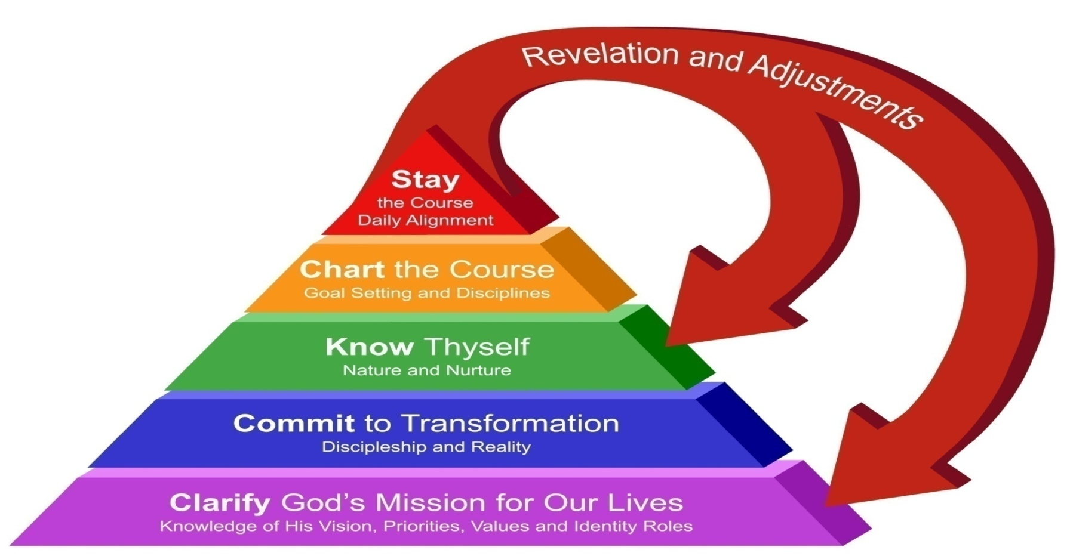

Life Focus Process
Notes:
Clarify God’s Mission: 12 Sessions
Commit to Transformation: 4 Sessions
Know Thyself: 4 Sessions
Chart the Course: 2 Sessions
Stay the Course: 2 Sessions

Slide 7
18 Foundational Truths
(Natural Laws) of Life Stewardship
Foundational Truths are fundamental patterns of nature and life that divine revelation, human experience and testing have shown to be valid.
They describe things as they really are, as opposed to how we think they are or how we wish they were.

Slide 8
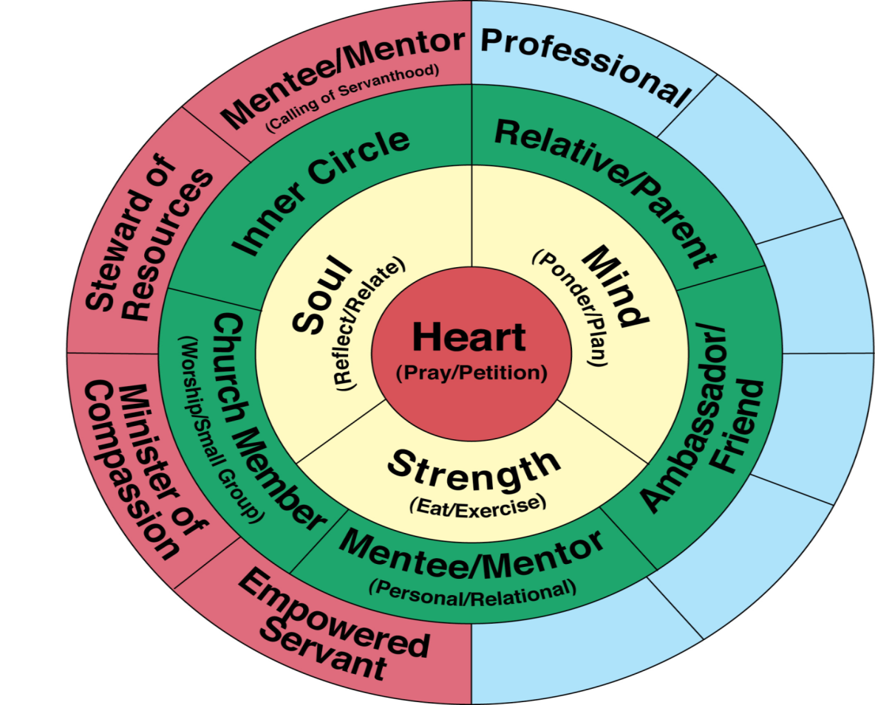
Our Roles Diagram
Notes:
The first twelve sessions of Omega will explore Life Spring Network’s Identity Roles Diagram.
Through examining roles in three different categories of our identity in Christ, we gain a holistic perspective of what new life in Christ was designed to be.

Slide 9
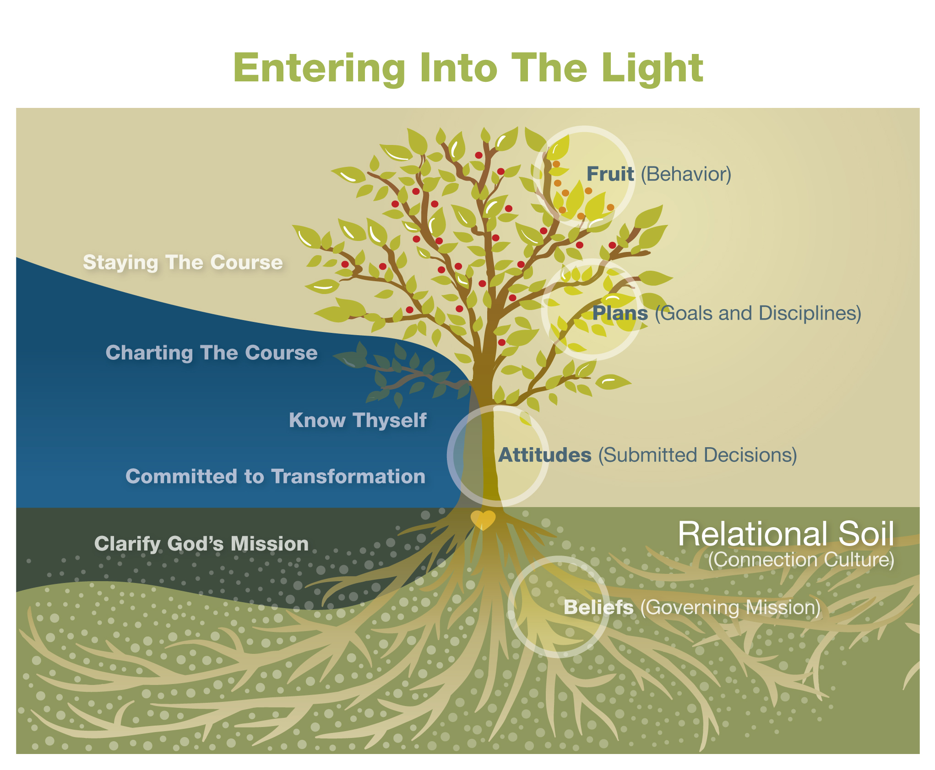

Slide 10
The Belief Model
Our beliefs are formed in our being by processing the interaction
of our true desires, feelings, thoughts and capabilities.
For each belief we subconsciously create rules that govern our behavior.
Needs
Belief
Window
Rules:
"If...
Then..."
Behavior
Patterns
Results
Something physically happens.
Feedback
If the results of your behavior meet your needs over the
long haul, this feedback tells you that you have a correct
belief or harmless opinion on your belief window.
Notes:
Our beliefs are a combination of what is truly in our Heart, Soul, Mind and Strength (Our Desires, Feelings, Thoughts, and Capabilities).
For each belief we subconsciously create rules that govern our behavior act on our belief and something happens. If the results of your behavior meet your needs over the long haul, this feedback tells you that you have a correct belief or harmless opinion on your belief window.
Regardless of whether or not our desires and beliefs are correct (in
line with God’s reality), incorrect (not reflective of reality), or matters of opinion or preference, we assume that all of them are correct and we behave accordingly.
Bad habits and areas where we struggle with self-control need to
be examined in light of our real beliefs, and then we need to engage in appropriate spiritually discerned disciplines to help us form
healthy habits.

Slide 11
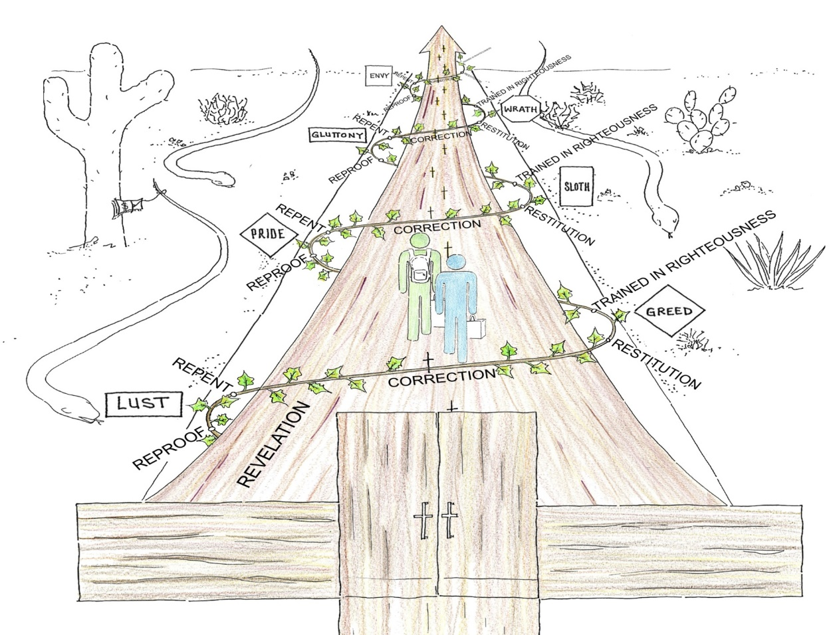
The Road of Life
To Eternal Life
The Wide Road to Destruction
Notes:
Put together with the church framing up and helping us walk the road of life together!
This is when our lives move from Black and White to Color!

Slide 12
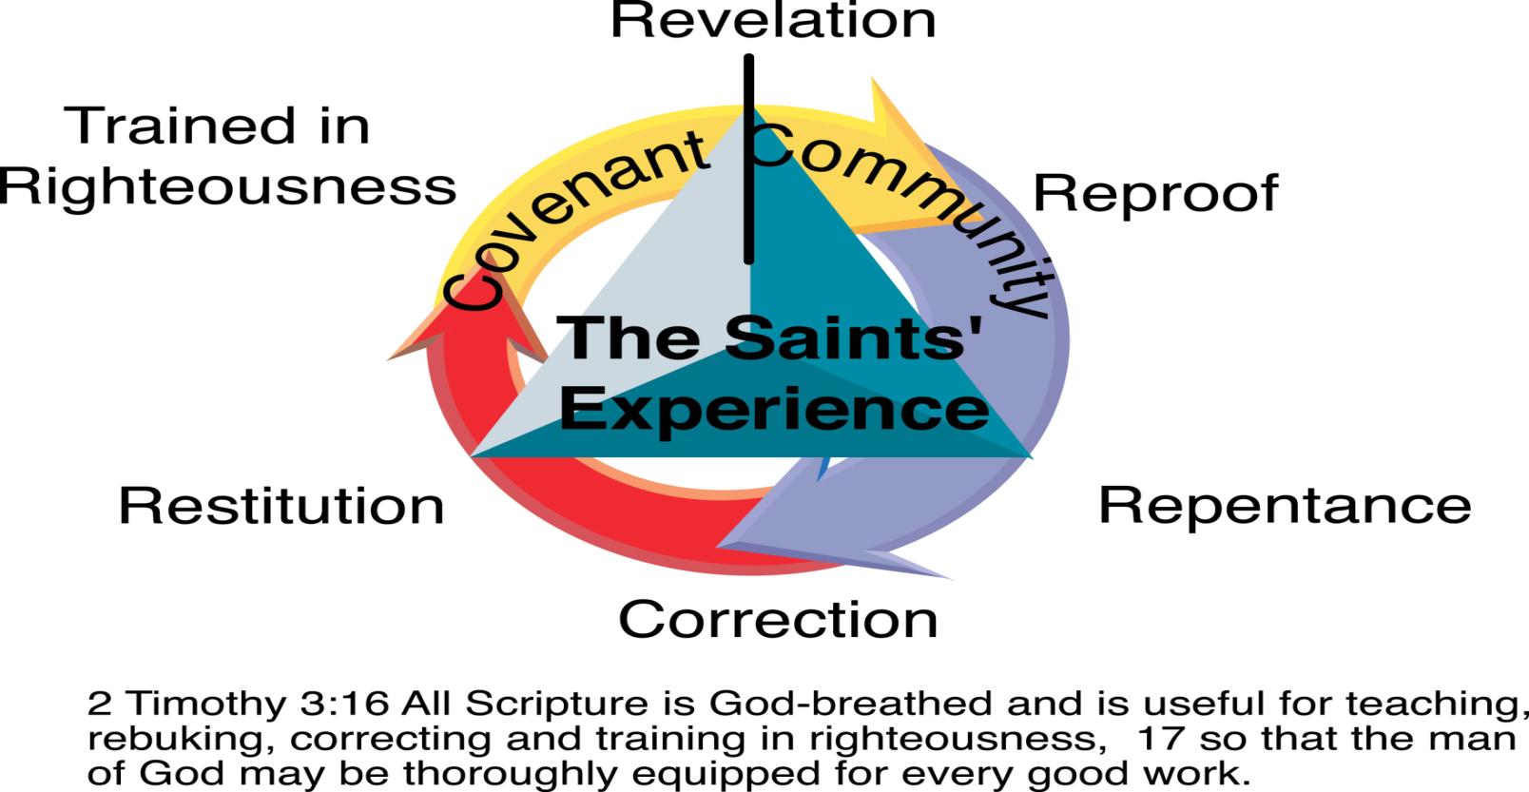
Cycle of Renewal and Holistic Transformation

Slide 13
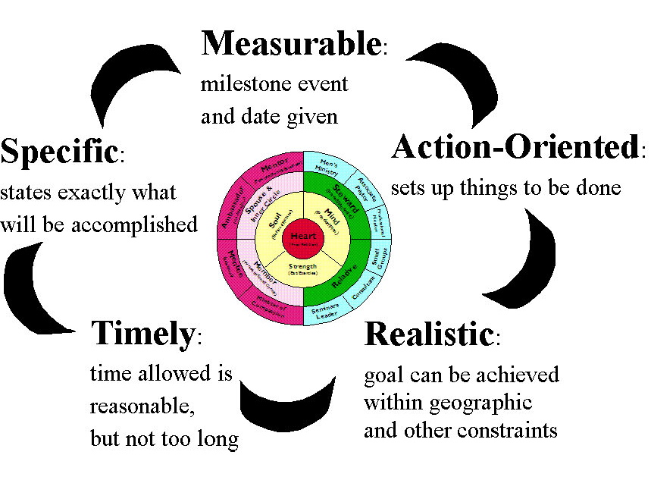
S.M.A.R.T. Goals
Notes:
S.M.A.R.T. Goals

Slide 14
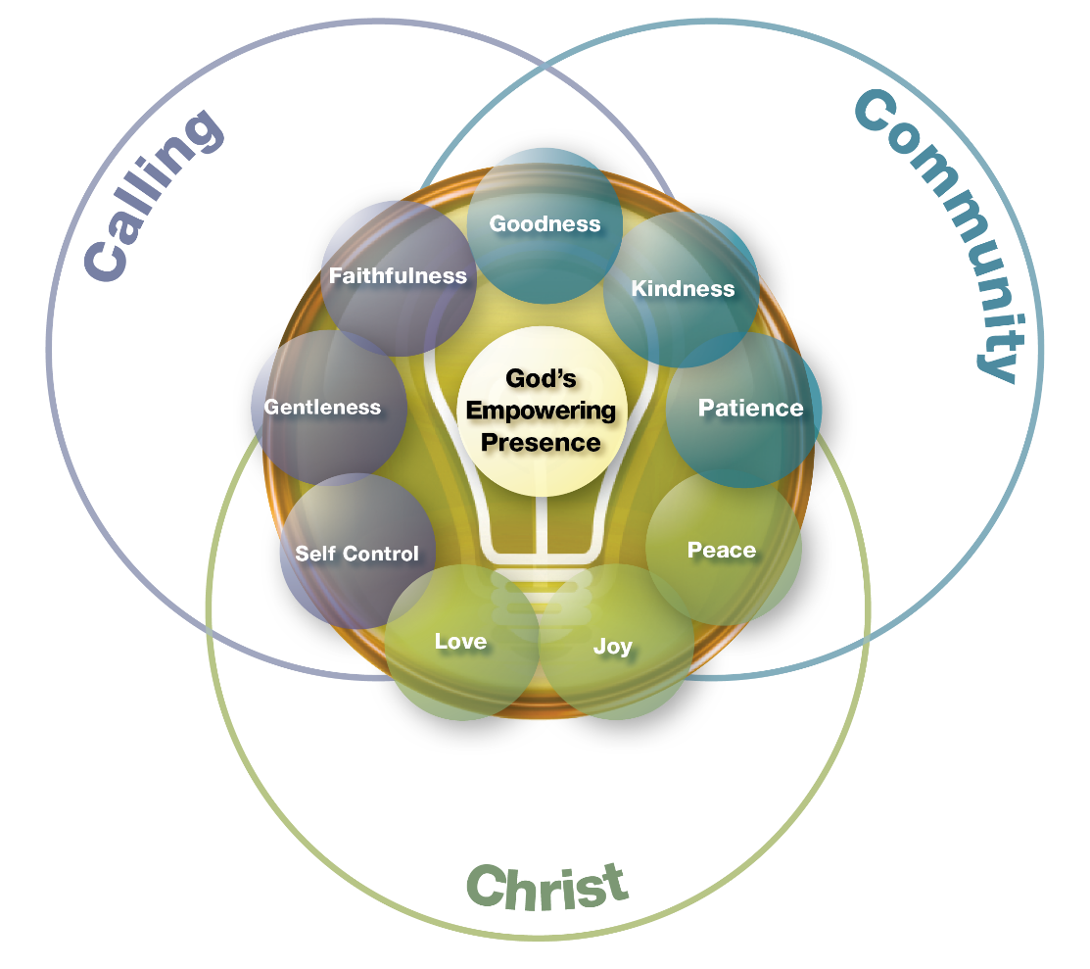
Fruit of the Spirit

Slide 15
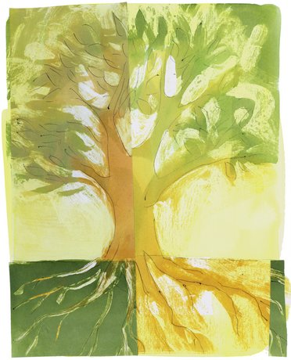
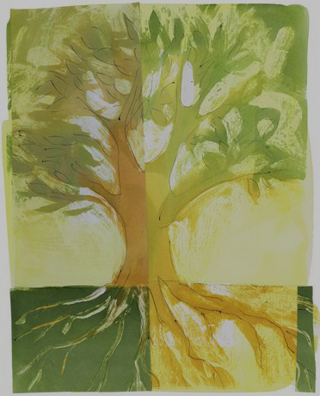
Spiritual Functionality
z
Notes:
Aligning with God

Slide 16
Schedule - Friday July 26th
8:00 a.m. – 8:15 a.m. Arrival/Opening Worship and Prayer
8:15 a.m. – 8:45 a.m. Spiritual Functionality (Fruit of the Spirit and 9 Faith Functions)
8:45 a.m. – 9:30 a.m. Reflection/Worksheets
9:30 a.m. – 10:00 a.m. Group Discussion/Interviews
10:00 a.m. – 10:15 Snack Break
10:15 a.m. – 10:30 a.m. Worship and Prayer
10:30 a.m. – 11:00 a.m. Spiritual Relationships (Creating a Connection Culture)
11:00 a.m. – 11:45 p.m. Reflection/Worksheets
11:45 a.m. – 12:30 p.m. Group Discussion/Interviews
12:30 Lunch* and trips to the Airport
*These meals are optional so if you need to skip we understand.

Slide 17
Fruit of the Spirit

Slide 18
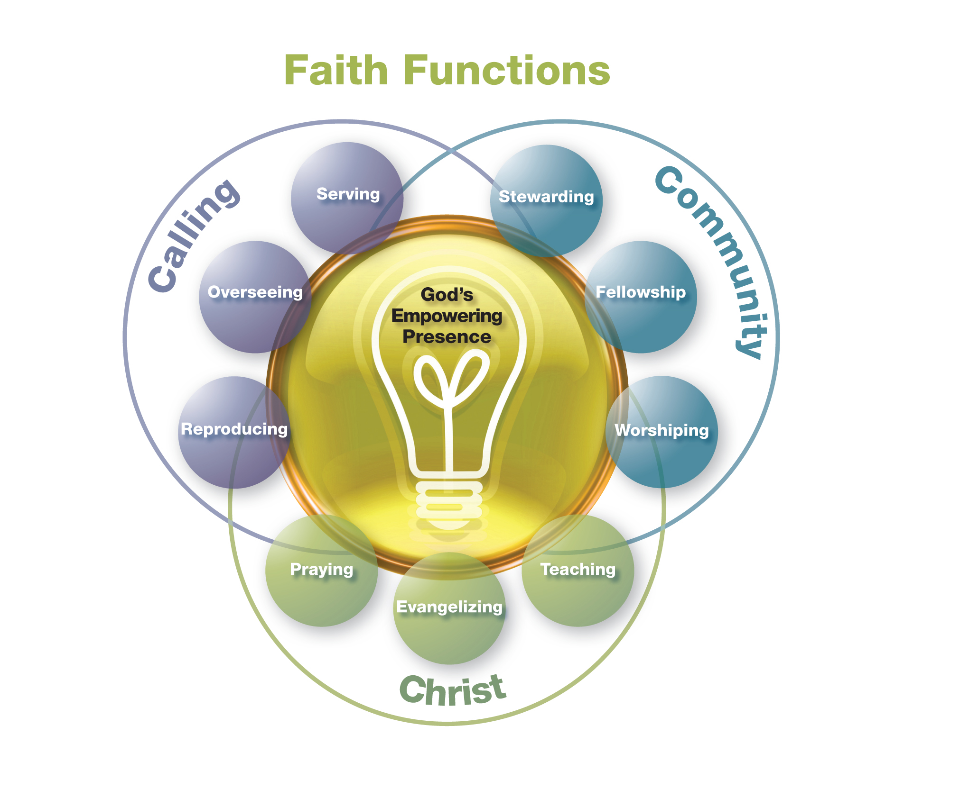

Slide 19
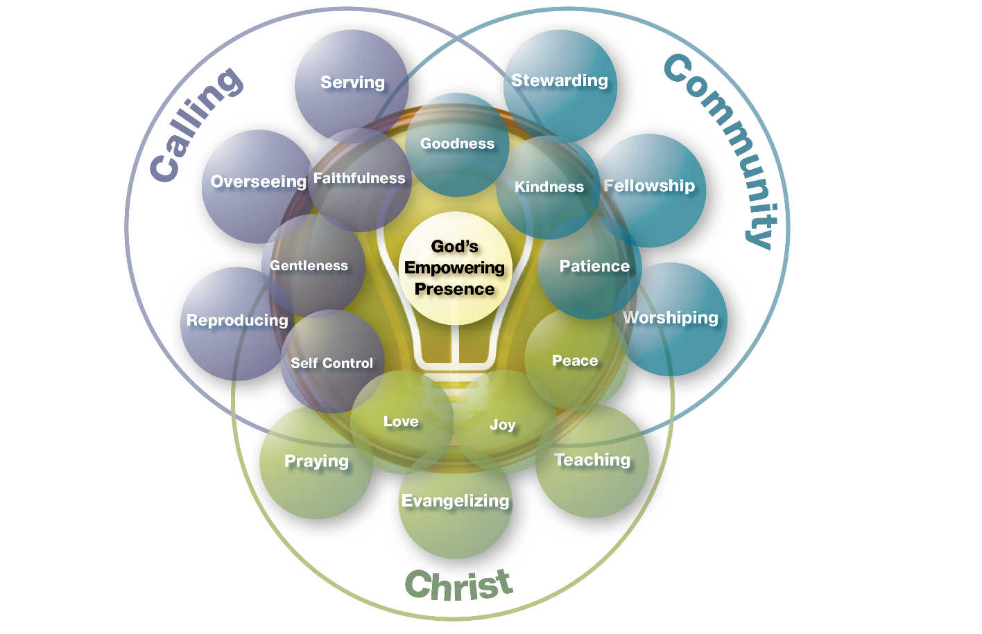
Fruit of the Spirit and 9 Faith Functions

Slide 20
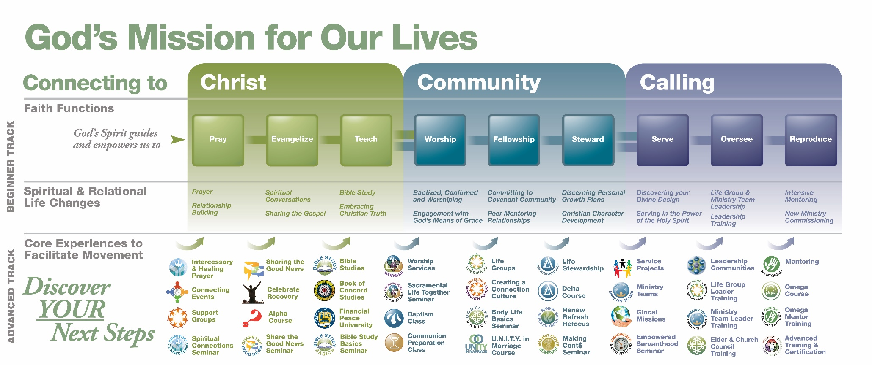

Slide 23
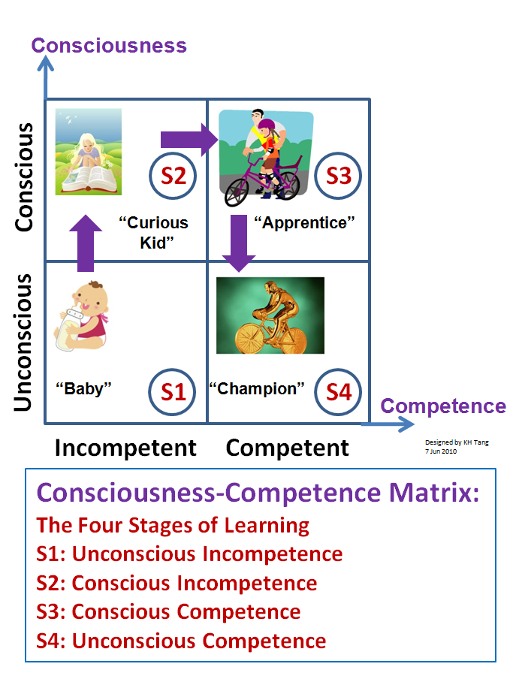
The Four Stages of Learning
Notes:
23

Slide 24
The Path to Change
Notes:
24

Slide 25

Spiritual Functions - Assessment
9 Faith Functions
Personal and Corporate Rating
  1 = Low engagement (On Life Support)
  2 = Engagement is decreasing (Bad and getting worse)
  3 = Religious engagement (Just Doing the Minimum required in our own Strength)
  4 = Increasing engagement (We are Intentionally Cooperating with the Spirit’s Prompting to Breathe Life into this function)
  5 = High engagement (Universally Understood, Embraced and Enabled by the Spirit)

Slide 26


Slide 27
The Path to Change
Notes:
27

Slide 28
Bonus Ministry Planning:
For Church Leaders: In thinking about how you rated your Spiritual functionality and the step on the path to change that you find your community at in each function, use the worksheet to list the ministry teams of your church, according to the main areas of the Map (Function) that they relate to. Then discuss and record: what’s right (what are the strengths of our church?), what’s wrong (what needs to be refined or eliminated?) and what’s missing (what new ministry teams need to be created?).
Notes:
Buddy Time:
At the start of this session we talked about the reasons people come to the Omega course. Which one do you identify with most? Why are you here?
Are you ready to make a C.O.R.E. commitment to the journey through the Omega Course with your Small Group?
Commit to the Journey
Open to grow
Relate to the Group
Enter into Scripture

Slide 29
________________________
____________
________________________
________________________
____________
________________________
________________________
____________
________________________
________________________
____________
________________________
________________________
____________
________________________
________________________
____________
________________________
________________________
____________
________________________
________________________
____________
________________________
________________________
____________
________________________

Slide 30
Homework Spiritual Functionality
Spiritual Functions Assessment and Strategic Ministry Team Planning
Discussion Time Faith Function Planning
What’s Right What’s Wrong and What’s Missing Worksheet

Slide 31
Schedule - Friday July 26th
8:00 a.m. – 8:15 a.m. Arrival/Opening Worship and Prayer
8:15 a.m. – 8:45 a.m. Spiritual Functionality (Fruit of the Spirit and 9 Faith Functions)
8:45 a.m. – 9:30 a.m. Reflection/Worksheets
9:30 a.m. – 10:00 a.m. Group Discussion/Interviews
10:00 a.m. – 10:15 Snack Break
10:15 a.m. – 10:30 a.m. Worship and Prayer
10:30 a.m. – 11:00 a.m. Spiritual Relationships (Creating a Connection Culture)
11:00 a.m. – 11:45 p.m. Reflection/Worksheets
11:45 a.m. – 12:30 p.m. Group Discussion/Interviews
12:30 Lunch* and trips to the Airport
*These meals are optional so if you need to skip we understand.

Slide 32
Group Questions
What scriptures or concepts stood out to you the most?
What do you hear God trying to teach you?
What do you need to do about it?

Slide 33
Spiritual Relationships
z
Notes:
Aligning with God

Slide 34
God, I Look To You

Slide 35
Christ Be Magnified

Slide 36
Lord I Need You

Slide 37
Spiritual Relationships
z
Notes:
Aligning with God

Slide 38
THE FORCE OF CONNECTION
Definition - A bond based on shared identity, empathy and understanding that moves self-centered individuals toward group-centered membership.
Notes:
38

Slide 39
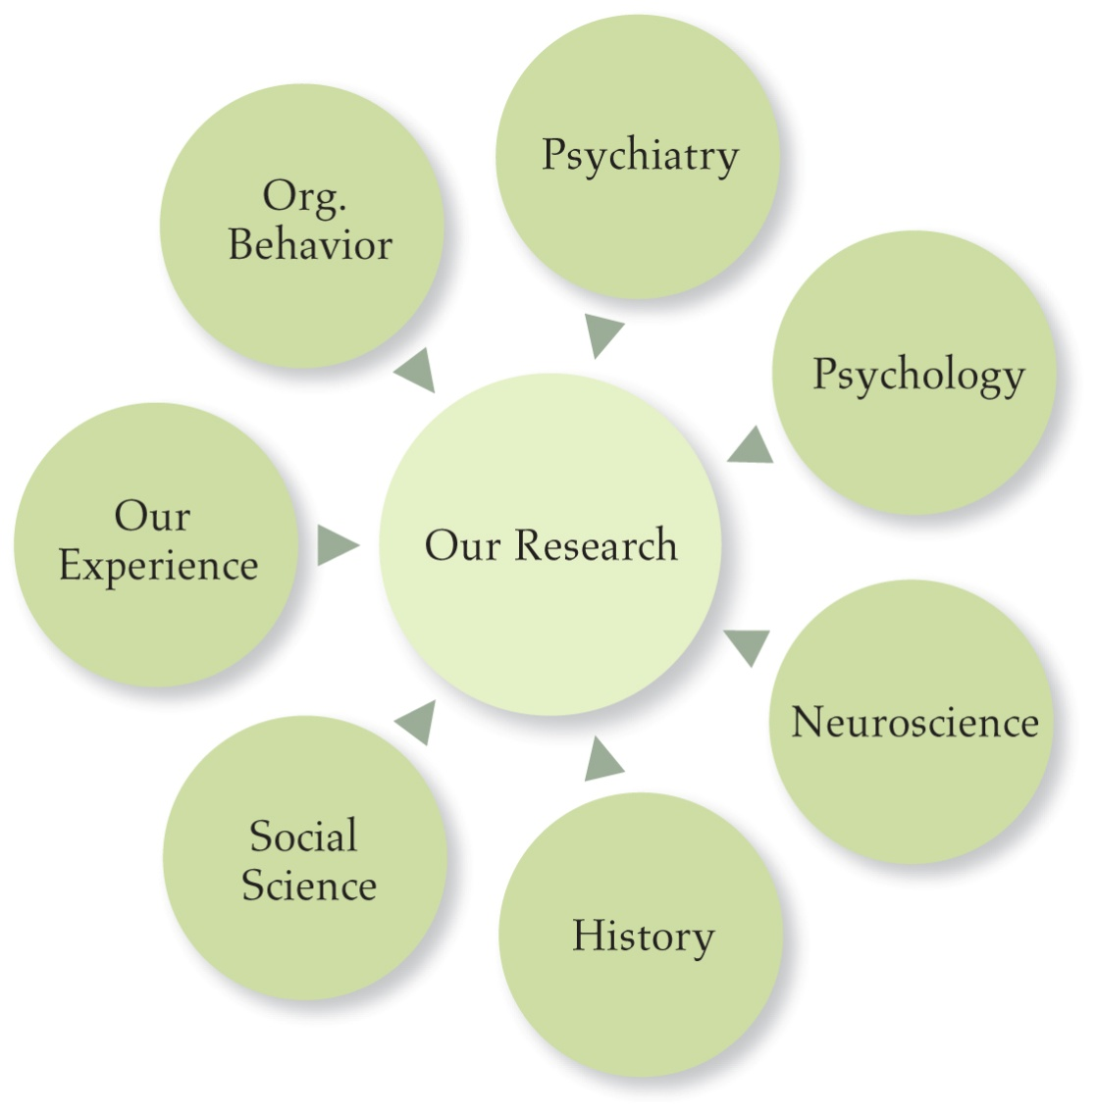
RESEARCH AND FINDINGS
Notes:
VERY INTERESTING RESEARCH ABOUT THE WAY WE TICK
PSYCHOLOGY RESEARCH
NEUROSCIENCE
PHYSICAL AND MENTAL HEALTH RESEARCH
EFFECTS THE BOTTOM LINE

Slide 40
CONNECTION: THE BOTTOM LINE
Mentally and physically healthier
More trusting
More productive
More cooperative
More creative
Better problem solvers
Connection = Flourishing, Life
Disconnection = Dysfunction, Death
Notes:
40

Slide 41
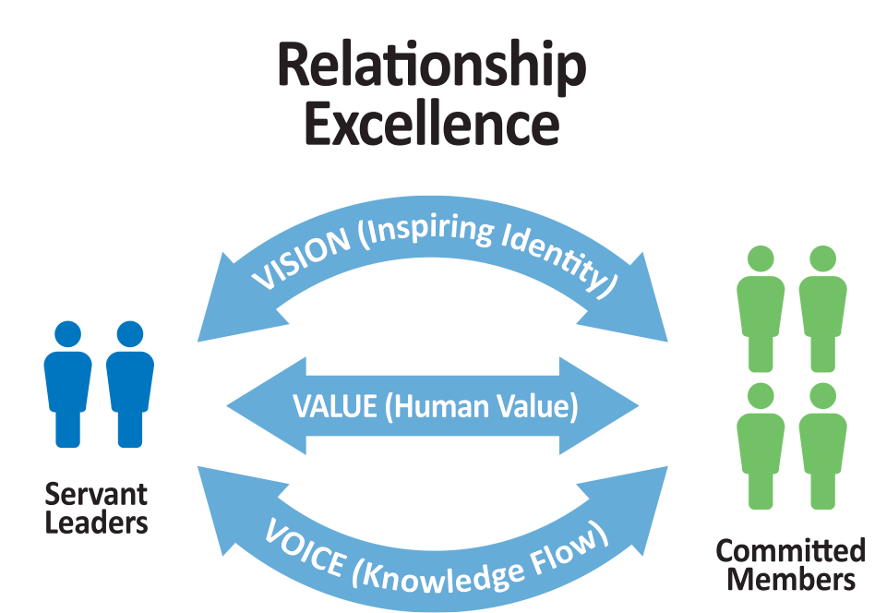
THE CONNECTION CULTURE
Core Elements
1. Inspiring Identity - Heart
2. Human Value - Soul
3. Knowledge Flow - Mind
Enabling Elements - Strength
4. Committed Members
5. Servant Leaders
The Connection Culture nurtures the key aspects of our corporate Heart, Soul, Mind and Strength!

Slide 42
Connection Culture - Assessment
5 Elements of the Connection Culture (p.12-14)
Personal and Corporate Rating
  ^{1 = Not Descriptive}
  ^{2 = Sometimes Descriptive}
  ^{3 = Fairly Descriptive}
  ^{4 = Descriptive}
  ^{5 = Strongly Descriptive}

Slide 43
THE CONNECTION CULTURE
ELEMENT #1
INSPIRING IDENTITY (“VISION”)
Notes:
THANKS
ALL ORGS NOT ALIKE
I BECAME INTERESTED…
AS I SET OUT I MET
WE LOOKED AT ALL THE AVENUES
WE DISCOVERED A VARIETY OF FACTORS
TIME AND AGAIN ONE FACTOR EXPLAINED
FORCE OF CONNECTION….

Slide 44
INSPIRING IDENTITY (“VISION”)
When everyone in the organization is:
motivated by the mission,
united by the values, and
proud of the reputation
Notes:
44
Explain the element of Vision and how it makes people feel
Patient Care To provide sensitive, high quality, cost effective health care services to all patients, regardless of ability to pay.
Teaching To be the primary teaching hospital for the Yale University School of Medicine and offer training opportunities for nurses and allied health care professionals.
Research To provide the setting for ongoing clinical research that helps bring medical advances from the laboratory to the patient's bedside.
Community Service To serve the community as a public health advocate and provide support and services which respond to the area's health care needs through health education, health promotion and access to care.

Slide 45
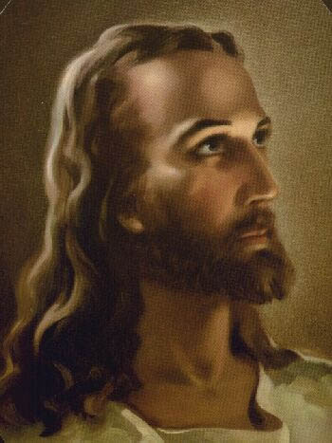
ELEMENT #1: INSPIRING IDENTITY
Notes:
Case study: Jesus
He came preaching the Kingdom of God!
He challenged His followers to transform the world from a cold sin filled and selfish relational environment to a warm loving community where people give their life for one another. Matthew 28
In John 17 He prayed about the unity and love that the church would express to one another and the world.

Slide 46
God’s Mission for our lives
Connecting people in our town and beyond in real loving relationship
with God through Jesus Christ in the power of the Holy Spirit,
with each other in contagious Christian community
and with their calling of servanthood in the world.
Notes:
TLC Mission Statement - “To connect people in Roselle and beyond to a real loving relationship with God through Jesus Christ
in the power of the Holy Spirit and with each other in a contagious Christian community and with their calling of servanthood in the world.”

Slide 47
THE CONNECTION CULTURE
ELEMENT #2
HUMAN VALUE (“VALUE”)
Notes:
THANKS
ALL ORGS NOT ALIKE
I BECAME INTERESTED…
AS I SET OUT I MET
WE LOOKED AT ALL THE AVENUES
WE DISCOVERED A VARIETY OF FACTORS
TIME AND AGAIN ONE FACTOR EXPLAINED
FORCE OF CONNECTION….

Slide 48
HUMAN VALUE (“VALUE”)
When everyone in the organization:
understands the needs of people,
appreciates their positive, unique
contributions, and
helps others achieve their potential
Notes:
48
Explain the element of Value and how it makes people feel.

Slide 49
HUMAN VALUE (“VALUE”)
Know my story
How well do you know the people you work with?
What is their background?
What are their dreams and ambitions?
What motivates them?
Who is important in their life?
What qualities do they strive for?

Slide 50
THE CONNECTION CULTURE
ELEMENT #3
KNOWLEDGE FLOW (“VOICE”)
Notes:
THANKS
ALL ORGS NOT ALIKE
I BECAME INTERESTED…
AS I SET OUT I MET
WE LOOKED AT ALL THE AVENUES
WE DISCOVERED A VARIETY OF FACTORS
TIME AND AGAIN ONE FACTOR EXPLAINED
FORCE OF CONNECTION….

Slide 51
KNOWLEDGE FLOW (“VOICE”)
When everyone in the organization:
seeks the ideas of others,
shares ideas and opinions honestly, and
safeguards relational connections
Notes:
51
Explain the element of Voice and how it makes people feel.

Slide 52
KNOWLEDGE FLOW (“VOICE”)
Organizations with strong Knowledge Flow create:
a safe place to share ideas
intentional times to get together as a team
ground rules for actively sharing information as well as listening to and respecting each other
Notes:
52
An organization with strong knowledge flow will create:
1) safe place to share ideas
2) intentional times to get together as a team
3) ground rules for listening and respecting each other
And ultimately, an organization with Knowledge Flow will:

Slide 53
THE CONNECTION FORMULA
Vision + Value + Voice
= CONNECTION

Slide 54
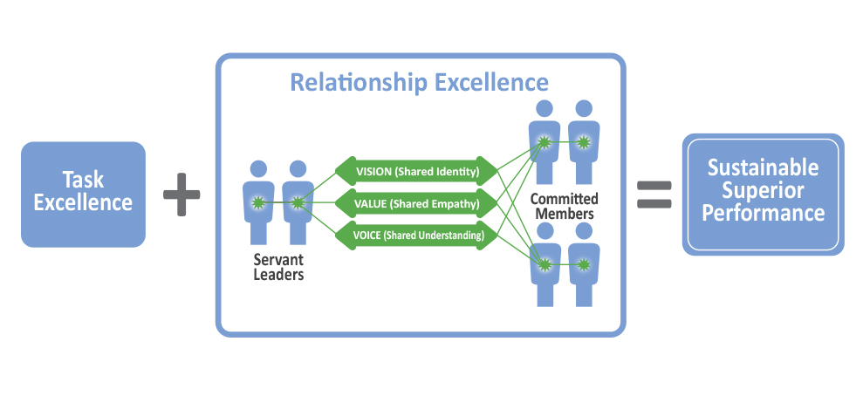
THE CONNECTION CULTURE

Slide 55
THE CONNECTION CULTURE
ELEMENT #4
COMMITTED MEMBERS
Notes:
THANKS
ALL ORGS NOT ALIKE
I BECAME INTERESTED…
AS I SET OUT I MET
WE LOOKED AT ALL THE AVENUES
WE DISCOVERED A VARIETY OF FACTORS
TIME AND AGAIN ONE FACTOR EXPLAINED
FORCE OF CONNECTION….

Slide 56
COMMITTED MEMBERS
People in the organization who are:
committed to task excellence,
promoting the Connection Culture, and
living out character strengths and virtues.
Notes:
56

Slide 57
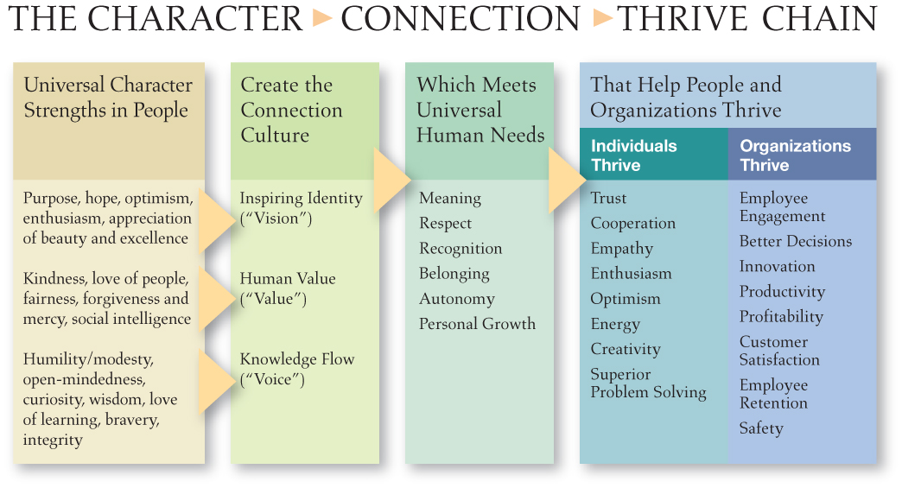
CHARACTER
Notes:
57
PEELED BACK THE ONION ANOTHER LAYER
1. STEVE JOBS OF APPLE---PURPOSE---PASSION FOR EXCELLENCE AND BEAUTY
2. DAVID NEELEMAN OF JET BLUE--LOVE OF PEOPLE, FAIRNESS, KINDNESS, FORGIVENESS, SOCIAL INTELLIGENCE
3. AG LAFLEY OF P&G --- HUMILITY, OPENMINDEDNESS, CURIOSITY, WISDOM, LOVE OF LEARNING

Slide 58
THE CONNECTION CULTURE
ELEMENT #5
SERVANT LEADERS
Notes:
THANKS
ALL ORGS NOT ALIKE
I BECAME INTERESTED…
AS I SET OUT I MET
WE LOOKED AT ALL THE AVENUES
WE DISCOVERED A VARIETY OF FACTORS
TIME AND AGAIN ONE FACTOR EXPLAINED
FORCE OF CONNECTION….

Slide 59
SERVANT LEADERS
Committed Members empowered with the authority to:
coordinate task excellence,
facilitate the Connection Culture, and
model and mentor others in character strengths and virtues
Notes:
59
59

Slide 60
THE CONNECTION CULTURE
Core Elements
1. Inspiring Identity - Heart
2. Human Value - Soul
3. Knowledge Flow - Mind
Enabling Elements - Strength
4. Committed Members
5. Servant Leaders
The Connection Culture nurtures the key aspects of our corporate Heart, Soul, Mind and Strength!

Slide 61
THE CONNECTION CULTURE

Slide 62
Homework:
For each element of a connection culture, think about which step on the path to change your community is on. Then use the worksheet on the following page to discuss each element and plan your next steps.
Notes:
Buddy Time:
At the start of this session we talked about the reasons people come to the Omega course. Which one do you identify with most? Why are you here?
Are you ready to make a C.O.R.E. commitment to the journey through the Omega Course with your Small Group?
Commit to the Journey
Open to grow
Relate to the Group
Enter into Scripture

Slide 63
Schedule - Friday July 26th
8:00 a.m. – 8:15 a.m. Arrival/Opening Worship and Prayer
8:15 a.m. – 8:45 a.m. Spiritual Functionality (Fruit of the Spirit and 9 Faith Functions)
8:45 a.m. – 9:30 a.m. Reflection/Worksheets
9:30 a.m. – 10:00 a.m. Group Discussion/Interviews
10:00 a.m. – 10:15 Snack Break
10:15 a.m. – 10:30 a.m. Worship and Prayer
10:30 a.m. – 11:00 a.m. Spiritual Relationships (Creating a Connection Culture)
11:00 a.m. – 11:45 p.m. Reflection/Worksheets
11:45 a.m. – 12:30 p.m. Group Discussion/Interviews
12:30 Lunch* and trips to the Airport
*These meals are optional so if you need to skip we understand.

Slide 64
Homework Spiritual Relationships
Discussion Time Worksheet
Connection Culture Assessment
Connection Culture Next Steps Planning Worksheet

Slide 65
Group Questions
What scriptures or concepts stood out to you the most?
What do you hear God trying to teach you?
What do you need to do about it?

